Slide 1
Mater Mothers Alignment 1
29 August 2026
matermothers.org.au

Slide 2

Acknowledgment of Country

Slide 3

We wish to acknowledge that not all those who are pregnant or who have given birth identify as women.
When we use the terms mother, woman or women during today's discussions, please know that we include those who have a different gender identity.

Slide 4
Housekeeping and Acknowledgments
Housekeeping: Toilets & fire exits
Thanks to:
  MMH
  Drs Wendy Burton, Huda Safa & Emma Paterson
  Dr Maggie Robin, Rural Generalist GP Obstetrician
  Anne Williamson, Erin Hutley-Clark & Brooke Panadero, GPLM
  The extended MMH GP Shared Care Alignment team

Slide 5
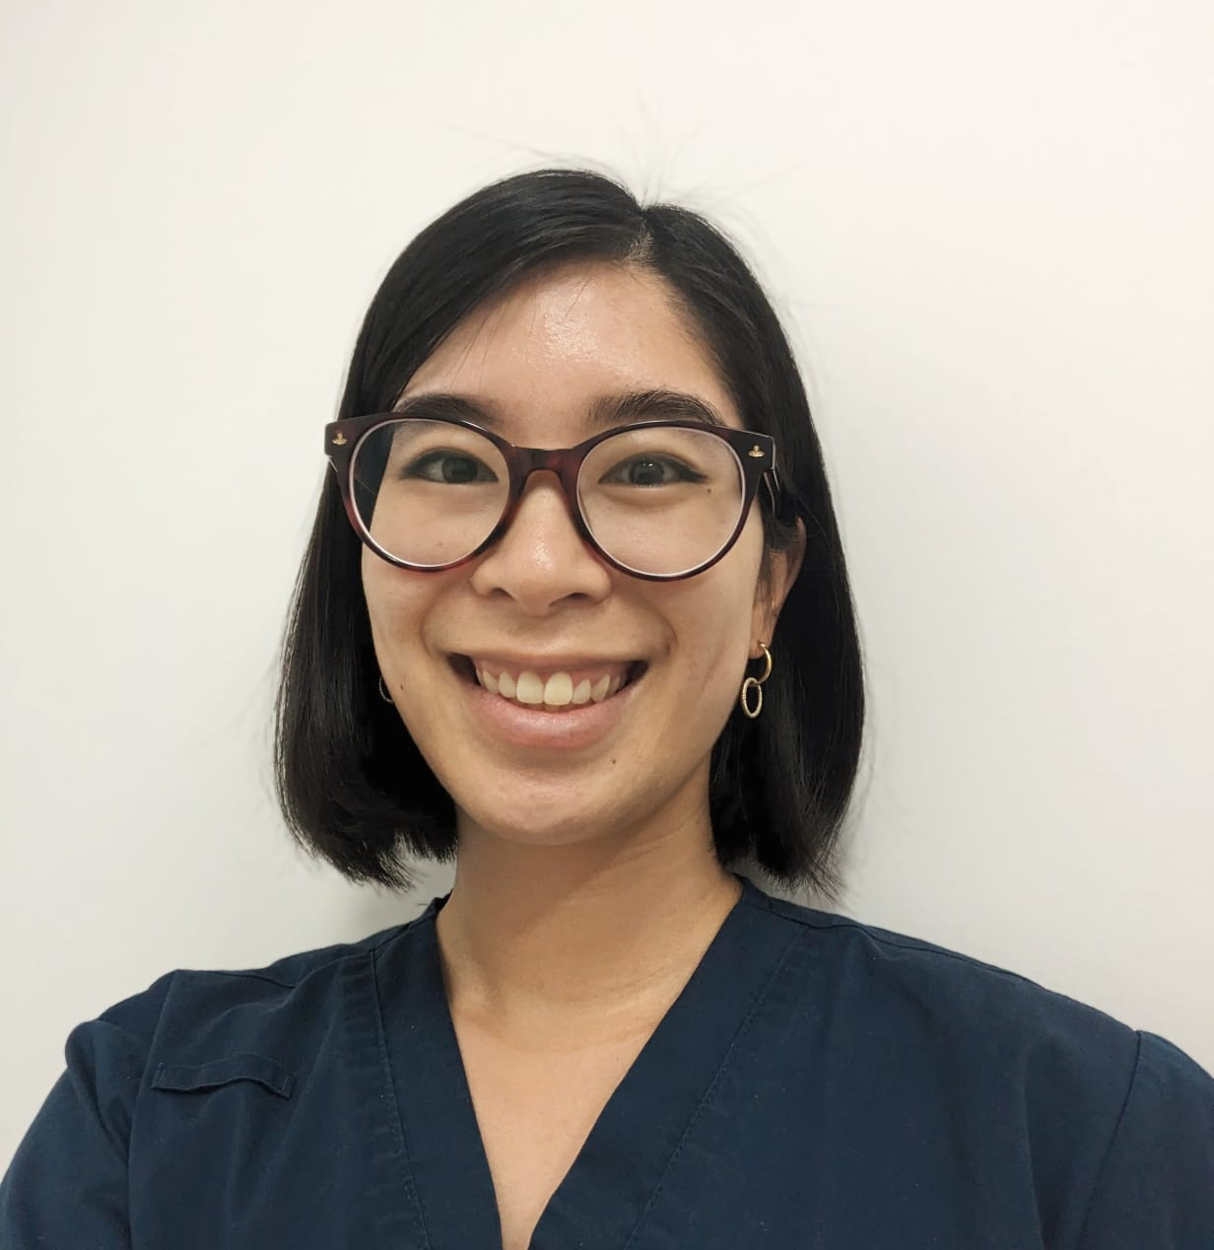
Today’s facilitator
MMH Alignment 1, 29th August 2026
Dr Lok Tung (Tung) Lee
BSc MBBS FRACGP DRANZCOG
GP, Growlife Medical Highgate Hill
GP ANC, Mater Mother's Hospital

Slide 6

Getting the most out of your day
All questions welcome
Please raise your hand at the relevant time
You may be asked a question
Phone out, but on silent!
  If you need to take a call, please leave the room
Depending on the ‘depth of the dive’, we may have to take some questions on notice and get back to you with an answer post-program

Slide 7
Session 1
Time | Session | Who
8:00 am | Welcome: course expectations, learning objectives | Dr Lok Tung Lee
8:10 | Models of care: Understanding Mater maternity care options | GP Liaison midwife (GPLM) Anne Williamson
8:20 | Referrals: What, why and how | Dr Lok Tung Lee
8:35 | What’s new in the Zoo? Dr Lok Tung Lee | Dr Julian Pavey (Obs Med) Dr Yanyan Tjioe (FRANZCOG)
9:00 | Recurrent issues: GDM, thyroid disorders Obesity | Dr Julian Pavey (Obs Med) Dr Yanyan Tjioe (FRANZCOG)
9:25 | Screening for Anomalies | Dr Scott Petersen (MFM)
10:00 | Morning tea break

Slide 8
Session 2
Time | Session | Who
10:30 | Mater Springfield | Brooke Panadero, GPLM
10:35 | Physiotherapy | Dr Lok Tung Lee
10:40 | Mental health – general principles | Elizabeth Keays Perinatal Psychologist
10:55 | Pharmacology & pregnancy | Dr Treasure McGuire Pharmacist
11:10 | Case work | Anne Williamson (GPLM) Erin Hutley-Clark (GPLM) Brooke Panadero (GPLM) Dr Yanyan Tijoe Dr Treasure McGuire Dr Lok Tung Lee, Antenatal GP
12:50 | Conclusion | Dr Lok Tung Lee

Slide 9
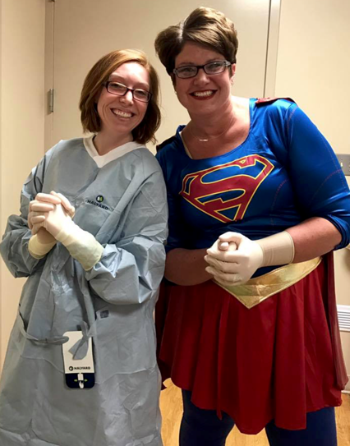
Program goals
Optimal patient experience
  Educate
  Update
  Equip
  Empower
Facilitate
  Innovation
  Integration
  Communication

Slide 10
No one knows everything!
We need to know
  Enough to make it worthwhile people coming to see us (Education)
  Where to look (Showcase resources)
  Who to call (Build relationships, inform, provide contact numbers)
  When and where to refer (Education, PAC, ED, ANC, Birth Suite)

Slide 11
Learning objectives
This program is designed to enhance your understanding of:
1. GP Maternity Shared care guidelines
2. Routine antenatal screening recommendations
3. Models of care and how to access them
4. High risk pregnancy recommendations
5. Medical conditions such as gestational diabetes and thyroid disease in pregnancy

Slide 12
Learning objectives
6. Appropriate screening options for fetal
anomalies in general and specific situations
7. Physiotherapy services available to women and
common ailments requiring treatment
8. Screening and management options for mental illness
9. Medications in pregnancy
10. Referral and communication pathways with MMH

Slide 13
Mater Mothers models of care
Anne Williamson, GPLM

Slide 14
MMH models of care
1. Preconception / fertility service
2. Midwifery group practice
3. Birthing in our community- BIOC
4. Refugee service
5. CHAMP service
6. Risk planning service
7. Bereavement service
8. Obstetric MGP diabetes

Slide 15
Specialised models of care (MOC)
Please assist appropriate triage by identifying risk factors such as:
  Indigenous status
  Refugee background
  Social risk
  Drug and alcohol use
  Previous pregnancy loss
Women may choose to have GP share care, but their booking appointments and assessment will occur in the specialist clinic.

Slide 16
Antenatal clinics, models of care
OBSTETRIC CLINIC Obstetrician Obstetric registrar Midwife MMH Monday to Friday PREVENTION OF PRETERM BIRTH CLINIC | OBSTETRIC MEDICAL CLINIC Midwife and Obstetrician Obstetric registrar Obstetric physician MMH Monday to Friday | GP SHARED CARE Midwife history Obstetrician/Obstetric registrar at booking appointment GP routine visits MMH at K36 midwife/obstetrician or midwife at Brookwater + obstetrician via telehealth
MIDWIVES CLINIC MMH and Inala Monday –Friday Young Womens <21yrs Tues + Wed Norman Park – Thursday Brookwater – Monday RPM (Risk Planning Midwife) for women with high psychosocial risk factors MMH Monday and Thursday | REFUGEE CLINIC Midwife/Obstetrician Obstetric physician Social Worker MMH Tuesday and Wednesday | BIOC (Birthing in Our Community) Midwifery Group Practice for Aboriginal and Torres Strait Islander women or women with partners who identify as ATSI Midwives + Indigenous health workers Obstetrician/registrar at booking and when required
OMGP (OBSTETRIC MGP) / DIABETES CLINIC Known midwife continuity of care Obstetrician/Registrar Endocrinologist Diabetes Nurse Educator + dietitian | PREGNANCY AFTER LOSS CLINIC MMH early review if last pregnancy IUFD, stillbirth or neonatal death CHAMP CLINIC Recent or current drug and alcohol use MMH Wednesday | MIDWIFERY GROUP PRACTICE Coorparoo + Norman Park Inala + Acacia Ridge Coorparoo <21yo (“Young Women’s”) Refugee background Inala Telehealth consult with Obstetrician/ registrar at booking

Slide 17
Early discharge post caesarean section
Home recovery option
At Mater public women can transfer home 24 hours post c/s
Eligibility criteria
  maternal interest
  women who don’t need an interpreter
  PHx of previous birth
  no history of diabetes
  BMI < 40
  homecare eligible
  adult support at home.
Routine postpartum care for these women includes earlier:
  intake of fluids
  discontinuation of IV
  mobilisation when full return of sensation
  removal of IDC

Slide 18
Private maternity options
matermothers.org.au

Slide 19


Slide 20
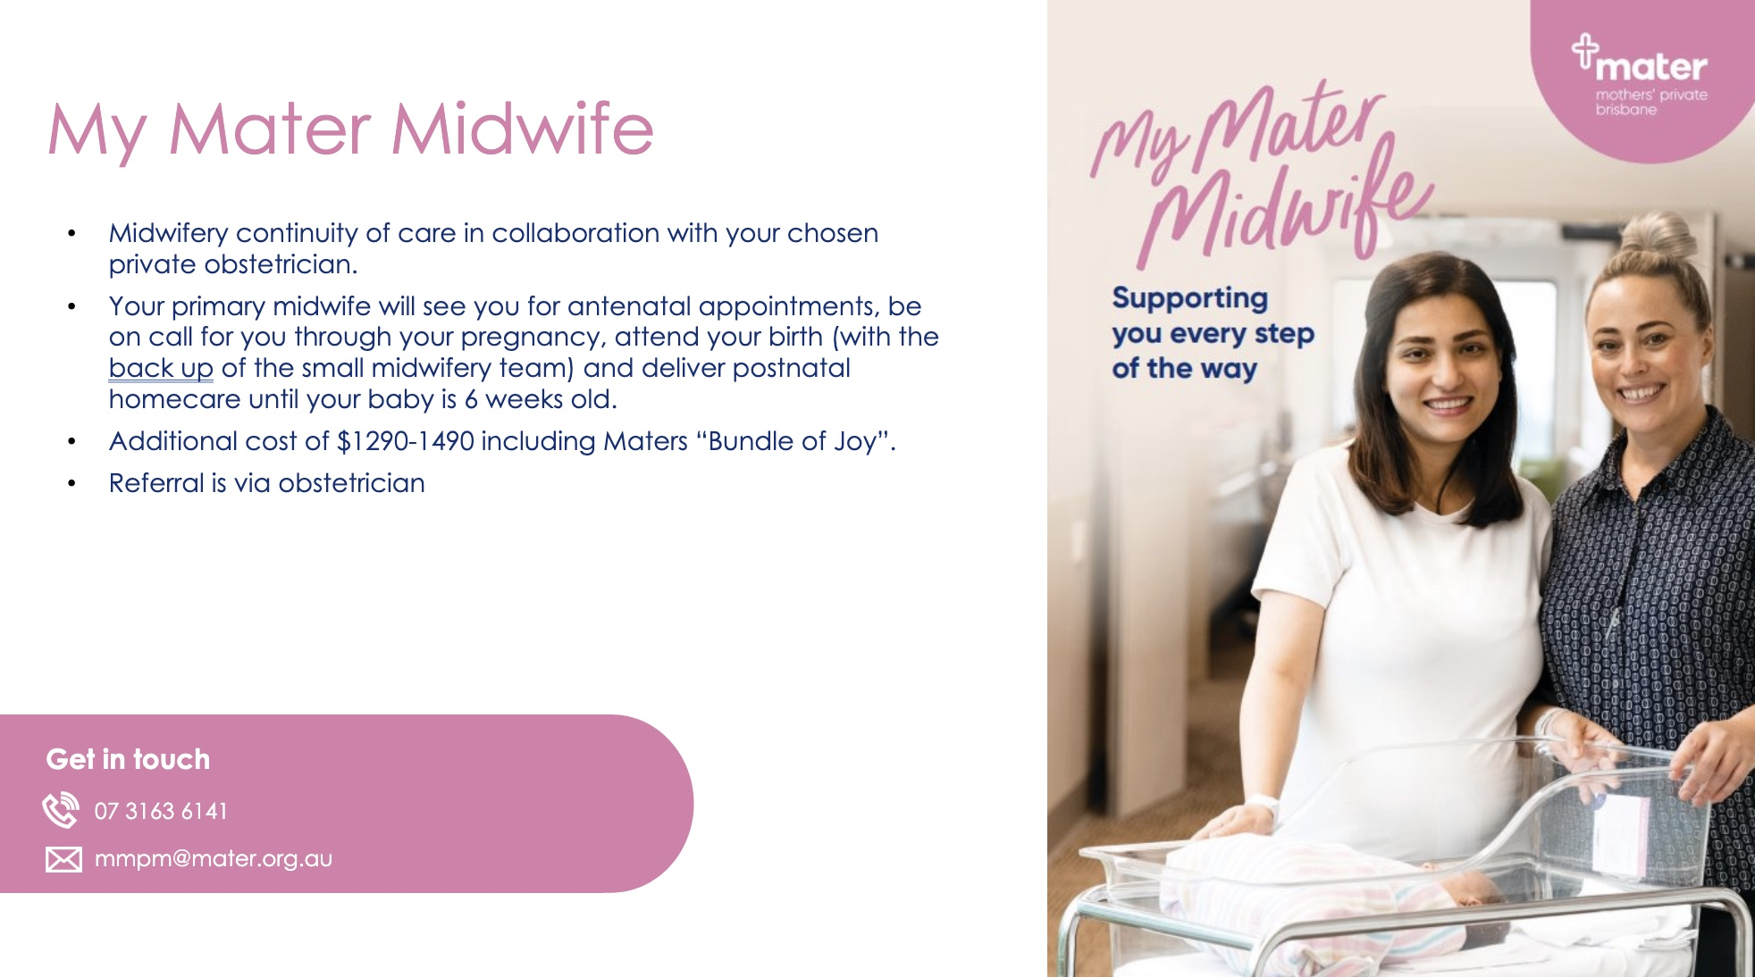

Slide 21
Communication
The importance of getting it right
Dr Lok Tung Lee
matermothers.org.au

Slide 22
Linking into MMH
Antenatal Clinic (ANC) receives 200-400 referrals a week
Information = safe, effective and efficient triage
  Medical, obstetric, social risk factors
  Indications for early appointment
Need advice? Contact the GP Liaison Midwife
The use of an antenatal Smart Referral or the MMH referral template is mandatory. Please include ALL patient information requested.
cc MMH ANC on ALL investigations

Slide 23
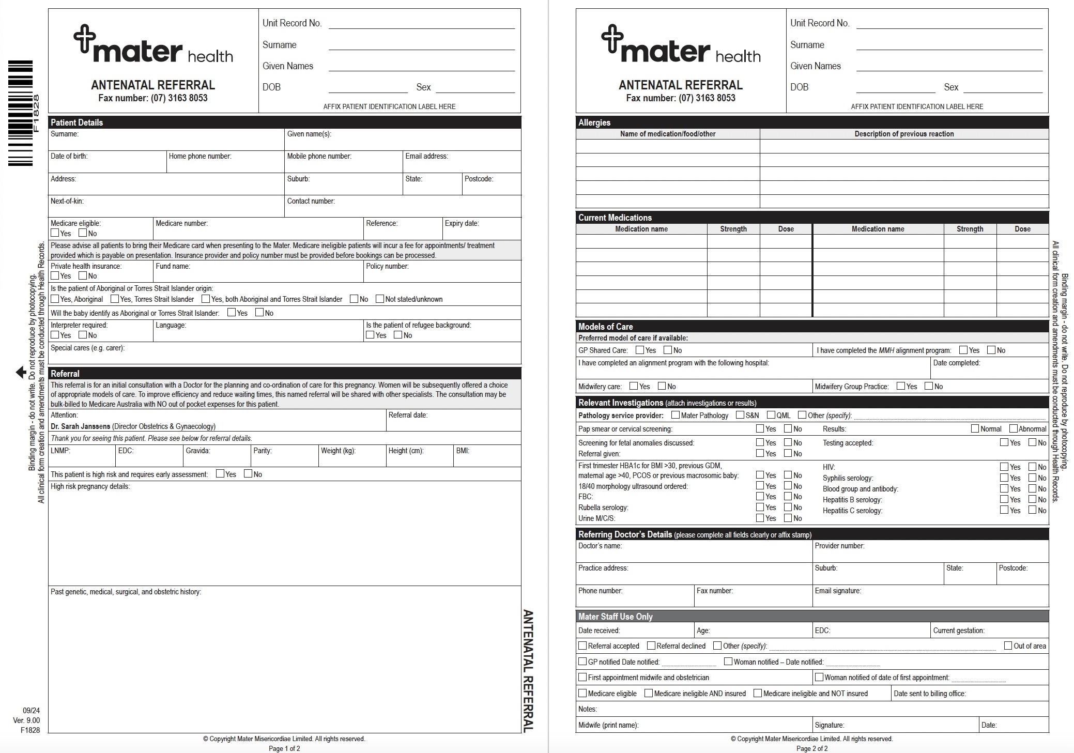

Slide 24
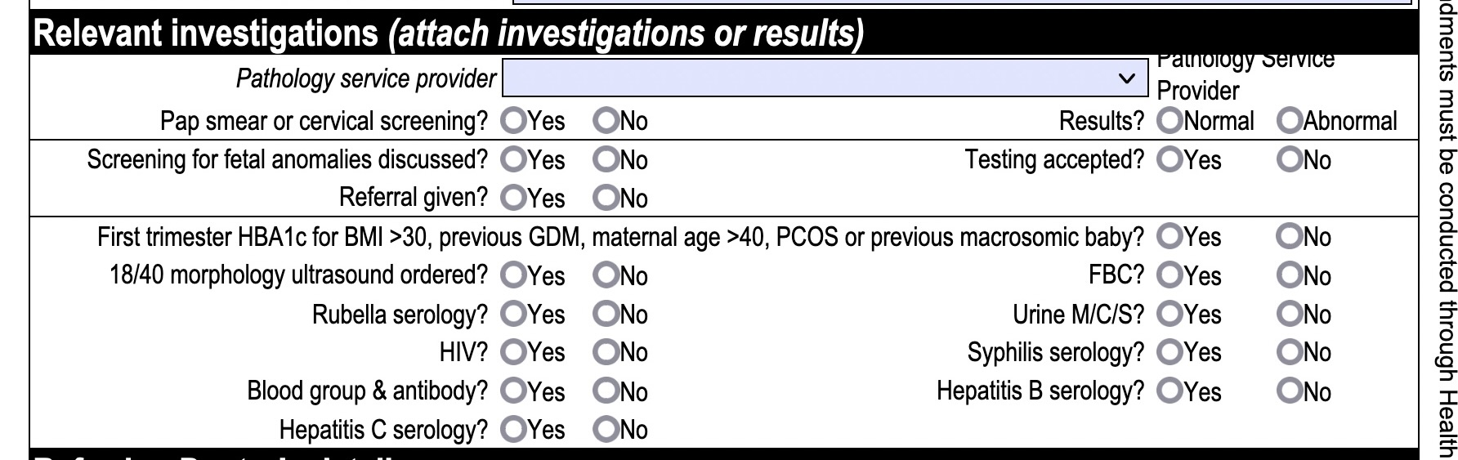
Please attach copy AND cc MMH
Copy of results in referral = helpful for triage
cc results to MMH
Printed copy of reports in the Pregnancy Health Record OR copied to My Health Record = immediate access to clinical information
Press print!

Slide 25
MMH Catchment Area
Refer all women to their local service. If you are uncertain, or if time is critical = contact GPLM.
Private hospital, public births
Local hospital, tertiary referral centre
High demand = no routine low risk referrals outside catchment
  Exceptions:
    Aboriginal / Torres Strait Islanders
    Those requiring a specialist drug and alcohol service
Proof of address is required
Mater Mothers Private has no catchment restrictions

Slide 26
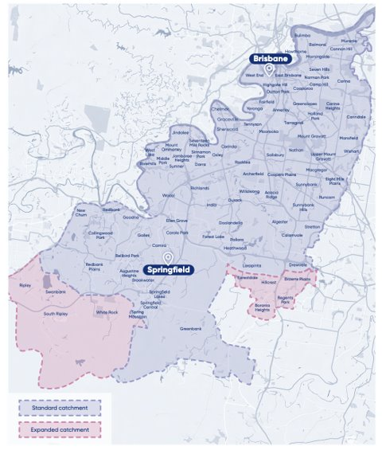
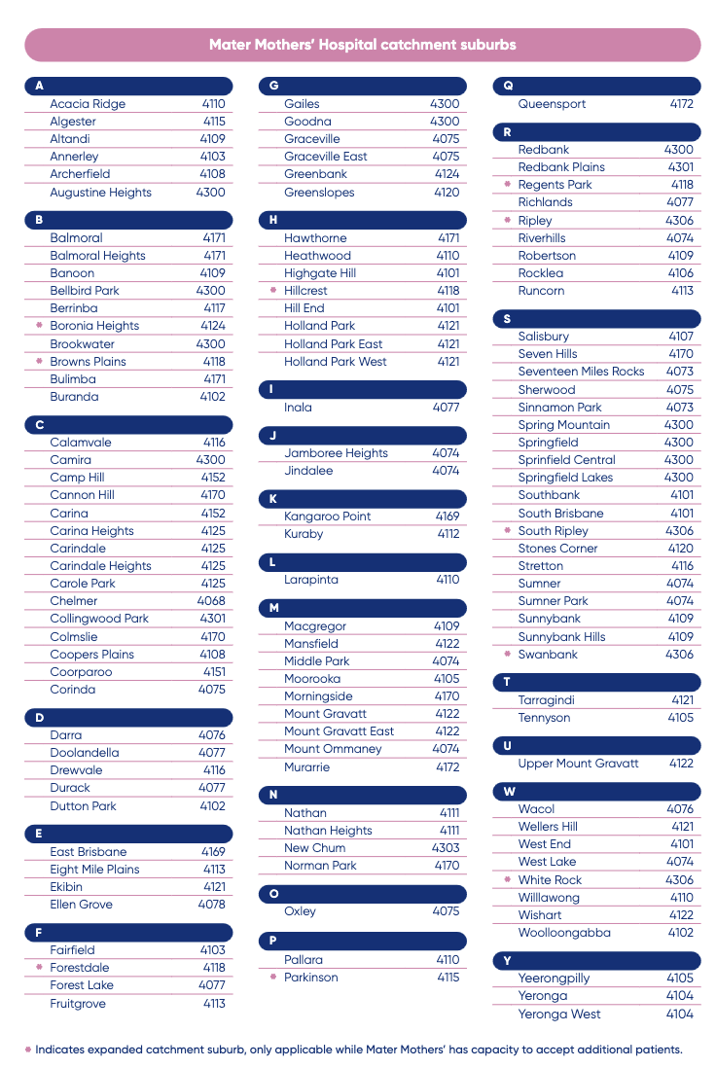
Pink area / dot point indicates expanded catchment while there is capacity

Slide 27
Mater Mothers’ Springfield is open!
Further details later today, after morning tea.
16-bed inpatient ward
24/7 Pregnancy Assessment Centre
16-cot Neonatal Critical Care Unit
Antenatal clinic (at Mater Health Hub, Springfield)

Slide 28
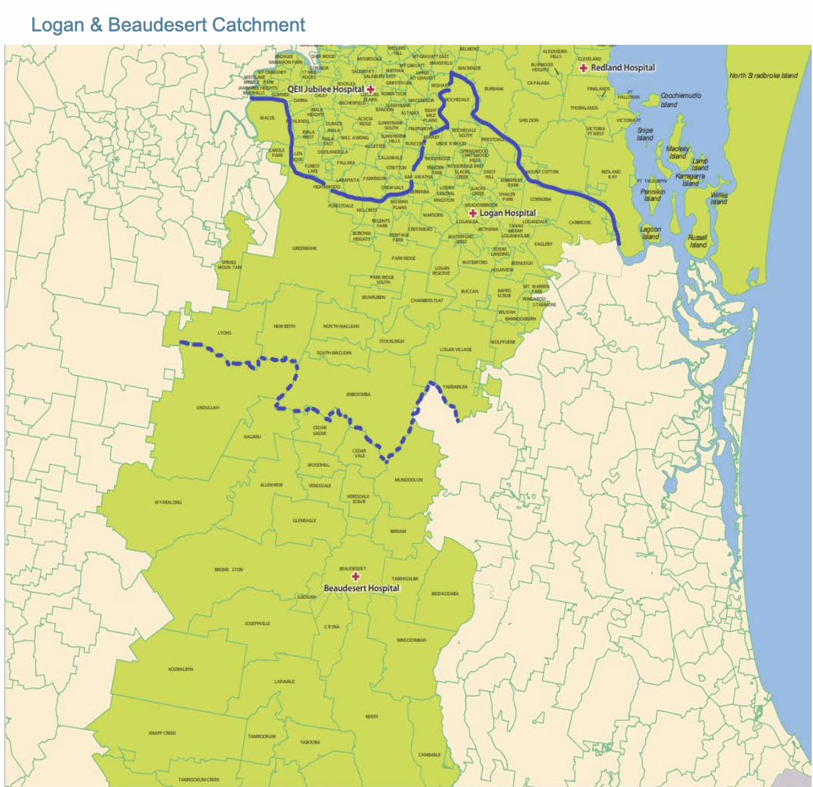

Slide 29
Booking in
Low risk women must complete information online before their antenatal booking appointment or it will be rescheduled
A link is sent via SMS
Mobile number must be c
(women to notify ANC of any contact changes )
If unable to be contacted their booking will be cancelled
Women who need an interpreter have a longer booking appointment, not the online version. Identify them!

Slide 30
Who is responsible for abnormal results?
You
If you order it, you are responsible for follow up and referrals
The cc result is not seen by clinicians until contact with the woman is made
What do you do with what you have found is in the MMH GP Maternity Shared Care Guideline
Unsure? Who can you call?

Slide 31
Who can you call?
For clinical advice or if a woman requires urgent review:
Obstetric consultant:
M-F 8.30-4.30 3163 1330
24hrs 3163 6612
Obstetric /Gynae Reg: 3163 6611 (24hrs)
Obstetric Medicine:
  Office hours Registrar: 3163 6630
  After hours Consultant: 3163 6656
Pharmacy queries: 3163 8226 / medicinesinfo@mater.org.au
The GP Liaison office
Mon - Fri 0730 - 1600 for all your questions
Ph 07 3163 1861
Mob 0466 205 710 (can leave a message) or
Email GPL@mater.org.au

Slide 32
Referral process
what to do with what you know
what to do with what you find
Women with pre-existing medical conditions identified in the antenatal referral don’t need separate referrals to specialist clinics. The obstetrician will sort it out at the first visit.
If a woman develops a complication after referral, notify ANC with correspondence and results (Fax 3163 8053 or send electronically); a new referral is not required.
OGTT positive? Notify ANC ASAP
If immediate referral is needed, refer the woman to PAC (24/7)

Slide 33
The referral pathway
All women should be referred to their local obstetric hospital
A comprehensive referral ensures appropriate triage
Local obstetricians will liaise with or refer women onto MMH prn
If complications arise, contact the local obstetric service, they can sort it out

Slide 34
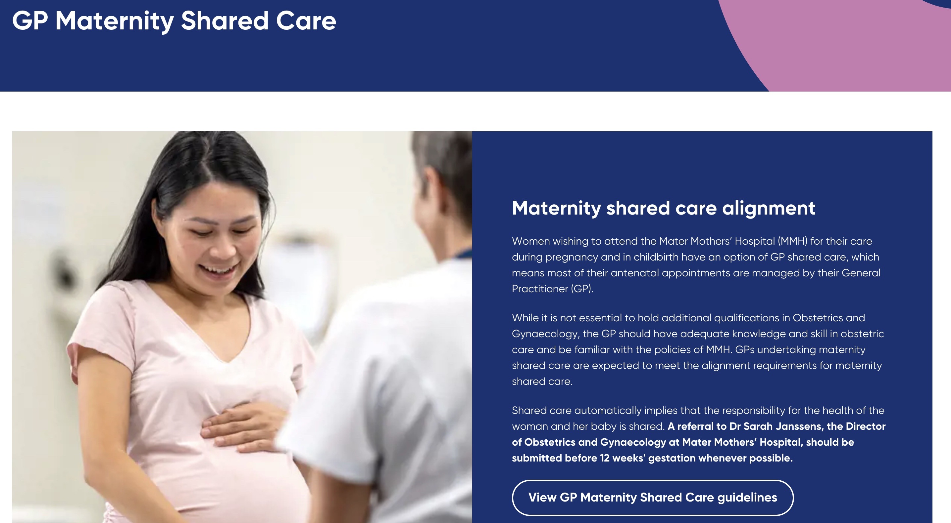
www.materonline.org.au

Slide 35


GP Maternity Shared Care Guideline
This is a 62 page summary of essential principles underlying GP maternity shared care.

Slide 36
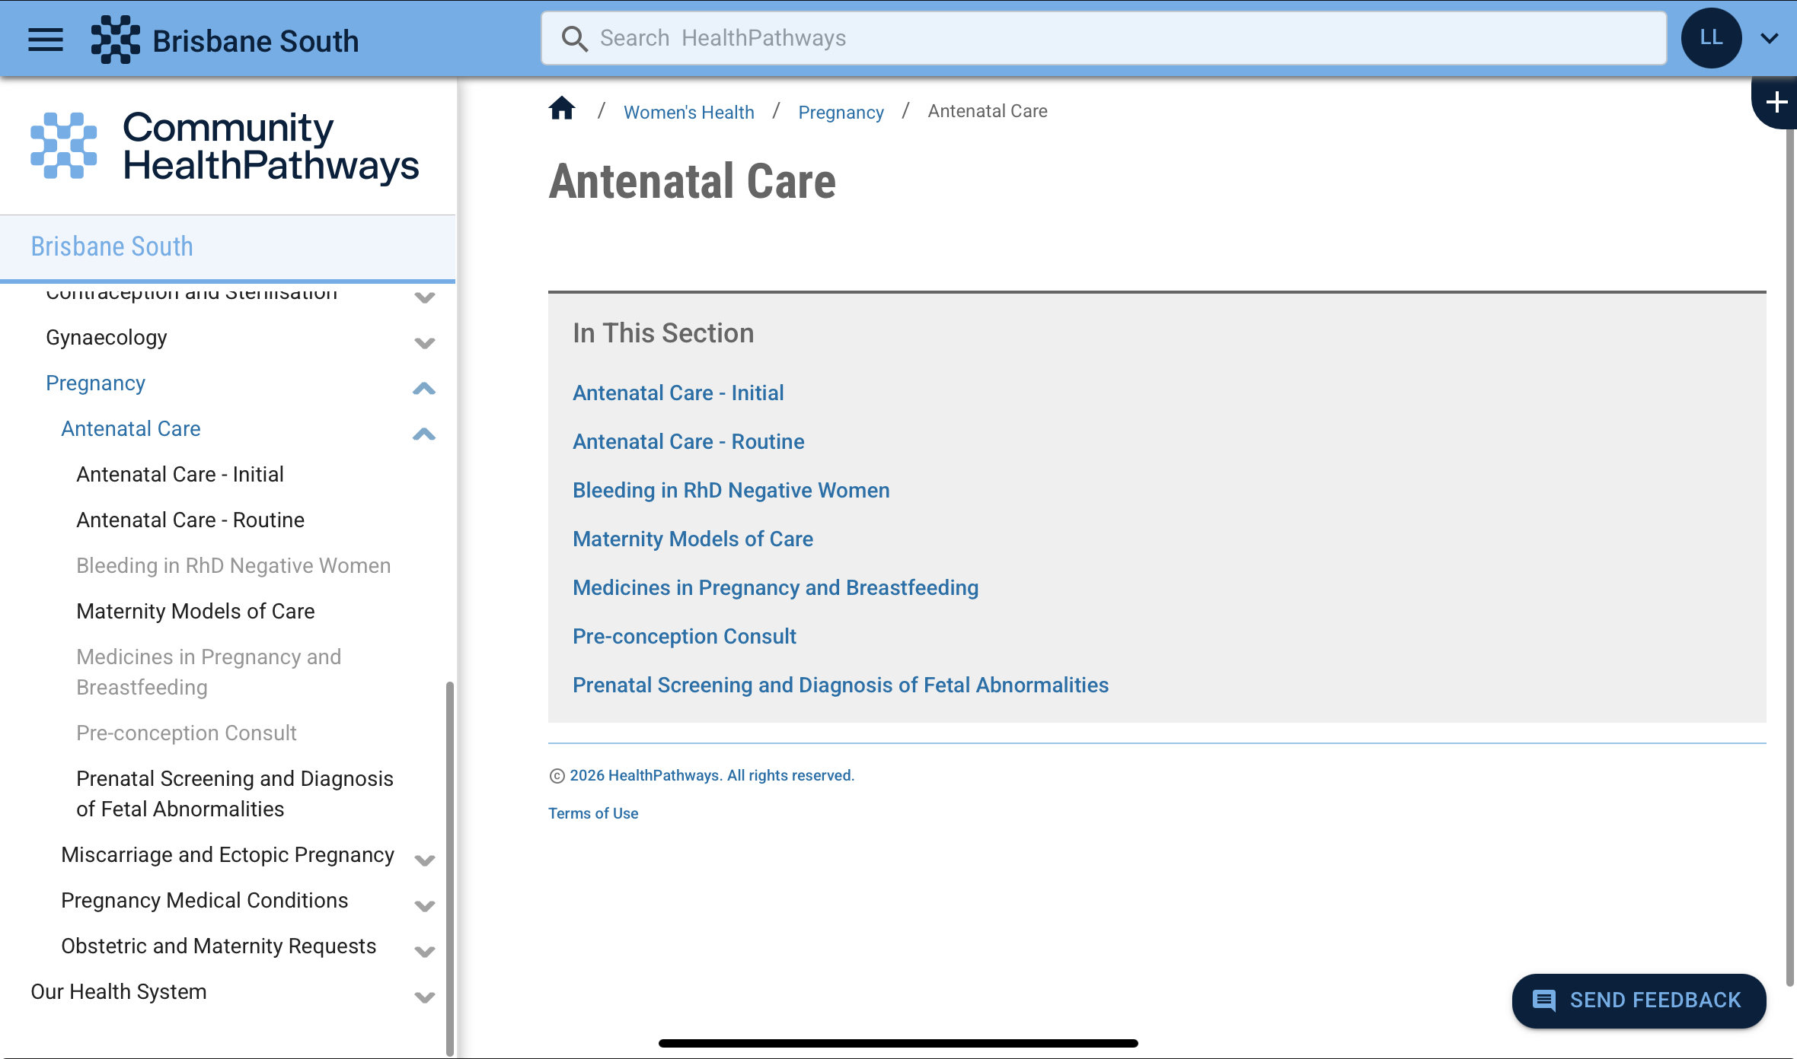
Spot on Health Pathway (MSHHS)

Slide 37
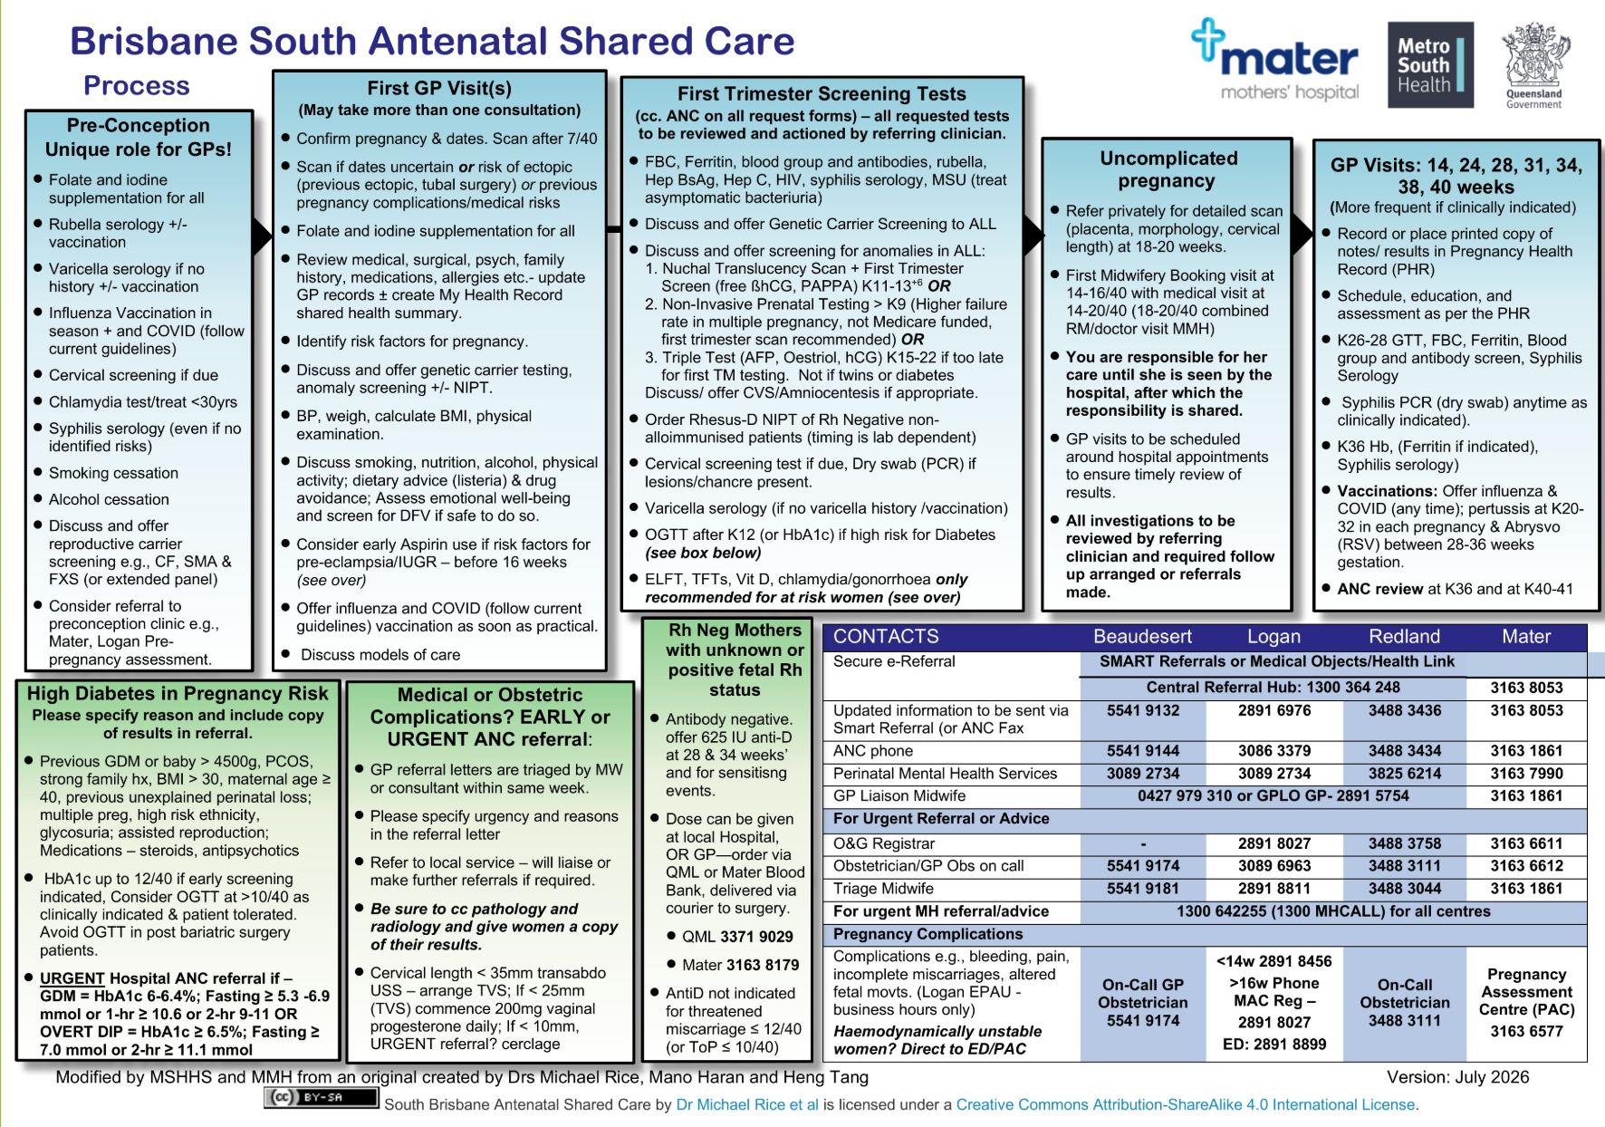

Slide 38
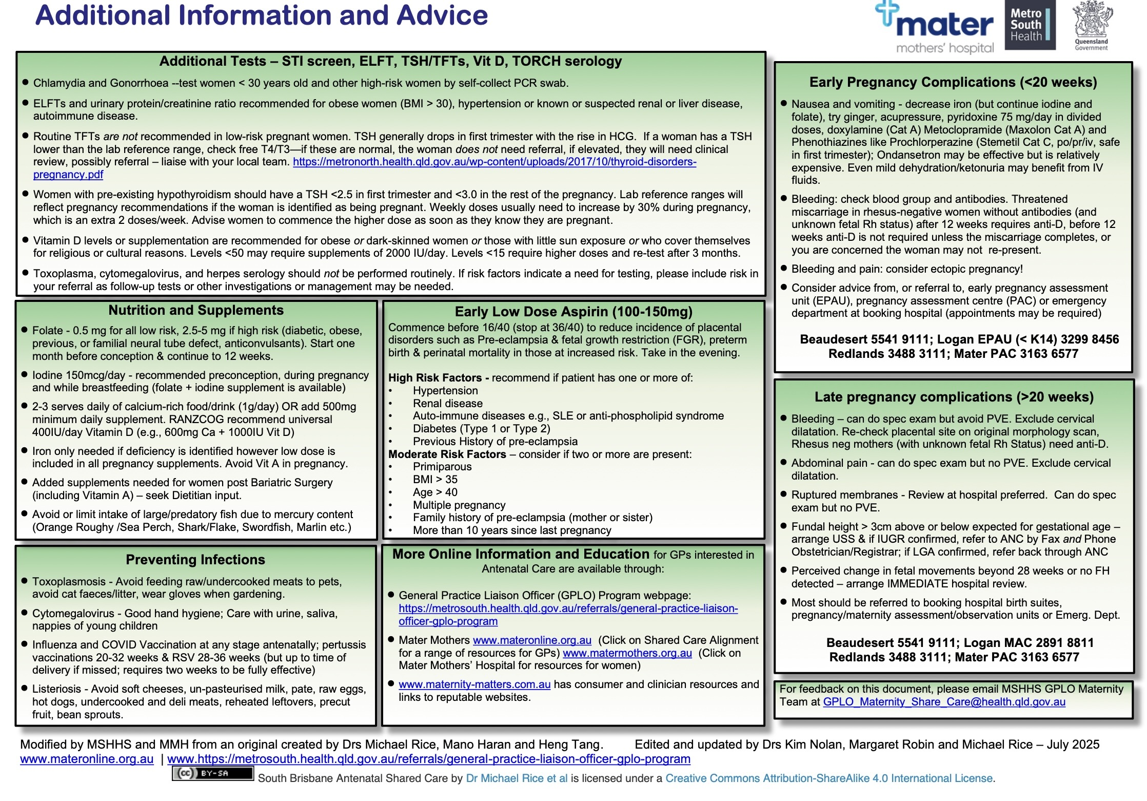

Slide 39

QR Code for MSH GP Shared Care 2-pager
Resources

Slide 40
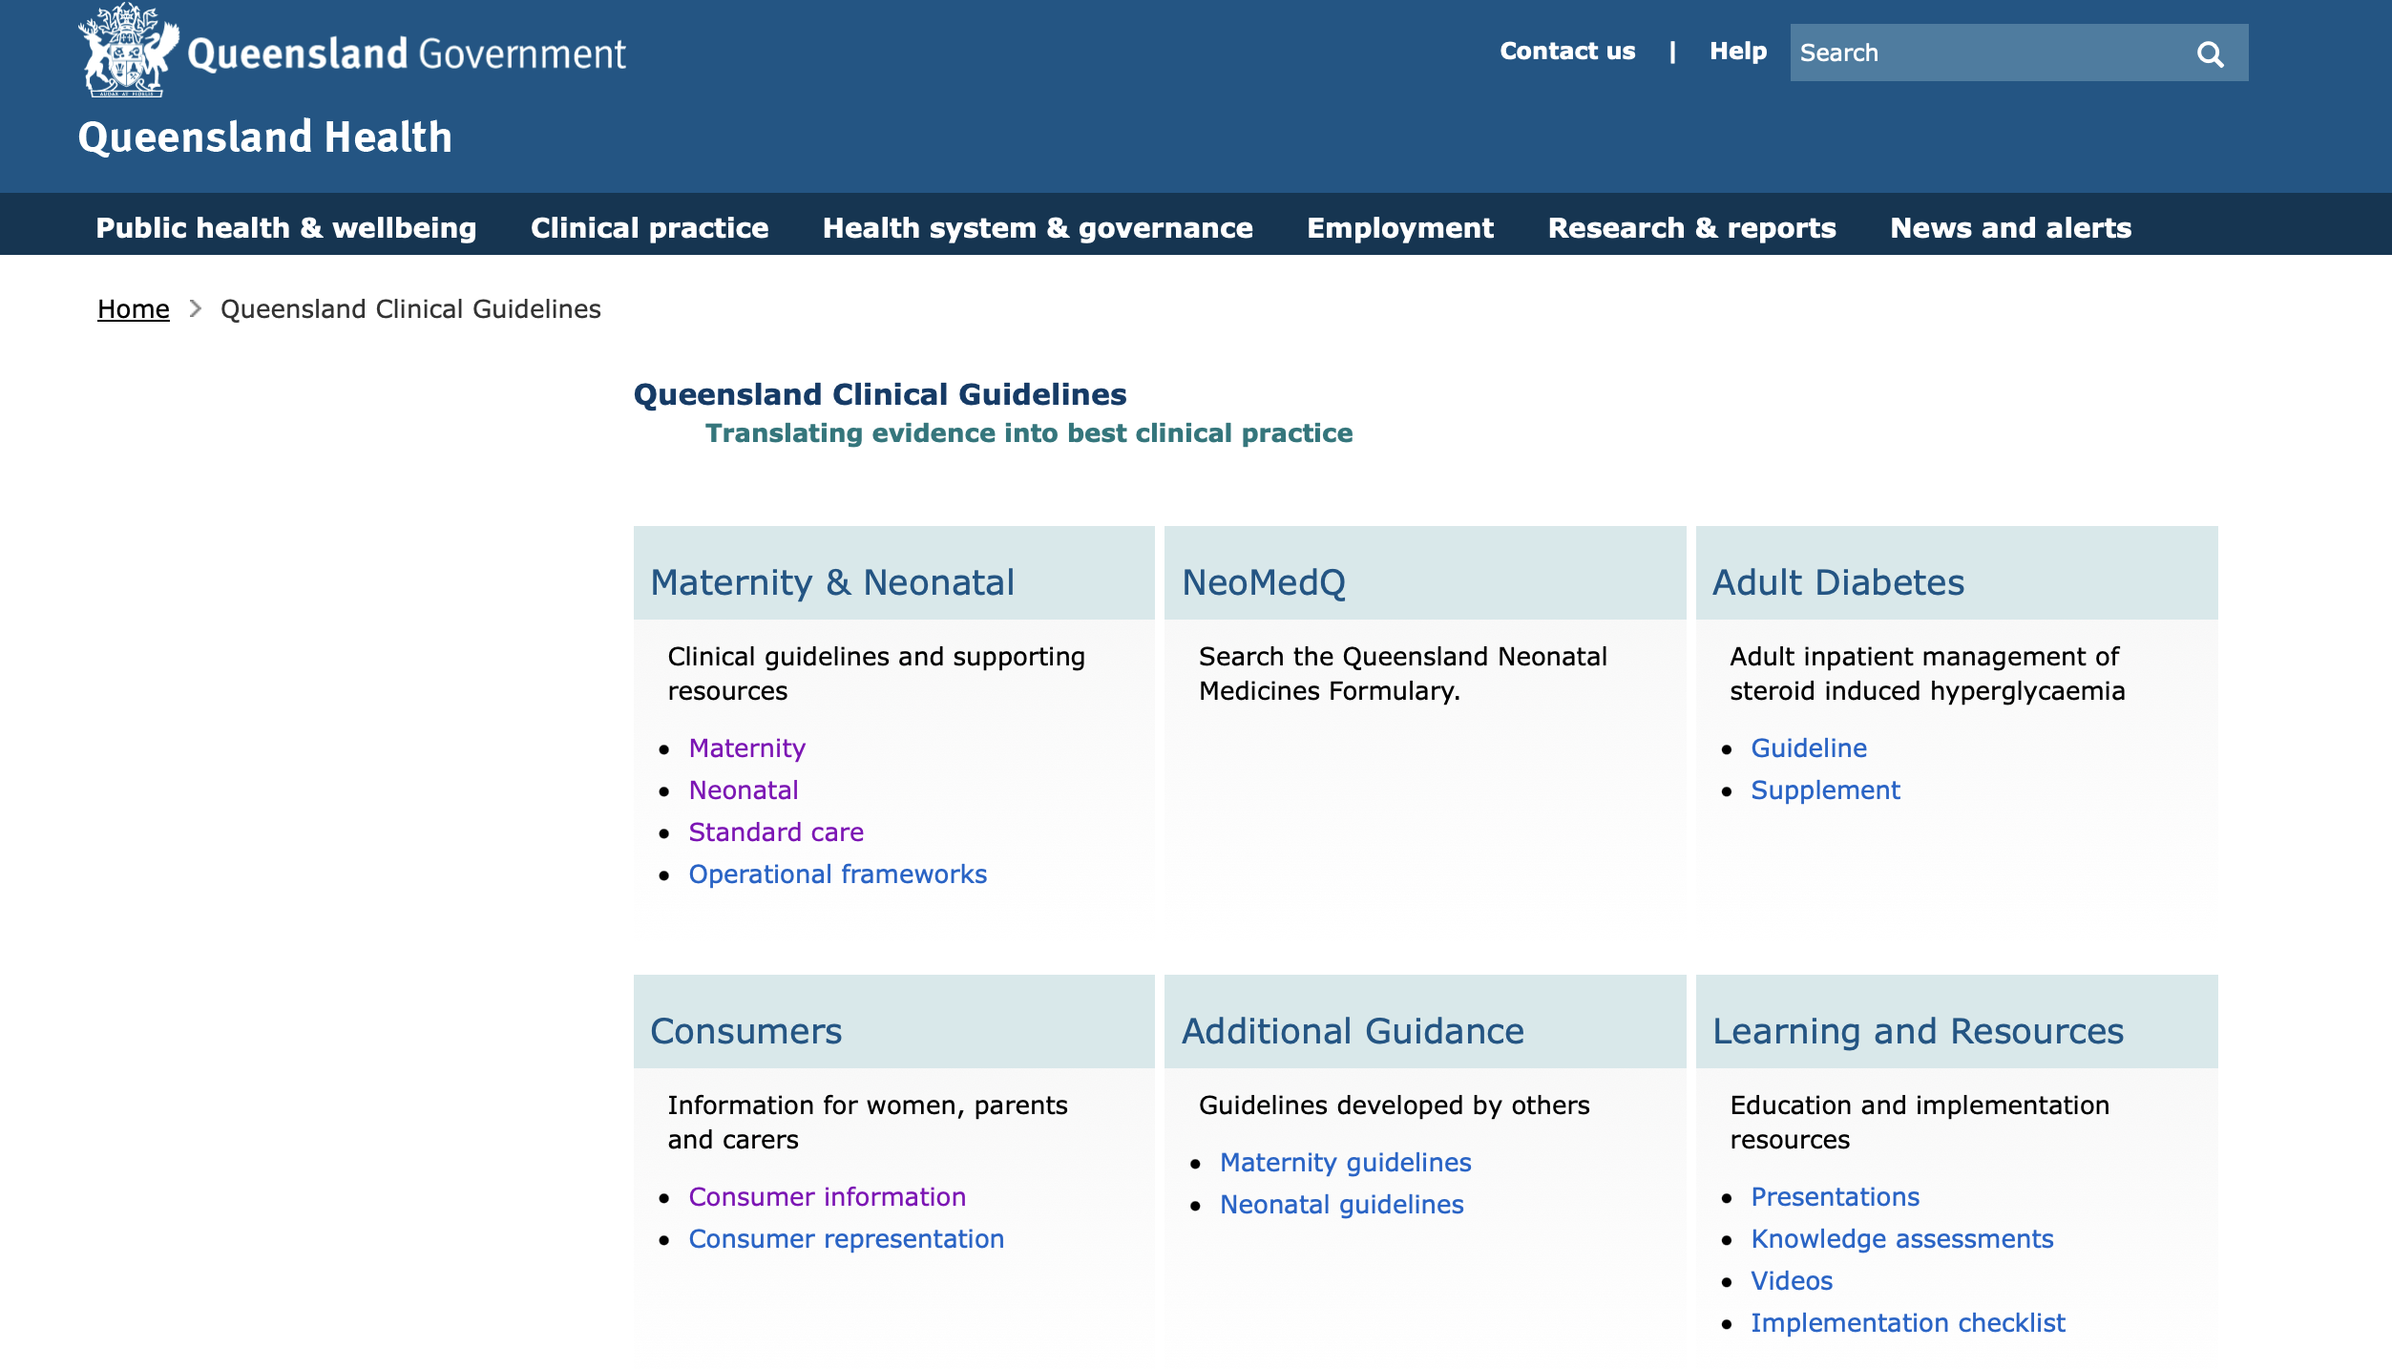
Guidelines-State (Qld)

Slide 41
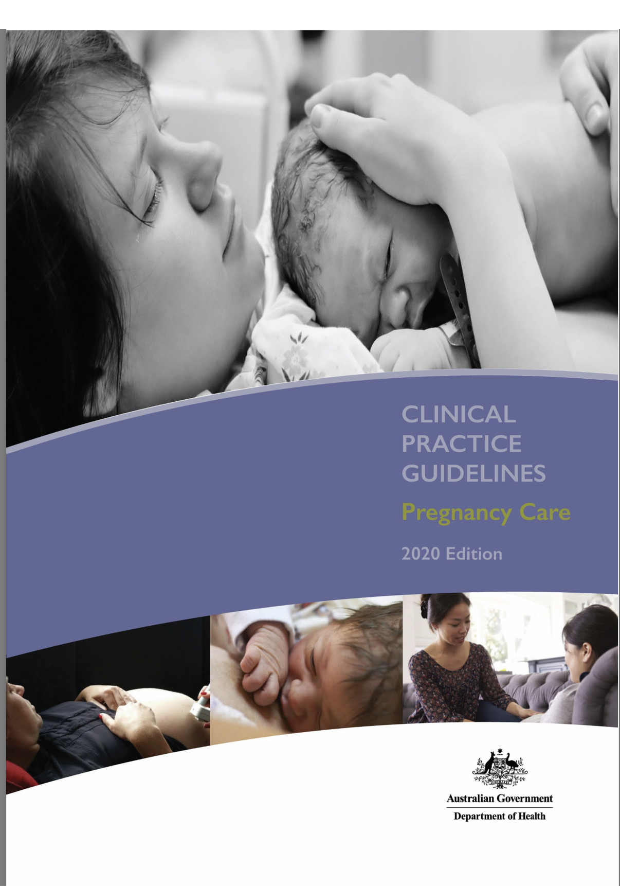

Guidelines-National
https://www.health.gov.au/resources/publications/pregnancy-care-guidelines

Slide 42

Please consider signing up
Mater has a consumer website www.matermothers.org.au
with models of care information
Women who do not have a GP can use this list to locate an aligned GP
Indicate your interest and consent on the feedback form

Slide 43
What’s new in Perinatal Care
Dr Lok Tung Lee
Dr Julian Pavey, Obstetric Physician
Dr Yanyan Tjioe, FRANZCOG
matermothers.org.au

Slide 44

Dr Julian Pavey
Introducing…
MBBS BMedSc FRACP
Endocrinologist & Obstetric Physician, Mater Mothers Hospital
Senior Lecturer, UQ
Special interests:
Diabetes technology
Diabetes in pregnancy
Medical disorders of pregnancy

Slide 45

Dr Yanyan Tjioe
Introducing…
Consultant Obstetrician and Gynaecologist
Delivers exclusively at Mater Mothers’ Hospital
Provides the full scope of obstetric and gynaecological care
Special interest in minimally invasive and laparoscopic surgery
Fluent in English & Chinese

Slide 46
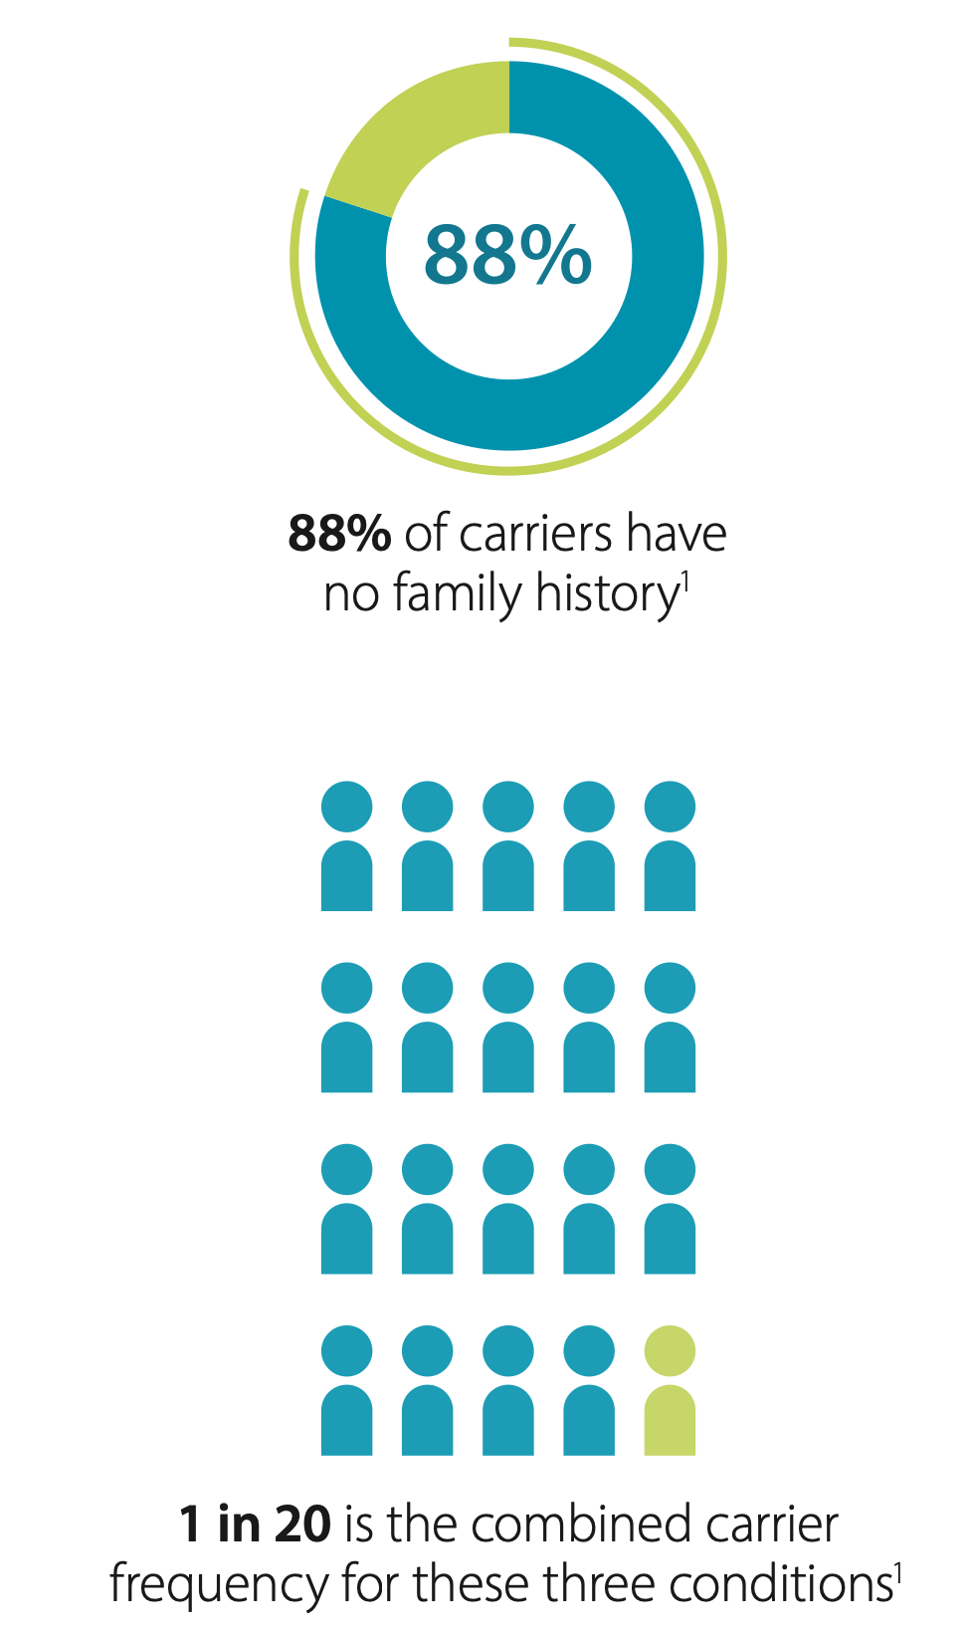
Medicare funding for Carrier Status testing
What’s new…
Since Nov 1, 2023
Spinal Muscular Atrophy
Cystic Fibrosis
Fragile X Syndrome
Medicare Criteria
Female planning pregnancy
Female who is already pregnant (best done ASAP)
Male reproductive partner of a female carrier
The rebate only applies ONCE per lifetime

Slide 47
NIPT for Rh factor
What’s new…
Fetal Rhesus screening is now rebatable by Medicare (item #73430)
Enables antenatal identification of fetal Rh status for Rh negative mothers
May avoid unnecessary administration of anti-D when fetus is Rh negative
Eligibility criteria:
  >/= 11/40 at SNP, > /=15/40 at Mater Pathology
  Rh negative mother, singleton pregnancies
  Antibody screen negative
  (Alternative specialized screening is available for antibody positive / alloimmunised patients)

Slide 48
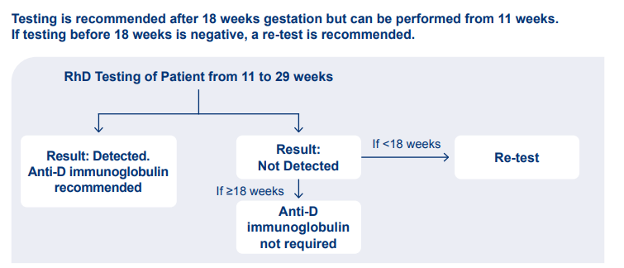
Fetal Rhesus Screening
Best performed after 18 weeks – if RhD negative result on a test prior to 18 weeks, repeat testing recommended.
Small risk of false negative RhD NIPT (approx 0.2%)
  Often if fetal cell free DNA below detection limit
  Assuming for routine postnatal RhD immunoprophylaxis based on cord blood RhD status, likelihood of false negative RhD NIPT result women being sensitised is approx 2%
  SNP: no longer bulk billing - $25 out of pocket fee (up to date as of 27/8/26)

Slide 49
Diagnostic criteria for GDM have changed as of 1st July 2025 (new ADIPS recommendation)
What’s new…
2014 | HbA1c (%) | Fasting BGL (mmol/L) | 1hr BGL | 2hr BGL
GDM | 5.9-6.4% | 5.1-6.9 | >/= 10 | 8.5-11
DIP | 6.5% | >/= 7.0 | No criteria | >/= 11.1
Targets | N/A | </= 5.0 | </= 7.4 | </= 6.7
2025 | HbA1c (%) | Fasting BGL (mmol/L) | 1hr BGL | 2hr BGL
GDM | 6.0-6.4% | 5.3-6.9 | >/= 10.6 | 9.0 -11
DIP | 6.5% | >/= 7.0 | No criteria | >/= 11.1
Targets | N/A | </= 5.2 | </= 7.4 | </= 6.7

Slide 50
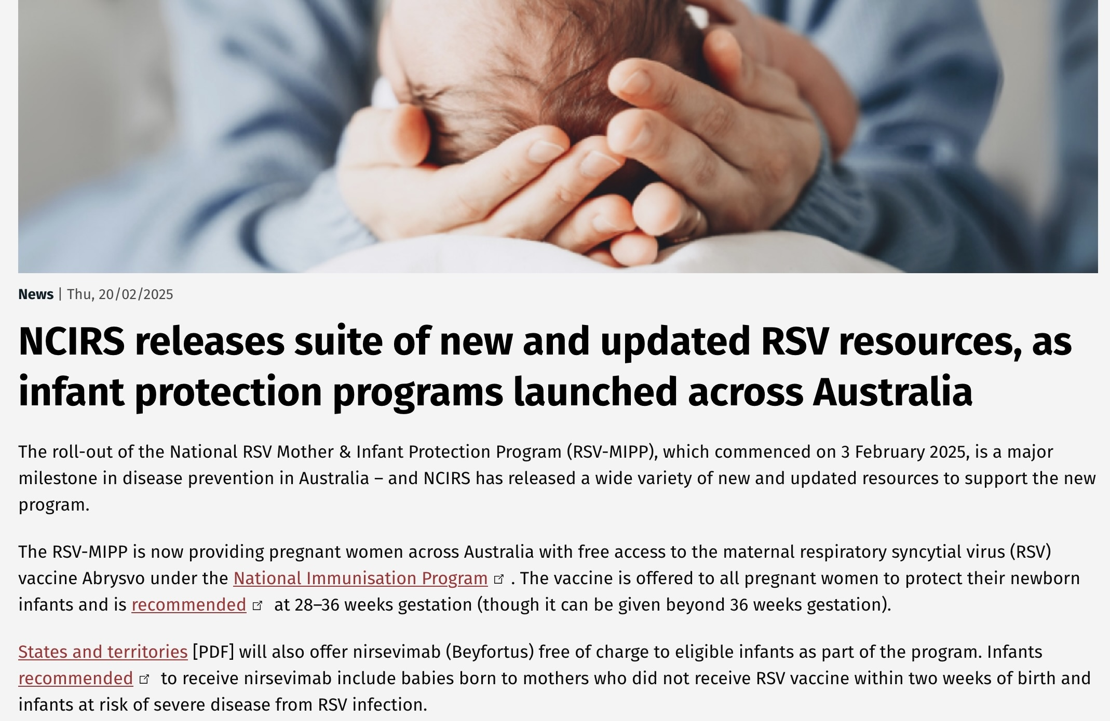
RSV vaccination for mothers & babies
What’s new…

Slide 51
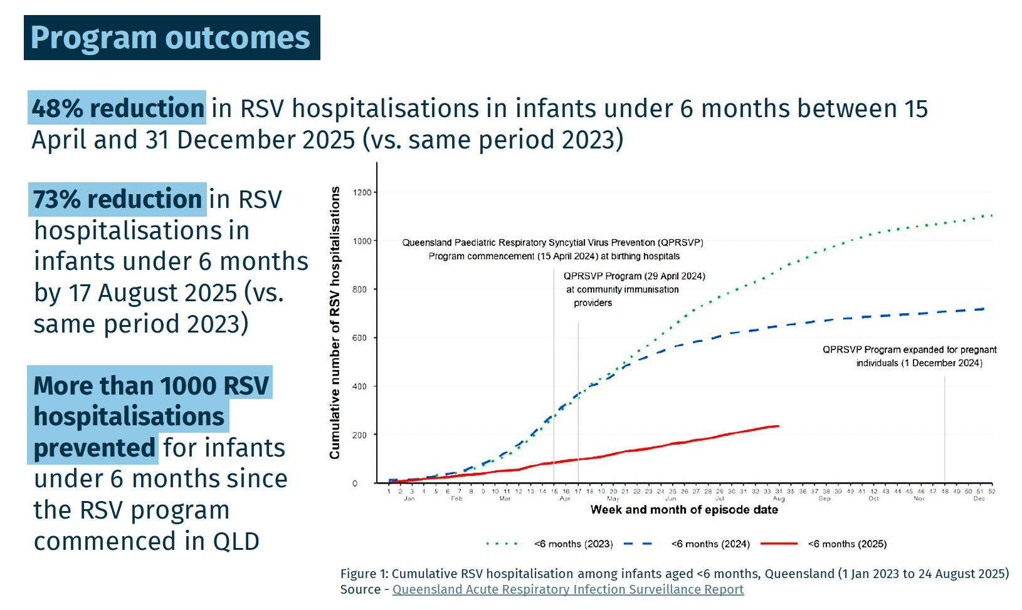
The impact of RSV vaccination...

Slide 52
Pertussis & influenza vaccination
Pertussis (DTPa) ideally from 20-32 weeks, but funded up until birth
If a woman has received DTPa before 20 weeks, it does not have to be repeated in the current pregnancy. The data shows transfer of antibodies as early as 13 weeks
Recommend DTPa booster for all close contacts of baby (not funded however)
Influenza vaccine can be administered at any gestation and provides additional protection for the first six months of an infant’s life

Slide 53
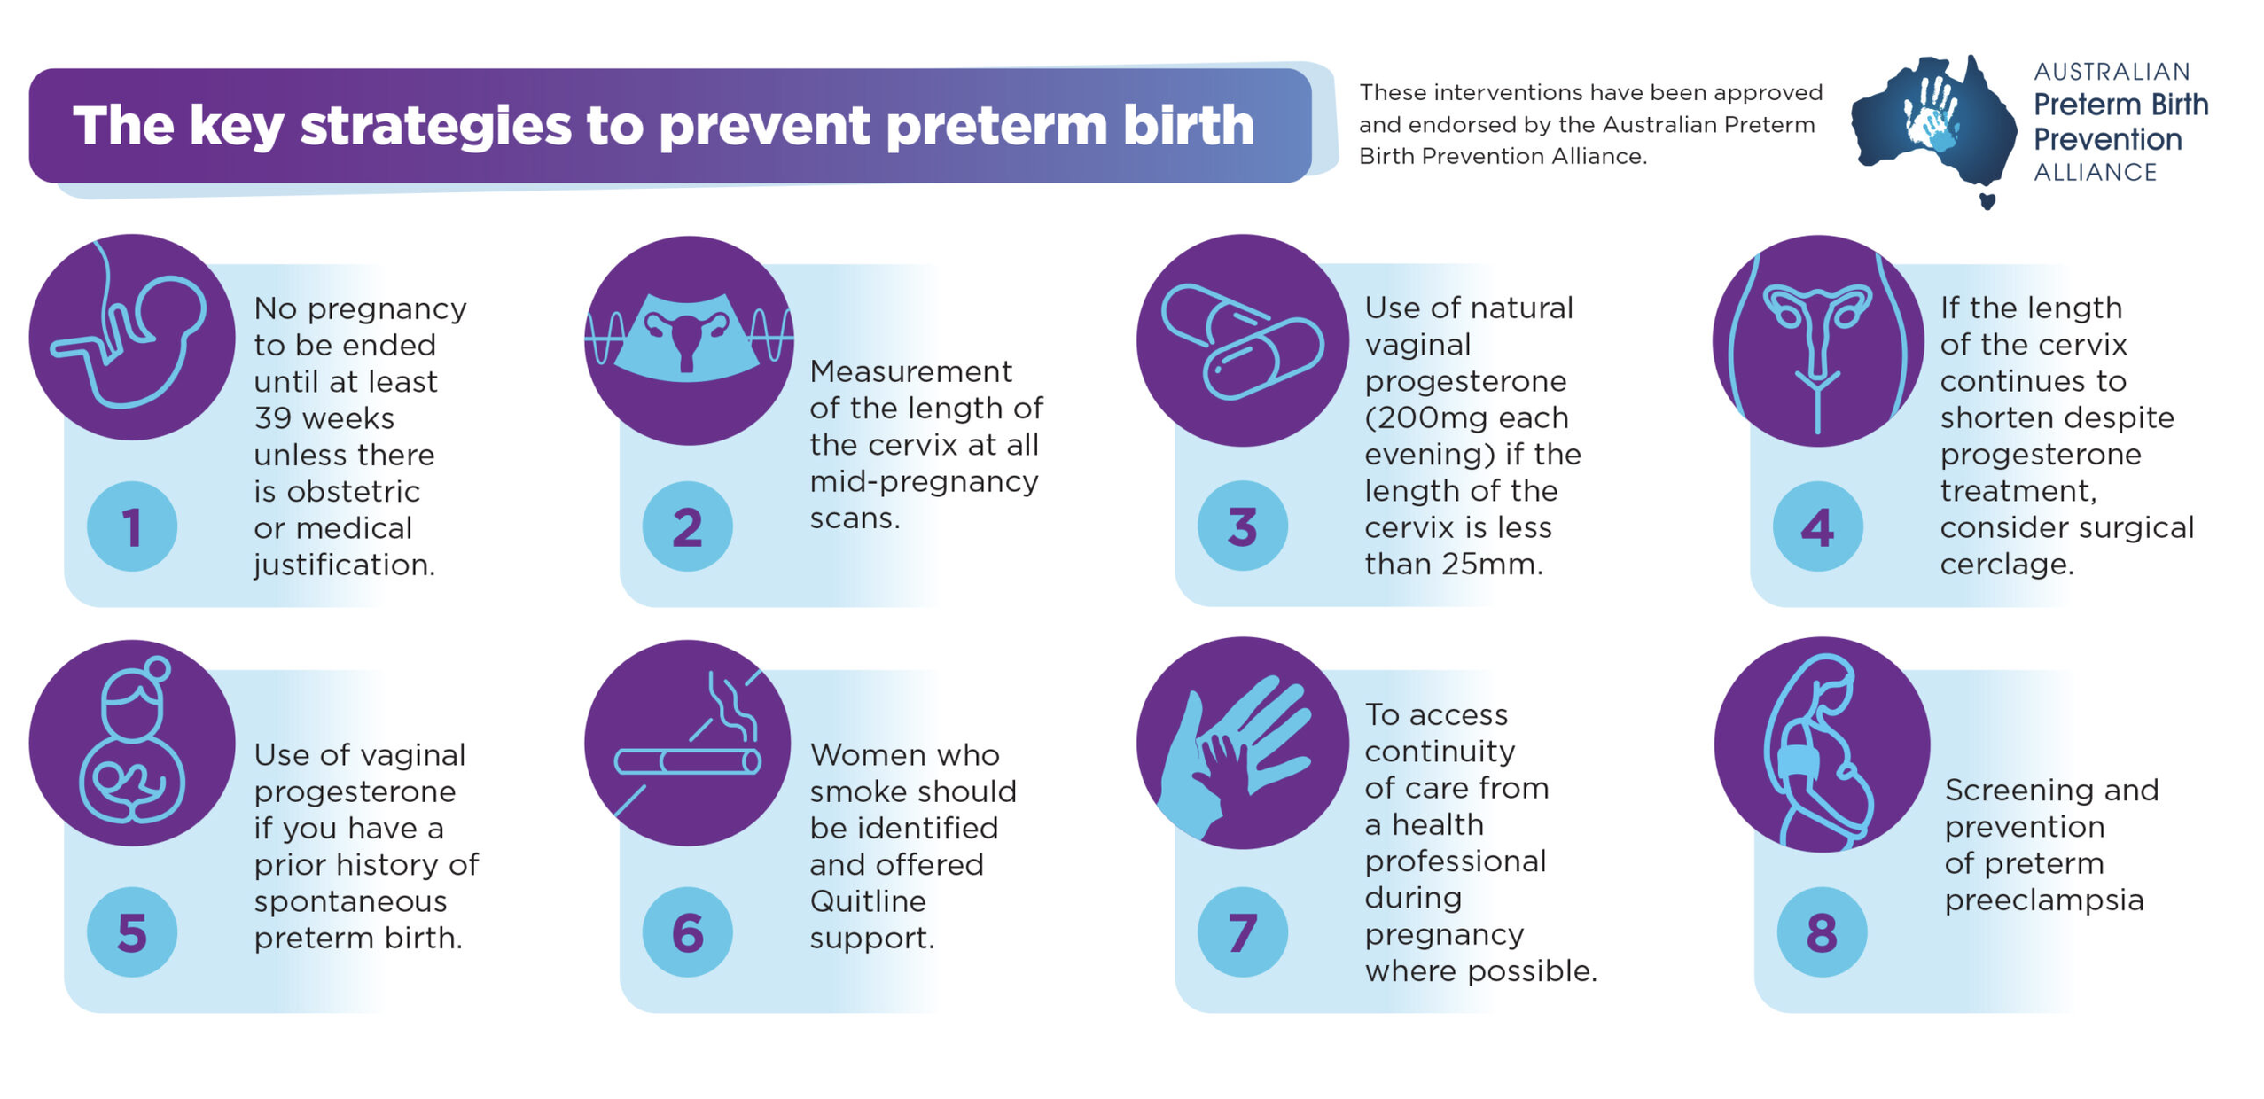
Preterm birth prevention
What’s new…
Please note that screening as "increased risk" for preeclampsia does not preclude GP Shared Care – care will only need to be transferred if preeclampsia or other complications develop.

Slide 54
Cervical length measurement (Point 2)
Best efficacy between 16 and 24 weeks
Offer transvaginal (TV) if significant Hx preterm birth/cervical surgery
Otherwise, routine transabdominal (TA) screening at morphology scan
Cut off TA: cervical length 35 mm (full bladder)
TV if </= 35 mm TA or cervix cannot be seen across its entire length with certainty
Cut off TV: </= 25 mm
Shortened cervix: urgent referral and commence natural vaginal Progesterone pessaries (200 mg nocte) the same day
Note that there are different streamlined Authority numbers depending on brand of progesterone: Uterogestan = 11835, Oripro = 11675

Slide 55
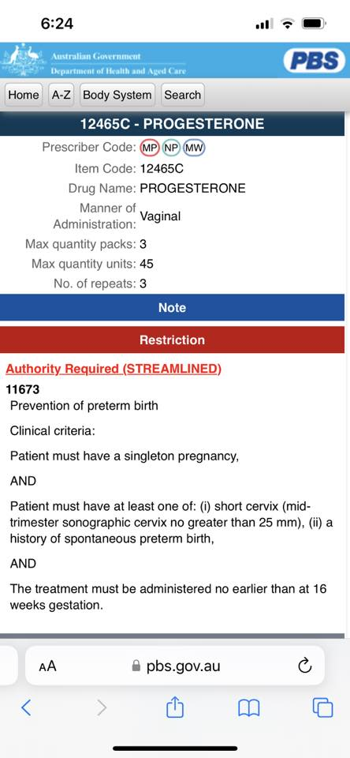
Point 1
Point 5
Use of vaginal progesterone (200mg each evening) if the length of cervix is 25mm or less. This treatment should continue until 36 weeks gestation.
Vaginal progesterone 200mg pessaries are also to be prescribed for any case in which there is a history of spontaneous preterm birth in a previous pregnancy between 20 and 34 weeks gestation. The treatment is used each night from 16 to 36 weeks’ gestation.

Slide 56
PV Bleeding – PV Progesterone support?
What’s new…
TGA approved (2022)
“UTROGESTAN 200 mg (soft capsule) is now also indicated for treatment of unexplained threatened miscarriage in women with bleeding in the current pregnancy and a history of at least three or more previous miscarriages. Use in women with less than three miscarriages may be warranted in those with reduced chances of future pregnancy such as those undergoing IVF treatment with limited viable egg and/or embryo availability or advanced fertility age. However, the benefit of treatment in clinical trials was limited to women with three or more miscarriages”
Note: not PBS listed for this indication
PBS listed for IVF and preterm birth prevention (short cervix or history of spontaneous preterm birth, from 16 weeks)

Slide 57
Progesterone pessaries for threatened miscarriage
“The usual dose is 400 mg (two pessaries) twice a day (morning and night).
Treatment should be initiated at the first sign of vaginal bleeding during the first trimester of pregnancy and should continue to at least the sixteenth week of gestation.”
Cost: $91 (Chemist Warehouse) for 42 pessaries = ~ $9/day for treatment

Slide 58
Preeclampsia Prevention
What’s new…
Interventions with an evidence base:
Moderate exercise >/= 140 min / week (recommended for all)
Aspirin 100-150mg / day (for those with risk factors)
Planned birth from 39 weeks (in selected cases)
Source: N Engl J Med 2022; 386: 1817-32. DOI: 10.1056/NEJMra2109523
Interventions with less compelling evidence:
Calcium supplementation has previously been recommended for preeclampsia prevention
A recent Cochrane review from December 2025 suggests that the evidence for calcium may be overstated; calcium therefore not routinely recommended
Source: Cluver CA, Rohwer C, Rohwer AC. Calcium supplementation during pregnancy for preventing hypertensive disorders and related problems. Cochrane Database of Systematic Reviews 2025, Issue 12. Art. No.: CD001059. DOI: 10.1002/14651858.CD001059.pub6. Accessed 19 February 2026.

Slide 59
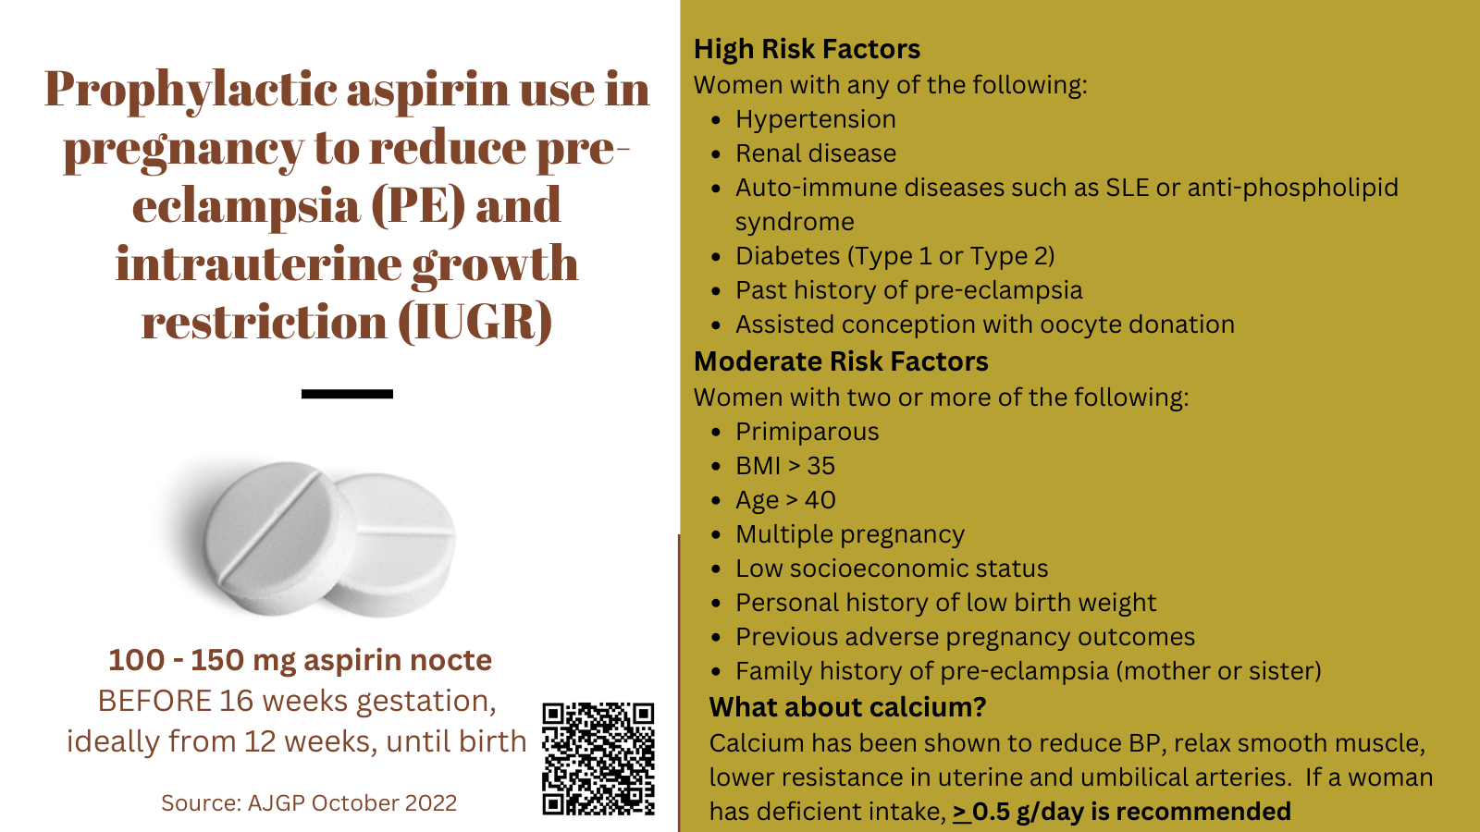

Slide 60
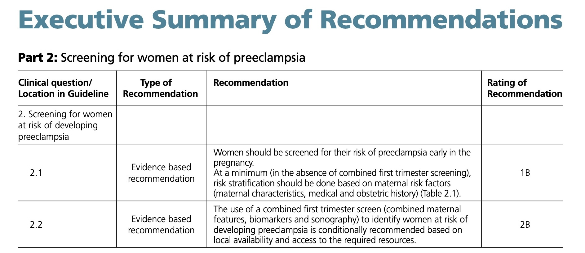
2023 SOMANZ Guideline
SOMANZ* has a Hypertension in Pregnancy Guideline 2023 (published 05/02/24) and, in addition to the risk factors identified previously, a combined first trimester screen may be recommended. This screen uses a combination of maternal history, blood pressure, biochemistry (Papp-A or PLGF) and uterine artery doppler to improve the detection rate for early preeclampsia.

Slide 61
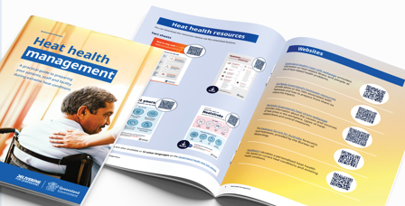

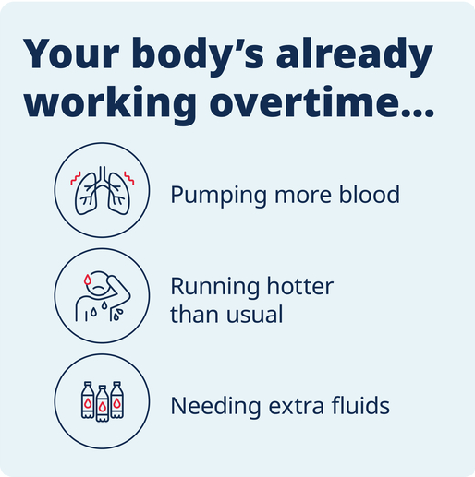

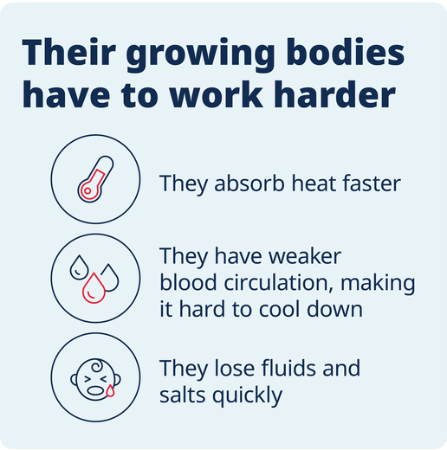

Heat harm: paediatric and maternity support
What does a patient need to understand?
Heatwaves are based on local Queensland averages (a high thresholder), with the additional burden of humidity on our bodies
Why pregnant people, babies and young children are particularly vulnerable (and what to do)
Real impacts seen during heatwaves in Queensland, increase of 5% in all cause mortality, 12% in QAS calls and 10.47% in Emergency Department presentations
Heat health management guide for primary care providers (RACGP + QH)
Heat health resources

Slide 62
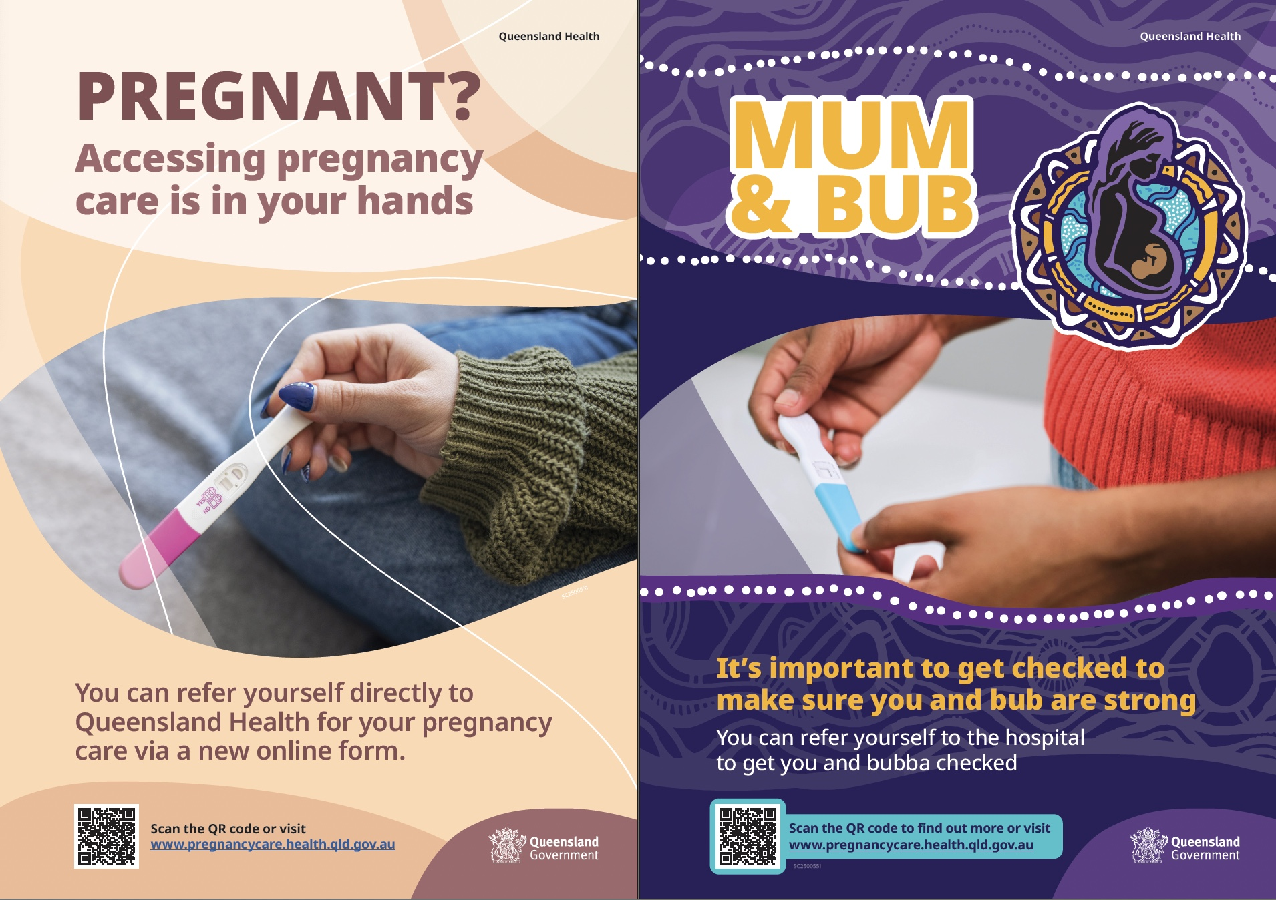
Self-referral went live in Queensland from July 2025

Slide 63
What does self-referral mean for primary care?
The self-referral initiative was announced by Queensland's Chief Midwifery Officer Liz Wilkes in May 2025
Borne out of research into adverse pregnancy outcomes which suggested that some vulnerable populations may have difficulty accessing timely pregnancy care and referral, due to social and financial disadvantage
Provides pregnant people with the option of directly self-referring to a maternity hospital for antenatal care and delivery
Mater remains committed to strong relationships between primary and hospital perinatal care
All patients initiating self-referral are encouraged to engage with a GP in the first instance and are provided with details of Aligned GPs as appropriate
Initial patient numbers via this pathway have been low, primarily patients with previous midwifery group practice (MGP) care, seeking MGP in a subsequent pregnancy

Slide 64
Item numbers relevant to Maternity Shared Care
What’s new…
16500 (Rebate $55) Antenatal Attendance
91853 (video: $55) 91858 (telephone: $55) equivalent of 16500
16591 (Rebate $166.40) “Planning and management, by a practitioner, of a pregnancy if:
(a) the pregnancy has progressed beyond 28 weeks gestation; and
(b) the service includes a mental health assessment (including screening for drug and alcohol use and domestic violence) of the patient; and
(c) a service to which item 16590* applies is not provided in relation to the same pregnancy
Payable once only for a pregnancy”
(16590 = planning to undertake the delivery for a privately admitted patient)

Slide 65
Additional item number for qualified GPs: 4001
Professional attendance of at least 20 minutes in duration at consulting rooms by a general practitioner who is registered with the Chief Executive Medicare as meeting the credentialing requirements for provision of this service for the purpose of providing non-directive pregnancy support counselling to a patient who:
(a) is currently pregnant; or
(b) has been pregnant in the 12 months preceding the provision of the first service to which this item or item 81000, 81005 or 81010 applies in relation to that pregnancy
Note: For items 81000, 81005 and 81010, see the determination about allied health services under subsection 3C(1) of the Act.
Fee: $89.35
Free online training available via RACGP and ACRRM, takes ~ 3 hours to complete

Slide 66
Postnatal item numbers
16407
Postnatal professional attendance (other than a service to which any other item applies) if the attendance:
(a) is by an obstetrician or general practitioner; and
(b) is in hospital or at consulting rooms; and
(c) is between 4 and 8 weeks after the birth; and
(d) lasts at least 20 minutes; and
(e) includes a mental health assessment (including screening for drug and alcohol use and domestic violence) of the patient; and
(f) is for a pregnancy in relation to which a service to which item 82140 applies is not provided (participating RM)
Payable once only for a pregnancy
Fee: $83.65
16408
Home visit for woman who was admitted privately for the birth. Midwife (on behalf of and under the supervision of the medical practitioner who attended the birth) Obstetrician or GP can claim. 1-4 weeks post partum, at least 20 min duration
Fee: $62.30

Slide 67
Recurrent issues:
GDM
Thyroid disorders
Obesity in pregnancy
Dr Julian Pavey
Obstetric Physician, MMH
GDM & Thyroid disorders
Dr Yanyan Tjioe
FRANZCOG, MMH
Obesity in pregnancy
matermothers.org.au

Slide 68
Testing for Diabetes in Pregnancy
Obstetric Medicine: Let’s revisit
First trimester HbA1c (or OGTT) for women at high risk of previously undiagnosed T2DM
Early (ideally 10-14 weeks) OGTT for women with risk factors
Routine OGTT (24 – 28 weeks) for all women not previously noted as abnormal (HbA1c NOT suitable)
Updated ADIPS consensus recommendations published in MJA June 2025
MMH and QHealth follow the ADIPS diagnostic criteria

Slide 69
HbA1c
HbA1c can be used as a diagnostic test for
undiagnosed diabetes in first trimester
HbA1c of ≥6.5% (48mmol/mol) required for a diagnosis of overt DIP
HbA1c of ≥6.0% diagnostic of GDM in first trimester only
Women with risk factors should have an early OGTT – ideally at 10-14 weeks gestation
HbA1c DOES NOT replace the GTT for women after first trimester, or postpartum
HbA1c can be used for long term follow up of women with a past history of GDM, for early pregnancy or preconception testing in a high-risk woman.

Slide 70
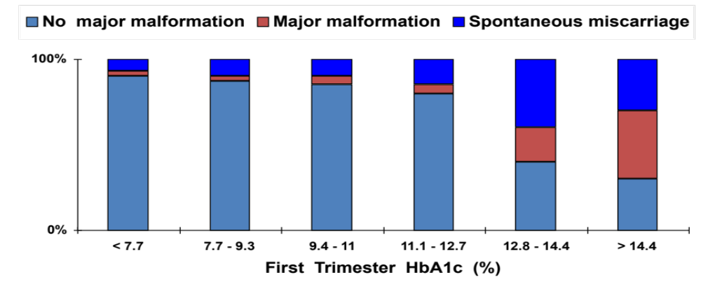
Why test?
Pre-gestational Diabetes
Fetal / Neonatal Considerations Greene MF et al Teratology 1989: 39; 224-231
Major Malformations / Spontaneous miscarriage

Slide 71
Potential Adverse Pregnancy Outcomes
Congenital Malformations
Miscarriage
Macrosomia (birth weight > 4500g)
Shoulder dystocia
Preterm birth
Respiratory distress
Hypoglycaemia of neonate
Polycythemia
Hyperbilirubinemia
Cardiomyopathy

Slide 72
GDM care in evolution
MMH in partnership with CSIRO use a smartphone app (“Mother”) to healthcare portal for remote management of GDM
This means we can see ALL the self monitored BGLs ALL the time!
Women can remain in their chosen model of care with remote monitoring
From GDM diagnosis (and notification to ANC by usual processes) all public women receive a GDM education video, 2 fetal scans are booked, and access to the app
Once registered with NDSS women can pick up a glucometer for free from any NDSS pharmacy.
All women will have two appointments with the diabetes educators and dietitians for individualized management – this can be F2F, telehealth or phone. Follow up of BGLs is continued via the app.
All women requiring insulin will receive education either F2F and video or phone chat and video. Titration will be done via the app
Videos can be accessed in six languages via the Mater website
New self monitored BGL targets < or equal to 5.2 fasting, and < or equal to 7.4 mmol/L at one hour from the first bite of food

Slide 73
Concerns about GDM
(or anything Obs Med related)
GDM:
  Email: diabetesmmh@mater.org.au
  Phone: 07 3163 1988
Other issues:
  Daytime senior Obs Med registrar available 0800 – 1630: 3163 6630
  After hours consultant cover: 3163 6656
  If you have concerns/questions about the app/GDM care in the community, please call

Slide 74
E consults for Obs Med
New service, part of Mater / UQ CHSRI :
Targeted advice for “medium level” clinical questions across multiple medical specialties including Obstetric Medicine
Clinical details and specific questions(s) via secure web portal – Medical Objects based…
Response generally within 2 working days
Obs Med rather than General Obstetrics
  e.g. Thyroid / Diabetes / Renal / Hypertension / Haematology - at the milder end of the scale not requiring full clinic review

Slide 75
E consults for Obs Med
The best access points for GPs are:
https://www.mater.org.au/health/about/mater-econsultant for more information on eConsultant. This page gives a link to mater online (below)
https://materonline.org.au/services/my-advice-service - which has all the resources practices require to set up and use eConsultant i.e., practice software templates and instructions
Email for queries: econsultant@mater.org.au

Slide 76
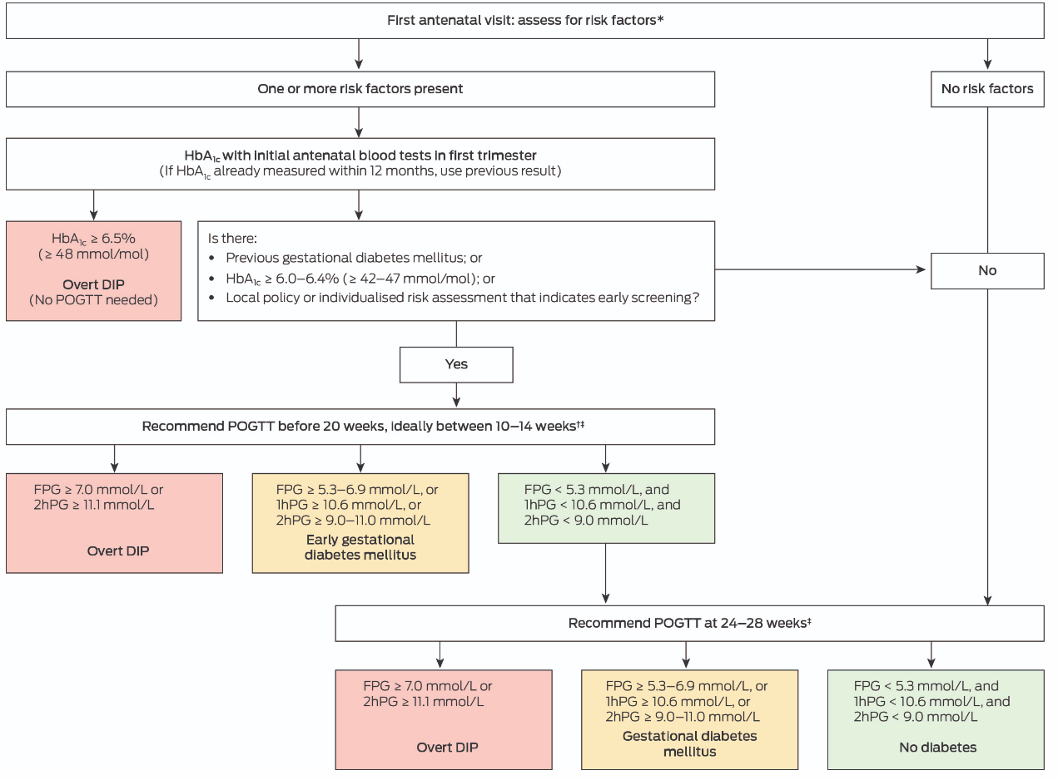

Slide 77
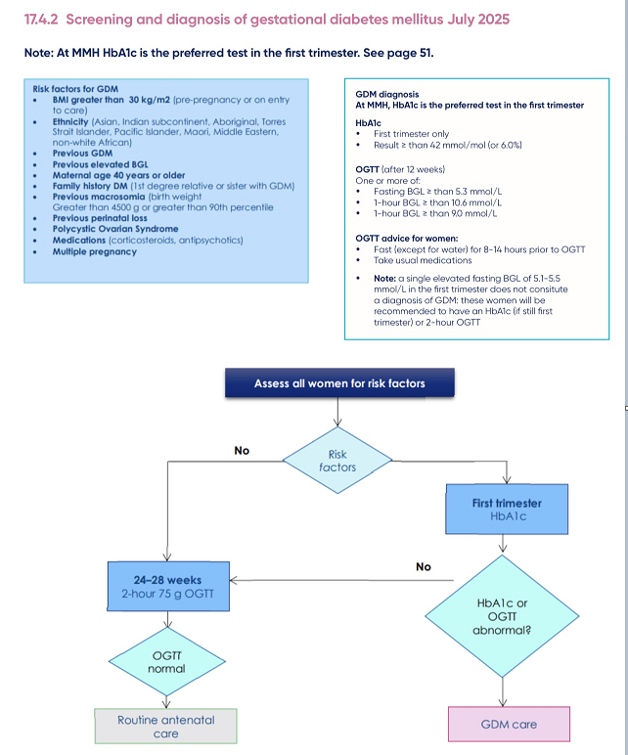

MMH Clinical Guidelines
GDM Flowchart
(page 49 MMH
MSC Guideline)

Slide 78
Diabetes test positive?
Notify MMH ASAP
  GPLM phone or email, please do NOT send a fax – it can get lost in the system
Women will be seen at MMH, but care can still be shared
Remember, these women are at a higher risk long term for developing diabetes and CVD, so follow up is important – 4HER clinic

Slide 79



Postpartum MMH care
To promote women’s health
To screen for heart disease risk factors
To educate and empower women to take steps to prevent heart disease
And to research better ways to help women in the future.

Slide 80
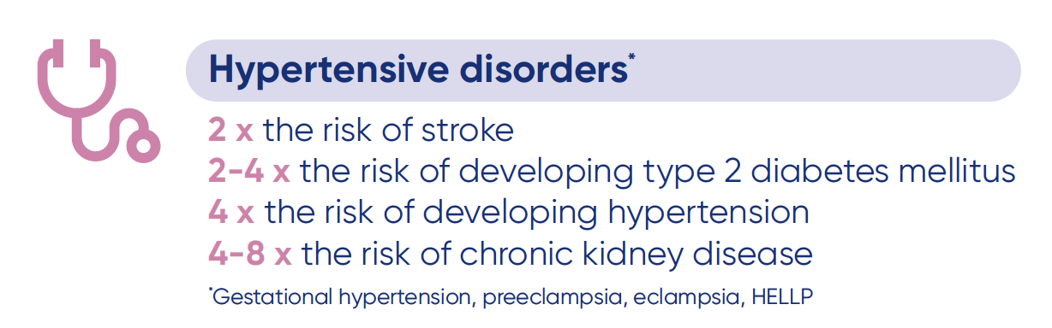
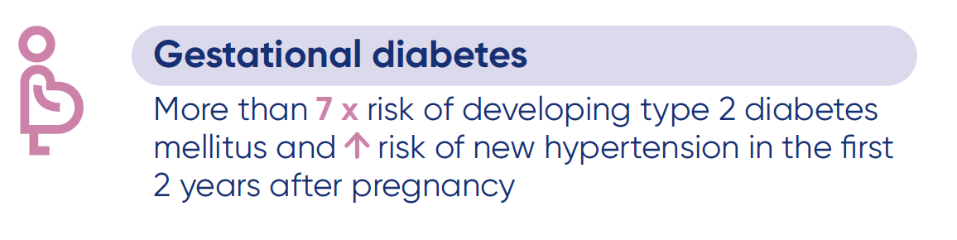

Slide 81
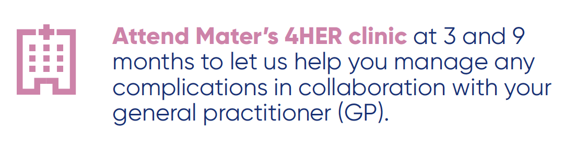
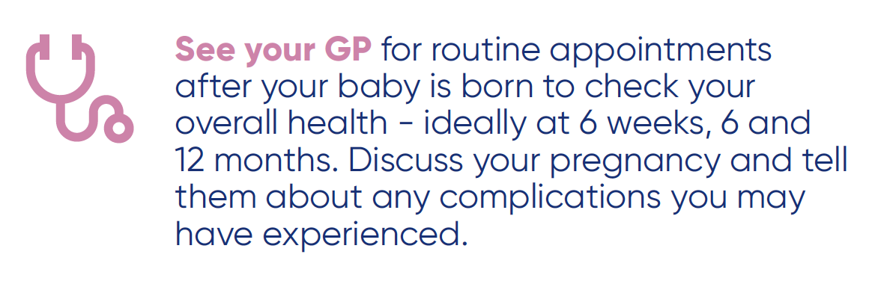
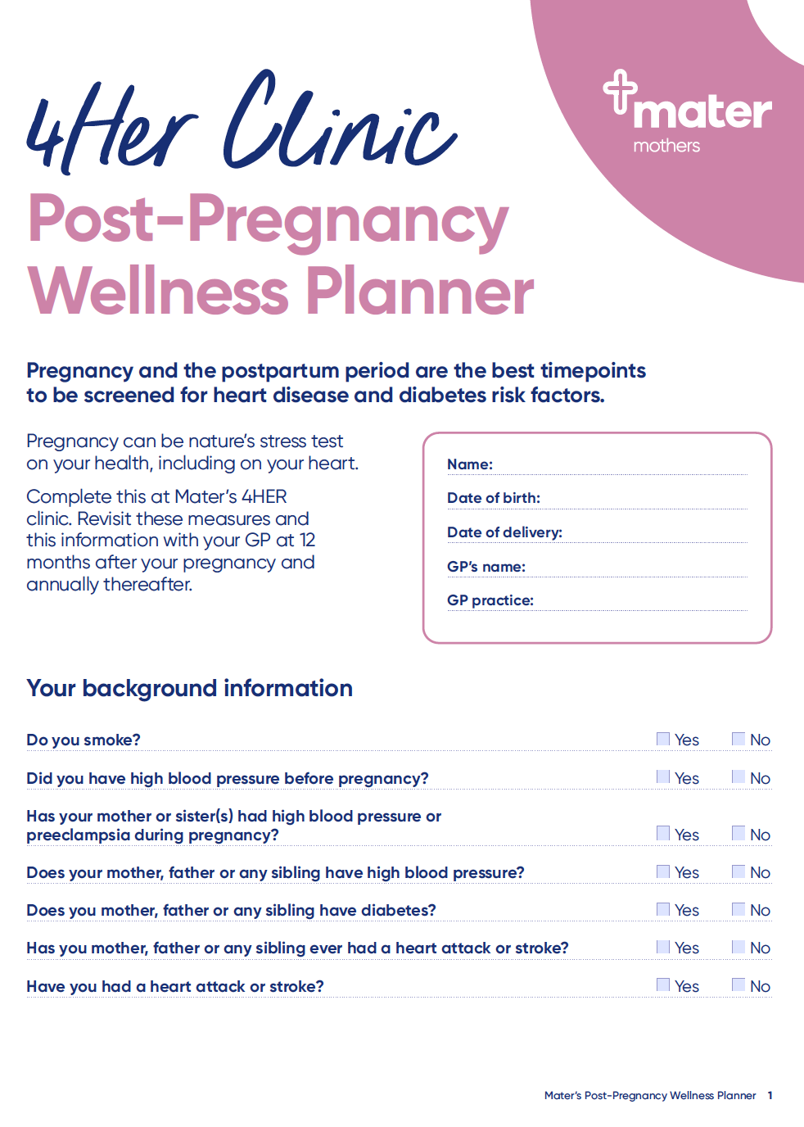

Mater’s 4HER website ->
- Info for women and GPs
- Women’s wellness planner
Videos:
- 4HER
- Nutrition 4HER
- Exercise after pregnancy

Slide 82
Why is thyroid disease important in pregnancy?
Hyperthyroidism
Fetal / neonatal hyperthyroidism
Increased perinatal mortality
Pulmonary Hypertension (uncontrolled)
Preeclampsia
Miscarriage
Premature labour
Placental abruption
Infection
Hypothyroidism
Infertility
Risk miscarriage
Reduced IQ children
Increased risk of hypertensive disorders of pregnancy
Placental abruption
Preterm delivery
Perinatal morbidity and mortality
PPH

Slide 83
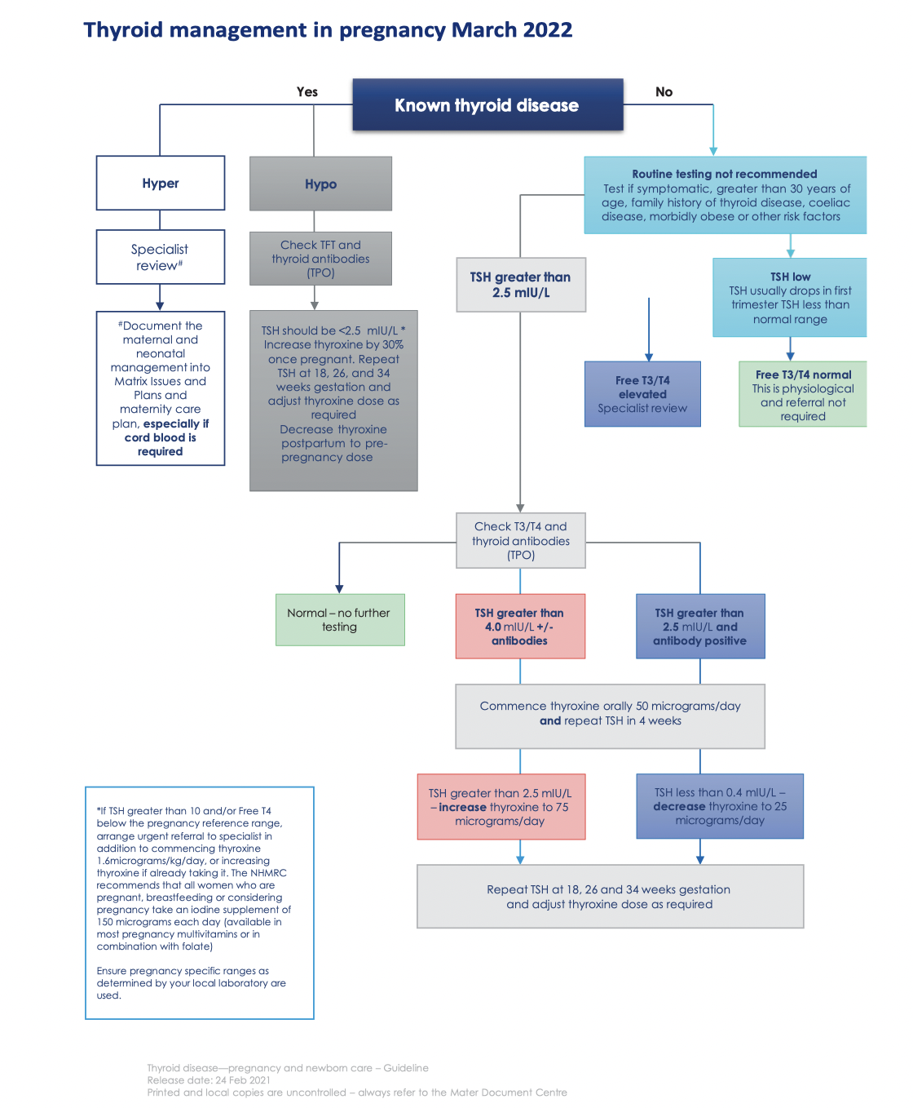

Page 33 of the Mater Guideline

Slide 84
Hypothyroidism
Let’s revisit
Overt hypothyroidism – increase thyroxine dose by 30% at conception. TSH >10? Commence thyroxine & refer urgently
Measure TSH at first visit; 6/52 later; then end 2nd and 3rd trimester if normal
Reduce back to preconception dose postpartum
Aiming for TSH < 2.5-1st trimester, < 3 - 2^{nd-}trimester, < 3.5 -3rd trimester
24 % of Australian women are positive for thyroid antibodies
Studies regarding treatment of euthyroid anti-TPO antibody women with thyroxine are inconclusive with respect to reduction in miscarriage and adverse pregnancy outcomes – so don’t routinely test!

Slide 85
Managing Thyroid issues- tips
Don’t routinely test for TFT in pregnancy in low-risk women!
Ensure those on thyroxine are taking it first thing in the morning on an empty stomach and NOT with pregnancy vitamin or iron
Most common cause suppressed TSH in first trimester is hCG mediated hyperthyroidism ~ 10% women
Occasionally Free T4 and Free T3 mildly elevated
Is differentiated from Graves’ disease by the presence of TSH receptor antibody and increased colour flow Doppler sonography on US
Don’t treat – will resolve in 2nd trimester RANZCOG guideline

Slide 86
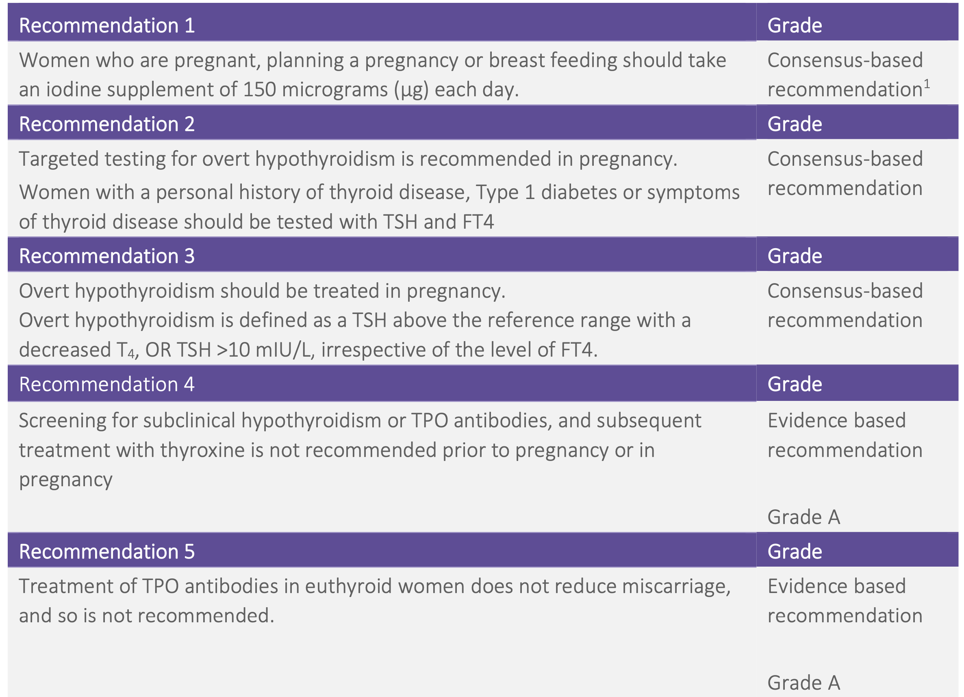

Subclinical hypothyroidism and hypothyroidism in pregnancy (RANZCOG)

Slide 87
Hyperthyroidism
Graves’ Disease most common cause throughout pregnancy
Rx with propylthiouracil 1st trimester; carbimazole 2nd and 3rd trimester
~ 60 % women able to have medications weaned by end 2nd trimester – need to watch for postpartum flare
Check TFTs every 4-6 weeks
TSH receptor antibody titre predicts risk fetal / neonatal thyrotoxicosis
Our Obstetric Physicians will sort this out!

Slide 88
Thank you
… Questions?
matermothers.org.au

Slide 89
Obesity in Pregnancy
MMH FRANZCOG Yanyan Tijoe: Let’s revisit
BMI classification
Classification | Overweight | Obese Class 1 | Obese Class 2 | Obese Class 3
BMI | 25-29.9 | 30-34.9 | 35-39.9 | ≥ 40
At least 1/2 of antenatal patients at MMH are overweight or obese
BMI >/= to 35 is considered to represent significantly increased risks for pregnancy, birth and postpartum

Slide 90
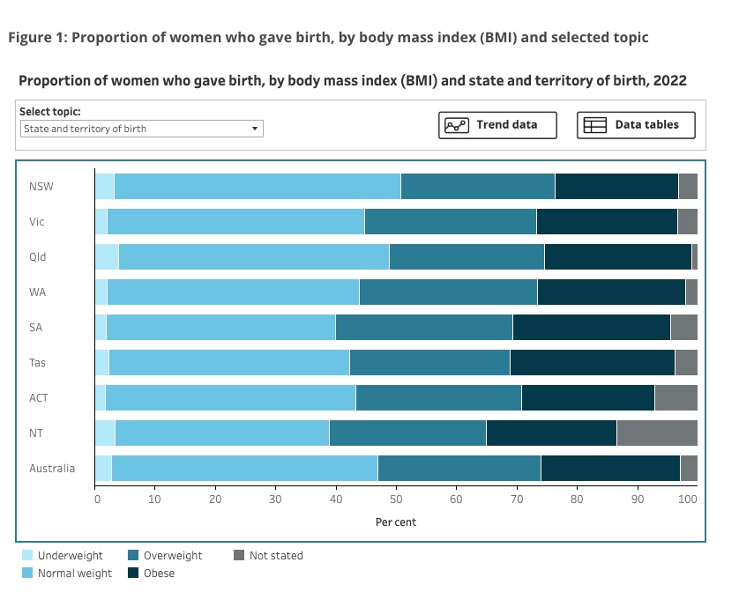
BMI of Australia’s birthing population, by state

Slide 91
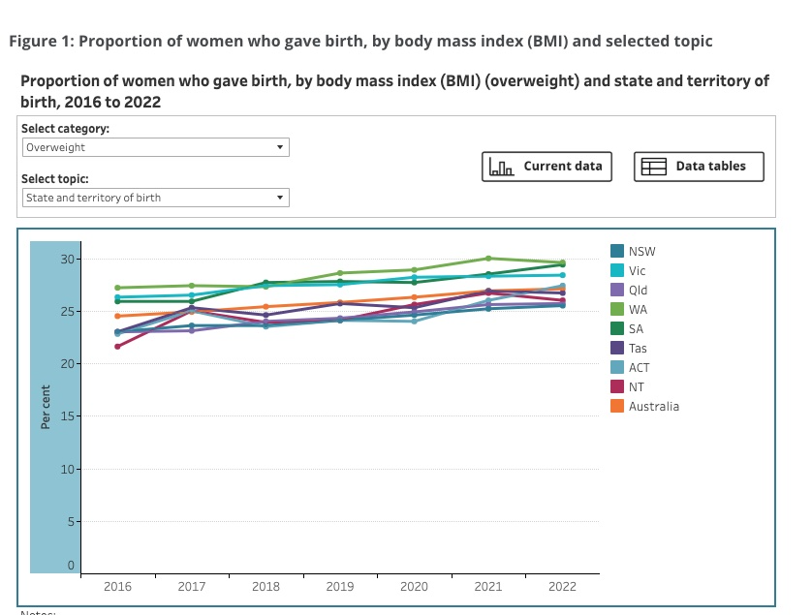
Overweight (BMI 25-29.9) rates in the birthing population, by state, 2016-2022

Slide 92
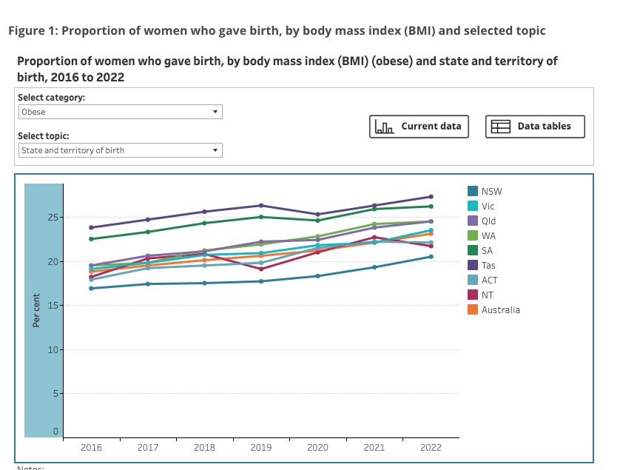
Obesity (BMI >/= 30) rates in the birthing population, by state, 2016-2022

Slide 93

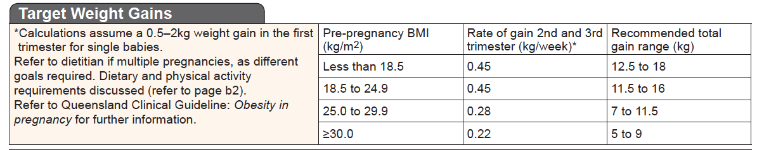
Obesity in pregnancy
It is recommended that all women are weighed each visit
Advise women of their target weight gain (see page 6 PHR) or use the MMH weight tracker or online weight gain tracker

Slide 94
BMI is important for triage
For women with a BMI >/= 30:
Routine scheduled bloods are recommended plus E/LFT, HbA1c (or early OGTT if k>12), and urine protein/creatinine ratio.
Advise women to take 5 mg of Folate daily preconception and in the first trimester as they have a higher risk of neural tube defects.
  Consider the following if obese with additional risk factors for:
    Hypertension - Low dose aspirin 150 mg/day,
    DVT - Antenatal thromboprophylaxis
Advise the hospital so they can organise appropriate internal referrals, eg: anaesthetist; consider suitability for a modified model of care.
BMI 40 + seen at k14, with Obstetric care or modified GP shared care. Not suitable for MGP or outreach (other than Springfield). Bariatric equipment is required.
Urinalysis with each visit and BP with extra large cuff
If early GDM screening is negative, an OGTT is to be performed at 26-28 weeks

Slide 95
Maternal Risks of Obesity
      Higher risk of
        GDM, Type 1 & 2 diabetes
        Hypertensive related disorders
        Thromboembolism
        Obstructive sleep apnoea
        Conditions which lead to induction of labour
        Complications in labour – decreased vaginal, increased caesarean births
        Anaesthetic complications
        Post operative complications
        Postnatal complications i.e. lactation difficulties, thromboembolism

Slide 96
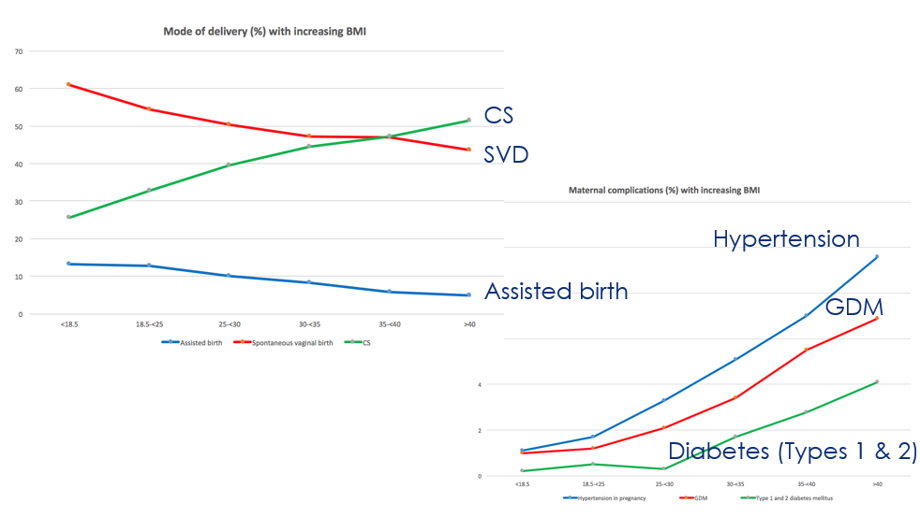
Frequency of adverse outcome increases with increasing BMI. The following charts are based
on analysis of 75,432 women birthing at Mater Mothers Hospital Brisbane 1998-2009
McIntyre HD, Gibbons KS, Flenady VJ, Callaway LK. Overweight and obesity in Australian
mothers: epidemic or endemic? Med J Aust. 2012; 196(3):184-8.

Slide 97
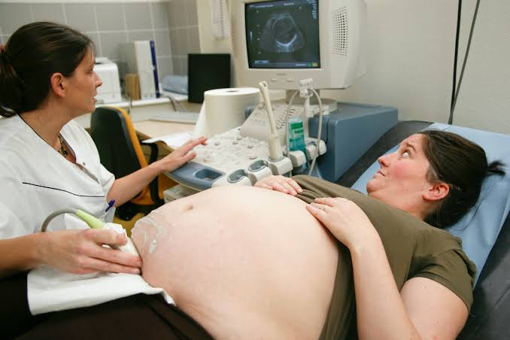
SFH? Lie, presentation?
Maternal obesity
Practical Issues
BP measurement
Bed weight capacity
Theatre trolley movement & patient shifting
Ultrasonography – less reliable and risk of wrist/upper limb injuries for sonographers
Listening to fetal heart/CTG
Venous access

Slide 98
Fetal / neonatal risks of obesity
      Higher risk of
        Perinatal death
        Neonatal death
        Stillbirth
        Congenital anomalies: NTD, cardiovascular, cleft lip/ palate
        Missed diagnosis of anomalies
        Macrosomia
        Small for gestational age (easy to miss)
        Large for gestational age
        Prematurity (< 37 weeks)
        Mechanical ventilation
        Jaundice
        Respiratory distress syndrome
        Hypoglycaemia

Slide 99
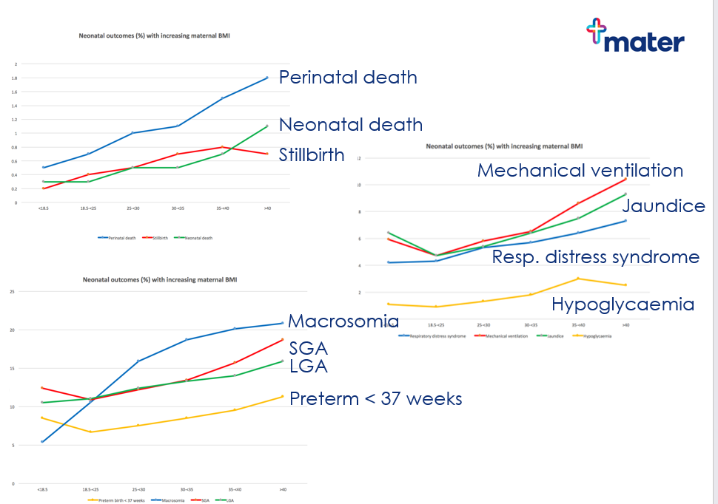

Slide 100
Talk to women about the risks
Maternal obesity
Antenatally
  Limitations on ultrasound screening for fetal anomaly and growth
  Reduced accuracy of NIPT
  “Fetal anomaly screening is incomplete due to maternal body habitus”
  Increased risk of diabetes, hypertension
Intrapartum
  Difficulty with monitoring fetal wellbeing in labour
  Increased likelihood operative birth
  Increased risk of anaesthetic difficulties
Postpartum
  Increased risk of thromboembolism
  Problems with establishing effective lactation
Treat as an opportunity for long term behaviour modification and offer dietitian referral

Slide 101
What will the hospital be doing?
Shared antenatal visits with GP if otherwise low risk
Offering dietetic support
  Anaesthetic referral for BMI >/=40
  Serial scans if required, to monitor fetal growth
    Risk unrecognised IUGR
    28, 34/40 if BMI >40
  Facilitating discussion about timing and mode of birth
    VBAC/IOL/anaesthetic risks in labour

Slide 102
Bariatric Surgery
Is becoming increasingly common in the birthing population
May not be readily mentioned by patients (some may not realise it’s a significant part of their medical history, some feel embarrassed or ashamed to mention) so ask specifically when taking a history
Has implications for pregnancy:
    Pregnancies occurring during the rapid post-procedure weight loss phase (typically first 18 months post-op) are at increased risk of fetal growth restriction, hence ideally pregnancy should be avoided during this phase, and if it occurs should be monitored for IUGR with serial scans
    Micronutrient deficiencies are more common (calcium, folate, iron, selenium, zinc, Vit A, B1, B12, D) – consider testing each trimester, and additional supplements / dietitian input may be required
    Patients who have had bariatric surgery should not undergo OGTT:
    Many will not tolerate the glucose challenge and will have vomiting
    Results often difficult to interpret (rebound hypoglycaemia due to dumping syndrome)
    One week of home BSL monitoring is the preferred screening method for GDM after bariatric surgery
    Gastric sleeve is usually associated with fewer pregnancy complications than gastric bypass – the preferred option for those considering bariatric surgery pre-pregnancy

Slide 103
What about GLP-1 agonists?
Contraception use advised with GLP-1 agonists in women of childbearing age
Not recommended to use during pregnancy or breastfeeding
Recommended washout period 2 months prior to conception
Risks of stopping: weight gain, poor glycaemic control

Slide 104

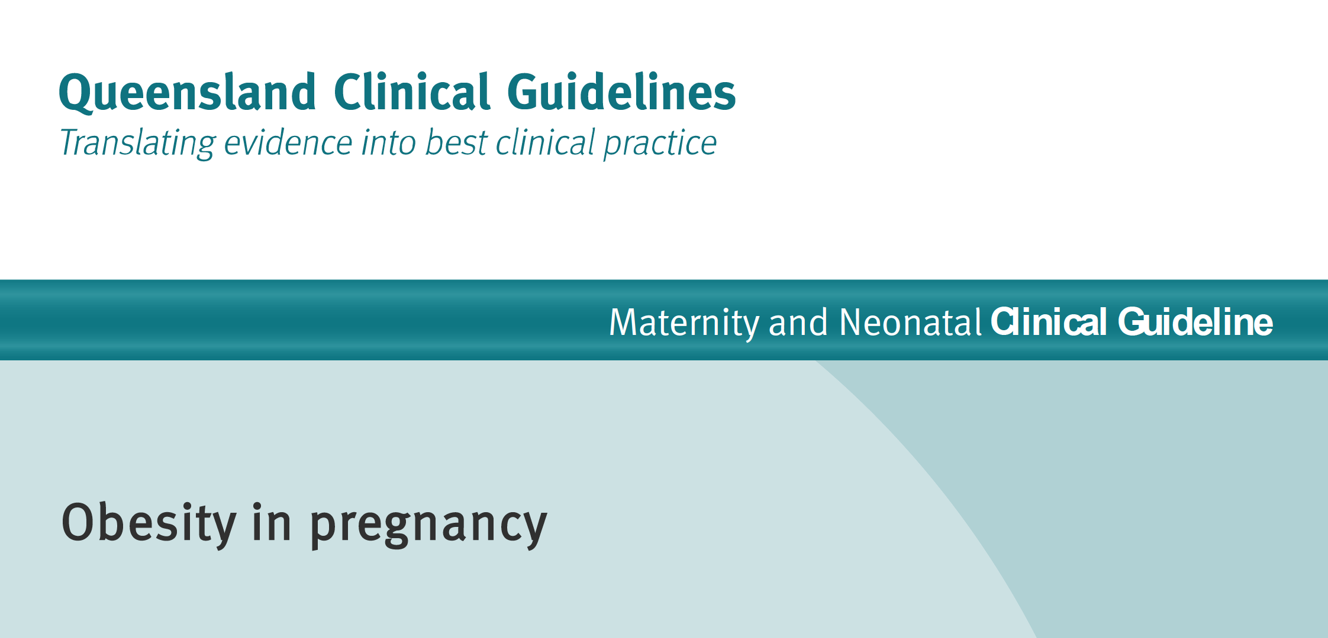
Obesity guidelines
http://www.health.qld.gov.au/qcg/

Slide 105
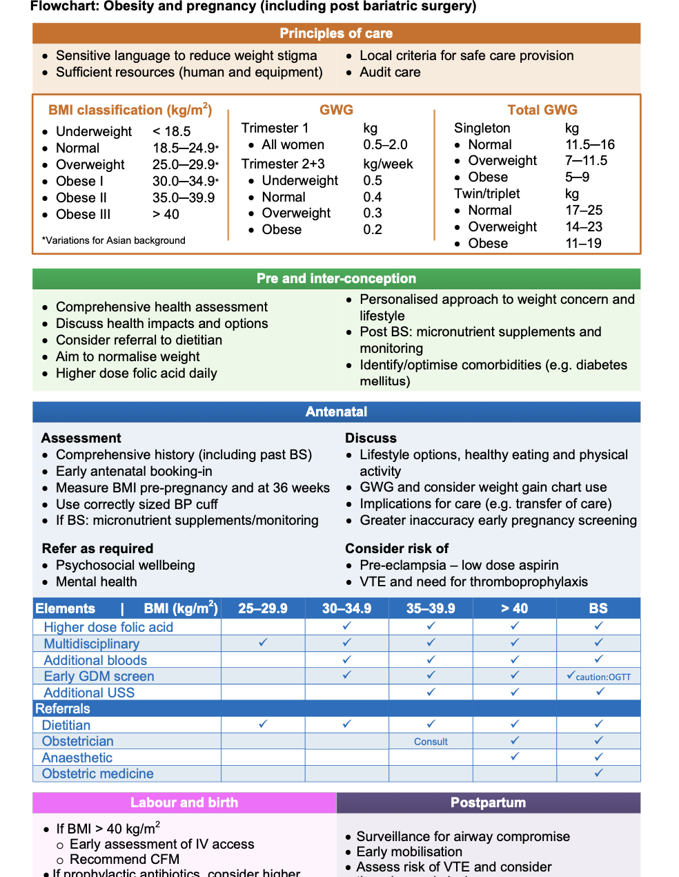

QCG Obesity
Refer early, including for dietitian support, women who have had bariatric surgery

Slide 106
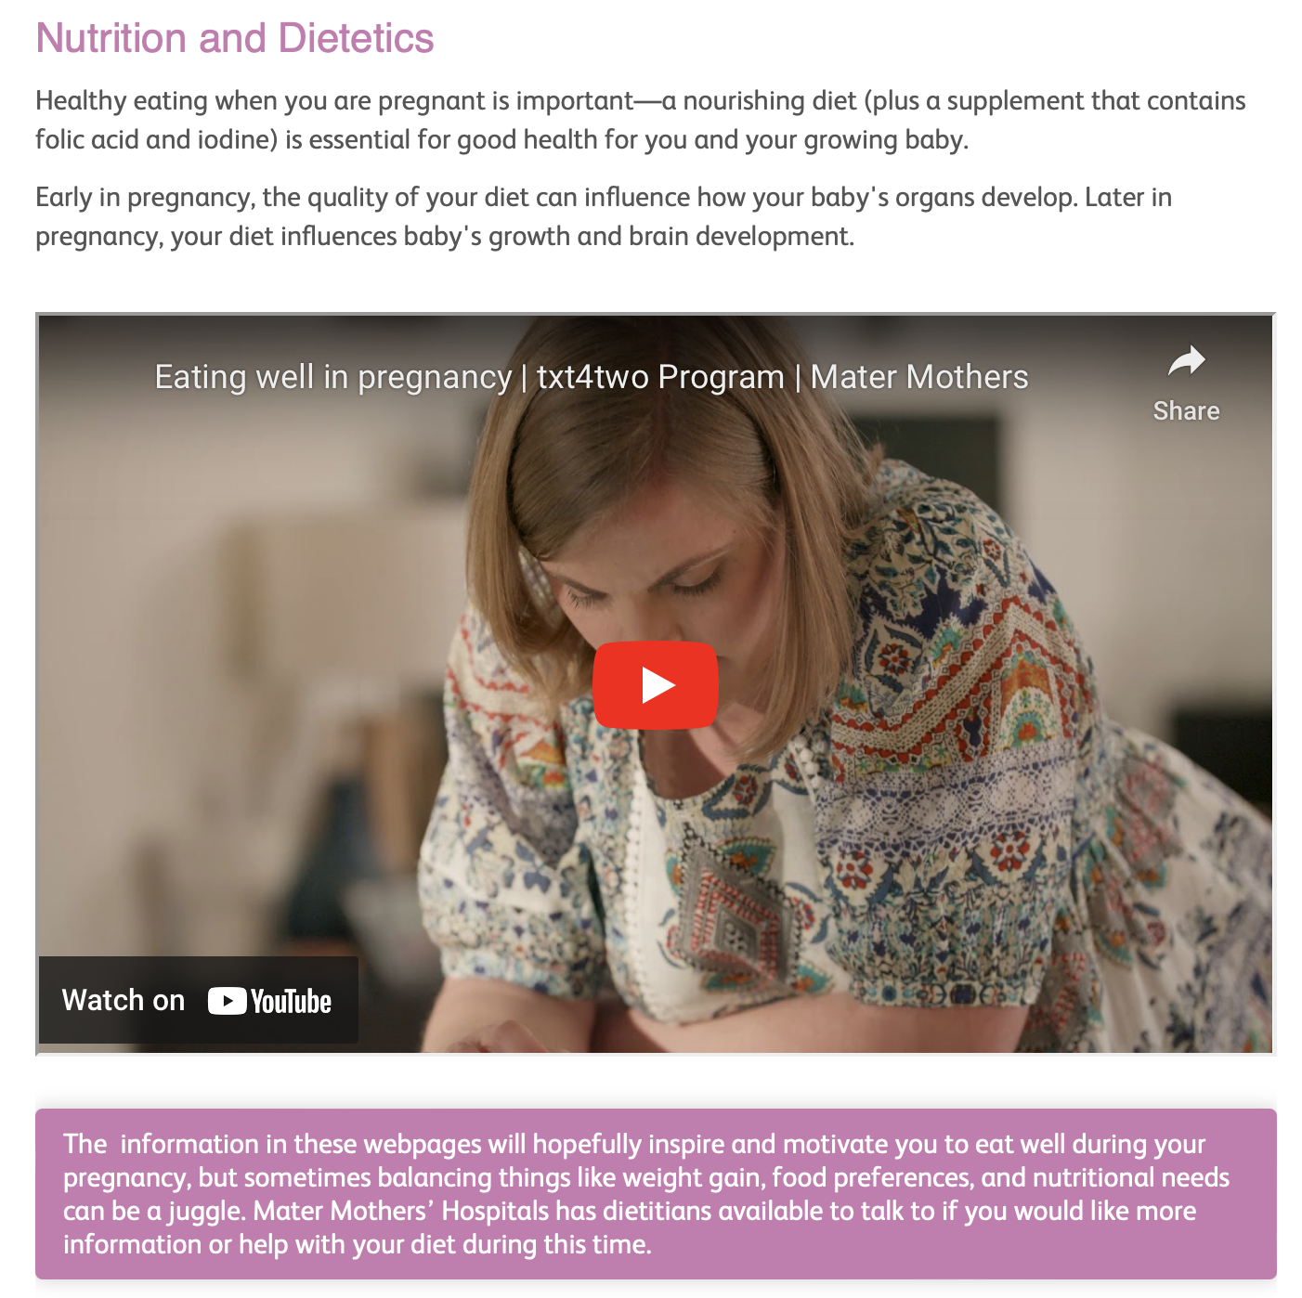

Nutrition and Dietetics advice

Slide 107
Screening
- Chromosomal
- Reproductive Genetic Carrier Screening
- Fetal Rhesus Status
- Pre-eclampsia
- CMV (Cytomegalovirus)
Dr Scott Petersen
Senior Specialist in Maternal Fetal Medicine
Mater Centre for Maternal Fetal Medicine
matermothers.org.au

Slide 108
How to approach screening …..
Screening in pregnancy is ever changing:
  The Traditional…
    Antenatal screening
    Chromosomal
  The expanding list …
    Reproductive Genetic Carrier Screening
    Fetal Rhesus Status
    Pre-eclampsia
    CMV (Cytomegalovirus)

Slide 109
How to approach screening …..
Each pregnancy
  Antenatal screening
  Chromosomal screening
Once only, and ideally before the first pregnancy
  Reproductive Genetic Carrier Screening (RGCS)
Contingent screening
  Fetal Rhesus Testing
  Pre-eclampsia
  CMV (Cytomegalovirus)

Slide 110
How to approach screening …..
Each pregnancy
  Antenatal screening
  Chromosomal screening
Once only, and ideally before the first pregnancy
  Reproductive Genetic Carrier Screening (RGCS)
  CMV IgG +ve mothers
Contingent screening
  Fetal Rhesus Testing (Rhesus negative mothers only)
    Red Blood Cell antibodies in every woman each pregnancy!
  Pre-eclampsia (First pregnancies/ Past history/ New Partner…? Each pregnancy)
  CMV (Cytomegalovirus) (Seronegative mothers need screening each pregnancy)

Slide 111


Slide 112
Some recommendations are old and not updated ….
Chromosomal screening ….
Approved by NHMRC in December 2011; expires December 2016
CMV

Slide 113
Some recommendations are old and not updated ….
Chromosomal screening ….
Approved by NHMRC in December 2011; expires December 2016
CMV

Slide 114
Chromosomal Screening
National Perinatal Statistics Unit last reported on congenital anomalies in Australia in 2002–03:
- Trisomy 21 was the most commonly reported (chromosomal) condition at birth (1.11 per 1,000 births = 1 in 901 births) but there was a high proportion (60%) of fetal deaths and terminations. When terminations were included, the estimated rate was 2.63 per 1,000 pregnancies (1 in 380).
More recent Victorian data on antenatal diagnoses of chromosome anomalies based on amniocentesis and chorionic villus sampling results from 2013–15:
- Estimated detection rate for Trisomy 21: 2.61 per 1,000 births (1 in 380);
- Estimated detection rate for Trisomy 18: 0.5 (1 in 2,000);
- Estimated detection rate for Trisomy 13: 0.3 per 1,000 births (1 in 3,333) respectively [873].
Queensland in 2010: Rates of trisomies 21, 18 and 13 were reported as 1.4, 0.5 and 0.1 per 1,000 births

Slide 115
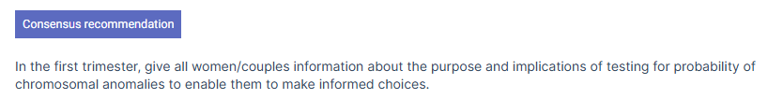
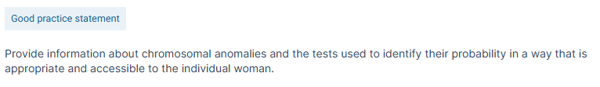
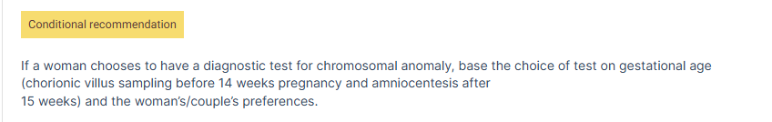

Chromosomal Screening
Approved by NHMRC in December 2011; expires December 2016
No NIPT reference….!
This is not quite true … we clinically consider likelihood of confined placental mosaicism to guide test choice in addition

Slide 116
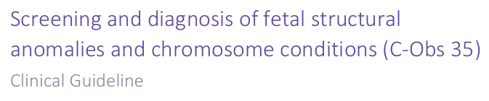


September, 2024

Slide 117

Each patient should be counseled in each pregnancy about options for testing for fetal chromosomal abnormalities.
  not only the risk of fetal chromosomal abnormalities
  but also the relative benefits and limitations of the available screening and diagnostic tests.
Testing for chromosomal abnormalities should be an informed patient choice based on provision of adequate and accurate information, the patient’s clinical context, accessible health care resources, values, interests, and goals.
All patients should be offered both screening and diagnostic tests, and all patients have the right to accept or decline testing after counselling.

Slide 118



September, 2024

Slide 119
Chromosomal screening
Diagnosis vs Screening
  Diagnostic testing requires cells = invasive
    Both NIPT and CFTS are screening tests
      NIPT: screens directly DNA
      CFTS: screens indirectly based on markers/associations
Statistical considerations for screening:
  Clinical prevalence in population
  Detection rate/ sensitivity
  Specificity (ability to exclude/be a true negative)
  Positive Predictive Value (PPV)
    Diagnosis made when test suggests high probability
    Impacted upon by prevalence of the condition screened

Slide 120

Positive Predictive Value (PPV)
Clinical Definition:
  PPV calculated from test parameters and prevalence of the condition = (sensitivity x prevalence) / ((sensitivity x prevalence) + (1 – specificity)(1 – prevalence)).

Slide 121


NIPT Calculators

Slide 122


Slide 123


Clinically … we use ultrasound features!

Slide 124
Chromosomal screening
Mosaicism
  two or more genetically different cell lines within the tissue sampled
    Fetal-placental mosaicism: 2–3% of pregnancies
    Eg trisomy rescue if abnormal conceptus
    CVS more commonly mosaic than amniocentesis (true)
      Placenta has high cellular turnover
      NIPT: Cell-free “fetal” DNA of Placental origin = trophoblast
    Risk of mosaicism in a chorionic villus sample (CVS) following a positive NIPT result for common aneuploidies:
      Trisomy 21 – 2% Trisomy 18 – 4%
      Trisomy 13 – 22% Monosomy X (45,X) - 59%

Slide 125


Non-invasive Prenatal Testing (NIPT)
  Counting/ratio based
  Molecular NOT karyotyping or whole chromosome
What NIPT testing is available?: 2 platforms
  Sequencing: from 10+ weeks
    Generation (QML); Sonic (S&N); Percept (VCGS); Harmony; Echidna
      Percept (gw-NIPT only) available at Mater
  Single nucleotide polymorphism (SNP): from 9+ weeks
    Panorama (Natera)
      Available through Mater MFM and Haven Ultrasound

Slide 126
What NIPT testing is available
Sequencing
    Basic – common trisomies and sex chromosomal abnormalities
    Genome-wide (gw) – includes RATS/ SI but not microdeletions
      Eg Percept
    Basic + microdeletions
  Issues:
    Multiple Pregnancies: Which baby? Does not distinguish
      Not validated in triplets but VCGS will report
    Triploidy: cannot exclude as no ratio difference detected

Slide 127
What NIPT testing is available
Single nucleotide polymorphism (SNP)
  Panorama
    Limited to “3 DNA sources” so not used if triplets or donor egg/ surrogacy with twins
    Benefits:
      22q11.2 microdeletion (DiGeorge) syndrome at no extra cost
      Triploidy
      Zygosity
        distinguishes between the twins
        identical and non-identical twins
        Validated in vanishing twin pregnancies (best after 12 weeks)
      Fetal Rhesus status

Slide 128
False positive NIPT results:
    Confined Placental mosaicism
    Twins (vanishing twin)
    Maternal CNVs (copy number variation)
    Maternal cancer/ Fibroids
    Maternal transplantation (Bone Marrow/ Organ)
False negative NIPT results:
    Maternal CNVs -translocation; mosaicism
No result ~3%
    Due to maternal obesity, low fetal fraction, dating error

Slide 129
Combined First Trimester Screening (CFTS)
Maternal Age
Ultrasound
- Biometry
CRL –Gestational Age
Nuchal translucency (NT)
- Nasal Bone
Biochemistry
PAPP-A
BhCG
Reports Probability
> 1in 300 as high

Slide 130
Chromosomal screening: NIPT vs CFTS
NIPT - not medicare rebated
  Direct test of DNA – superior chromosomal screening test
    Detection rates > 95%; high specificity
  Low false +ve rate (1/1000 or 0.1%)
    Confined placental mosaicism; Vanishing twin context
CFTS – medicare rebated
  Marker/ association based test
    Detection rates ~ 90%; high specificity
    High false +ve rate ~ 5%
  Increase pick-up beyond NIPT as combines ultrasound with biochemistry

Slide 131
Chromosomal screening
What else is screened?
NIPT
  DNA
    Chromosomal conditions
      Can report not just common trisomies (T13 / T18 / T21)
    Genetic conditions
      Fetal Rhesus Testing
      Autosomal/Recessive/X-linked conditions
Combined First Trimester Screen
  Ultrasound + Biochemistry
    Reports on the probability of the common trisomies (T13 / T18 / T21)
    Ultrasound
      Morphology/ Anatomy + Biometry + Markers
      →Not a reliable screening test for the detection of chromosomal abnormalities on own
      Pregnancy viability; Vanishing multiple pregnancy
    Biochemistry
      Atypical chromosomal conditions + Placental function

Slide 132
Obstetric Ultrasound
First Trimester Ultrasound assessment
  Nuchal translucency (>=3.5 mm from 11-14 weeks)
  Lymphatic anomalies – cystic hygroma; cutaneous oedema
  Acrania (1:1,000)
  Alobar Holoprosencephaly (1:1,300); Encephalocele (1:5,000)
  Spina Bifida (1:2,000) – screening based on intracranial signs
  Absence of arms, hands, legs or feet (1:2,000)
  Exomphalos/ Omphalocele (1:3,500); Gastroschisis (1:2000)
  Amniotic Band Anomaly/ Body Stalk Anomaly (1:7,500)
  Sirenomelia (1:60,000)
  Conjoined Twins (1% of monochorionic twins)

Slide 133


Chromosomal screening:
What is screened?
Common Trisomies:
  “Three copies of a chromosome”
      Non-disjunction = classical biological effect of increasing maternal age
      Unbalanced chromosomal rearrangement
  Trisomy 21 (Down Syndrome); T18; T13
      Most common
      Screened at NIPT and CFTS
Non-disjunction

Slide 134
Chromosomal screening:
What else is screened?
Options on NIPT:
  Sex
    Male or Female
    Does not evaluate for sex chromosomal abnormalities
      Eg Monosomy X reported as female
    Fetal sex is less reliably predicted at ultrasound based on phenotype
    Only SNP based NIPTS can differentiate between twins
      Percept/QML/Sonic/Harmony – if Y, then 1 or both twins?
      Panorama (SNP) – if Y then states 1 or both

Slide 135

Chromosomal screening:
What else is screened?
Options on NIPT:
  Triploidy
    “Three sets of chromosomes”
    Increase in all chromosomes
      Only screened at Panorama NIPT (SNP-based) only and CFTS
      Associated with partial molar pregnancies
      Incidence overall ~ 1-2% all conceptions but ~ 0.002% ongoing pregnancies

Slide 136
Chromosomal screening:
What else is screened?
Options on NIPT:
  Rare autosomal trisomies (RATs)
    trisomies not involving chromosomes 13, 18, 21, or sex chromosomes.
      Screened at genome-wide (gw) NIPT (eg Percept)
    incidence is low at 0.12% (1/835) to 0.39%
    pooled PPV of 11.46% (95% CI 7.80–15.65)
      Commonly present as confined placental mosaicism cases
      The autosomes 6, 7, 11, 14, 15, and 20 contain imprinted regions which cause parent-of-origin differential gene expression
    probability of a RAT being reported is reduced by having an ultrasound prior to NIPT collection confirming a viable, living, singleton pregnancy

Slide 137
Chromosomal screening:
What else is screened?
Options on NIPT:
  Segmental/ Subchromosomal Imbalances (SIs)
    unbalanced chromosomal re-arrangement > 7 MB in size
    Incidence ~ 0.07% - 0.16%
    PPVs 32- 47%
    genome-wide (gw) NIPT

Slide 138
Chromosomal screening:
What else is screened?
Options on NIPT:
  Microdeletion syndromes
    small subchromosomal copy number variants (CNVs), typically <5 Mb.
    22q11.2 microdeletion syndrome (DiGeorge syndrome or Velo-Cardio-Facial syndrome)
      1 in 2000, Panorama reports the incidence with their screen is higher-than-expected at 1/1,524 pregnancies in this cohort. The sensitivity is 83% and the PPV 53%.
    Cri-du-chat syndrome (5p15.33 deletion)
      1 in 15000-50000
    Wolf-Hirschhorn syndrome (4p16.3 deletion)
      1 in 20000-50000 (Females 2:1)
    Prader-Willi syndrome/ Angelman Syndrome
      Imprinting of chromosome 15q
      1 in 10000-12000.
    1p36 deletion syndrome
      1 in 5000-10000

Slide 139
Chromosomal screening
Definitions:
  Atypical chromosomal abnormalities
    Not the common trisomies or sex chromosomal abnormalities
      Includes RATs + microdeletions + other variants
      Not all examples detected at NIPT
    Prenatal diagnostic chromosomal testing
    ~ 0.14% of pregnancies.
    Found in up to ~ 7% with risk factors:
      women above 45 years of age
      Features at CFTS
        increased nuchal translucency (NT) thickness (≥ 3.5 mm)
        ultrasound-detected abnormality or fetal growth restriction
        abnormal biochemistry results
          pregnancy-associated plasma protein-A (PAPP-A) <0.2 MoM
          free β-human chorionic gonadotropin (<0.2 or ≥ 5.0 MoM)

Slide 140



Slide 141

Recommendations
Standard NIPT
  NIPT is the most accurate screening test for the common autosomal aneuploidies (trisomies 21, 13 and 18) in unselected singleton populations, and those at known increased probability.
  NIPT for Sex Chromosomal Abnormality (SCA) is sufficiently accurate to be offered alongside autosomal aneuploidy screening with specific pretest counseling and consent.

Slide 142

Recommendations
Recommendation: ACMG suggests NIPT for 22q11.2 microdeletion syndrome be offered to all patients (conditional recommendation, based on moderate certainty of evidence)
© 2022 American College of Medical Genetics and Genomics.
      1 in 2000, Panorama reports the incidence with their screen is higher-than-expected at 1/1,524 pregnancies in this cohort. The sensitivity is 83% and the PPV 53%.

Slide 143
First Trimester Chromosomal Screening
Each pregnancy; Every pregnant woman
Management
  CFTS – high probability
    Consider NIPT if only continuing the pregnancy and not acting on the result
    DO NOT consider NIPT and REFER for consideration of diagnostic testing if:
      increased nuchal translucency (NT) thickness (≥ 3.5 mm)
      ultrasound-detected abnormality or fetal growth restriction
      abnormal biochemistry results
        pregnancy-associated plasma protein-A (PAPP-A) <0.2 MoM
        free β-human chorionic gonadotropin (<0.2 or ≥ 5.0 MoM)

Slide 144
First Trimester Chromosomal Screening
Each pregnancy; Every pregnant woman
Management
  NIPT – high probability
    Refer for ultrasound evaluation and consideration of diagnostic testing
    →Following a positive NIPT result in the absence of a significant fetal structural anomaly (FSA), care is required in selecting the optimal diagnostic invasive test

Slide 145

Chorionic Villus Sampling (CVS)
TA or TC
  Loss 1/450
Early gestation
Access to placenta
Placental chromosomal mosaicism ~1%
Reliable for gene testing
11-14 weeks
    TA - CVS

Slide 146

Amniocentesis (15+ weeks)
- Loss 1/900
- Low mosaicism rate = true

Slide 147

Metaphase Karyotype
(14 days)
FISH (48hours)

Slide 148
After NIPT, CVS vs amniocentesis
Considerations:
  Timing of diagnosis
    Affects termination of pregnancy decisions
    Stress of awaiting diagnostic testing
  Role of ultrasound
    Major chromosomal abnormalities are associated with abnormalities on assessment of morphology and biometry even at the early anatomy/ structural assessment
  Mosaicism
    Confined placental mosaicism (CPM) may underlie a positive NIPT result (esp. gw-NIPT RATs)
      amniocentesis is the single most informative test for fetal karyotype.
      CPM indicates serial growth scans given association with fetal growth restriction

Slide 149


Slide 150



Slide 151


Slide 152


Slide 153

VCGS website = PrePair

Slide 154
Recessive Gene Carrier Screening
Preferable to screen before a couple conceives so that they have time to understand and consider their reproductive options
Medicare rebatable for 3 Autosomal Recessive Genetic Diseases
  Cystic fibrosis (1 in 25; births 1 in 2,500)
  Spinal Muscular Atrophy (1 in 40; births 1 in 6-10,000)
  Fragile X (1 in 150; for births 1 in 4,000 males)
Sequential screening - one member of the couple is screened (usually the woman since the woman’s carrier status for x-linked conditions is relevant)

Slide 155



Mackenzie’s Mission

Slide 156


CFTR, SMN1, and FMR1 accounted for 44% of at-risk couples with high-clinical-impact results, meaning that 56% of at-risk couples with high-clinical-impact results would have gone undetected if screening had been limited to these genes alone, as is currently funded by the Australian Medicare system.
In Mackenzie’s Mission, these three genes (CFTR, SMN1, and FMR1) accounted for 33% of couples at risk for severe or profound conditions

Slide 157
Recessive Gene Carrier Screening
~3000 genetic conditions are considered significant to the paediatric population
Other options:
  Extended panels are available:
    Myriad (QML) – 175 conditions $579;
    Beacon (Sonic) - 400 conditions (includes 50 X-linked) $595;
    Horizon (Natera) – 14 conditions as standard (1 in 7 mothers are carriers)
    PrePair (VCGS) – 500 to 1000 conditions
    Lumi Health – matches the McKenzie Mission

Slide 158

Genetic Carrier Screening
Genetic Carrier Screening
C-Obs 63
Current: March 2019
Options if familial carriage include:
1. Having a child naturally and testing after birth to see if the child is affected.
2. Conceiving naturally and having diagnostic testing during pregnancy to determine if the fetus is affected. This is usually performed with an invasive test (amniocentesis or chorionic villus sampling).
3. Conceiving the pregnancy by in vitro fertilisation (IVF) and testing embryos by preimplantation genetic diagnosis (PGD). Unaffected embryos would then be selected for achieving pregnancy.
4. Using donor sperm, egg or embryo from unaffected individuals.
5. Adoption.
6. Not having children.

Slide 159
Recessive Gene Carrier Screening
Management
  Record the result as it gets done only once!
    AR: 1 in 4 each pregnancy
    X-linked: 1 in 4 each pregnancy but 1 in 2 if a male
  Discuss options
    Prenatal diagnosis:
      invasive test
        chorionic villus sampling
        amniocentesis
    Non-invasive prenatal diagnosis (NIPD)
      Monogenic testing of cffDNA
      single-gene NIPT
      The future….

Slide 160

Prenatal Rhesus Testing

Slide 161
Prenatal Rhesus testing
PCR test unlike chromosomal NIPT tests
Medicare covered
  No limit…
    Screening Test: 73420
    Alloimmunised Specialised Testing: 73421
    Red Cross information:
      False negative RHD NIPT result: 0.2% or 1/500 given low fetal cell free DNA below the limit of detection → not receiving antenatal RhD-Ig + assuming routine postnatal Rh D immunoprophylaxis → ~ 2% isoimmunised
      Risk of alloimmunisation with full universal RhD immunoprophylaxis: ~0.2% or 1 in 500.

Slide 162
Prenatal Rhesus testing
Red Cross:
  Rhesus NIPT - NIPT for Fetal RHD status from 15 weeks
    No isoimmunisation history
    QIAcuity digital Polymerase Chain Reaction (dPCR) assay for allele/s : RHD*01/RHD*01N; Target: Exon 5, 7 and 10; Ag prediction D+/D-
    Limit of detection for this assay is 0.025% Fetal fraction.
    Accuracy based on the validation/ study data: 100% (95%CI 97.2-100%).
    PPV ≥98%; NPV ≥ 98%.
    A repeat collection and test is advised to confirm negative results in order to minimise the risk of false
    RHD pseudogene
      maternal RHD variants: not determine the fetal RHD status; universal immunoprophylaxis/ managed as if the mother is RhD negative
      paternally inherited RHD variant: may be reported as “RHD detected” predicting a fetal RhD positive phenotype, which may not match the cord blood RhD phenotype at delivery.
  NIPA for Clinically Significant Fetal Antigens from 12 weeks
    In isoimmunised women
    Bio-Rad Droplet Digital PCR system (ddPCR).
    Allele/s : RHD*01/RHD*01N; Target: Exon 5 and Exon 10

Slide 163
Prenatal Rhesus testing
Different labs with different aspects
  Red Cross:
    Rhesus NIPT from 15 weeks
    NIPA for Clinically Significant Fetal Antigens: from 12 weeks
    No multiples
  Sonic:
    From 11 weeks; multiples ok; if fetus predicted to be Rhesus negative, then repeat after 18 weeks; Sensitivity >98% single; >99% for multiple tests
  QML/4-Cyte: Red Cross
  VCGS: → no test
  Panorama (Natera)
    at standard NIPT; no dizygotic twins but in identical twins ; identify the RhD pseudogene (RHDψ) and RHD-CE-D hybrid gene
    Not performed in Australia but no additional cost (medicare not relevant)

Slide 164



Slide 165
Pre-eclampsia screening
In Australia, PET complicates ~ 0.4% (1/250) < 34 weeks and ~ 3% < 37 weeks pregnancies.
PET screening should always be considered in a first pregnancy.
Aspirin for Evidence-Based Pre-eclampsia Prevention (ASPRE):
  low-dose aspirin prophylaxis in high-risk women before 16 weeks of gestation reduced the prevalence of preterm PET by 62%.
Screening helps identify cases at high probability of early onset, which is the group that best responds to management with aspirin to modify this risk.
  Pre-eclampsia before 37 weeks

Slide 166
Pre-eclampsia screening
Where:
  Mater – selective private cases
  Specialised Obstetric Ultrasound Centres: Haven/ QUFW/SOGI/ Some Radiology
11-14+1 weeks
  Not CRL dependent
Screening in pregnancy is based on maternal history, mean arterial pressure, uterine artery mean-PI and biochemistry measures
  PAPP-A
    Traditional
    from earlier gestations than PlGF
  PlGF is the recommended biomarker for pre-eclampsia screening available from 11 weeks
    Improves sensitivity over PAPP-A alone by 31%

Slide 167

CMV
Congenital infection of CMV occurs in approximately 6 out of 1000 births in Australia.
A common mode of transmission to pregnant women is through contact with saliva or urine of young children (including their own).
Emerging international evidence suggests that universal antenatal CMV screening in the first trimester before 14 weeks may be effective and cost-effective in certain settings, with some countries beginning to adopt this approach. However, their applicability to the Australian context remains uncertain…
Prompt diagnosis and treatment with valaciclovir may be more effective earlier in pregnancy thus early and timely referral and review from clinicians experienced in CMV management may improve treatment outcomes.

Slide 168






Slide 169



CMV
Non-symptomatic serology testing = Exposure-based testing should be with IgG serology only and is advised as early as possible during the first trimester.
- My addition: Consider avidity to confirm as false +ve IgG serology happens; if high avidity = past infection/exposure
Where there is a clinical presentation suggestive of possible CMV infection, serology testing should be conducted for CMV IgG and IgM plus IgG avidity, if CMV IgG and IgM are positive. Diagnosis of primary CMV is based on the new appearance of CMV-specific IgG in a woman who was previously seronegative or the detection of CMV IgM antibody with low IgG avidity.

Slide 170
Prevention
Anti-viral treatment – Secondary prevention
  Valaciclovir to prevent vertical transmission
    precursor drug of acyclovir, a DNA polymerase inhibitor.
    acyclovir is subsequently converted into acyclovir triphosphate, exerts antiviral activity through DNA chain termination and disruption of viral DNA synthesis
    8 g/d of oral valacyclovir
      Side-effects: n=139 women - 29 (20.8%) nausea; 29 (20.8%) headache; 2 (1.4%) low platelets count; 3 women (2.1%) developed acute kidney injury – crystallization in tubules; resolved after cessation of treatment; prevented by fragmenting the administration and ensuring adequate hydration.
    Pack 500 mg [100] x 2 PBS: $200.00; Authority: 5975 Cytomegalovirus infection/disease

Slide 171



N=527 cases Studies: n=3
Reduced vertical transmission: aOR 0.34
(95% CI 0.18-0.61)
  both periconception and first trimester
Reduced neonatal infection aOR 0.30
(95% CI 0.19-0.47)
Reduced TOP aOR 0.23 (95% CI 0.22-0.24)

Slide 172
Thank you
… Questions?
matermothers.org.au

Slide 173
Break - we resume at 10:30
Alignment 1

Slide 174
SESSION 2:
Time | Session | Who
10:30 | Mater Springfield | Brooke Panadero, GPLM
10:35 | Physiotherapy | Dr Lok Tung Lee
10:40 | Mental health – general principles | Elizabeth Keays Perinatal Psychologist
10:55 | Pharmacology & pregnancy | Dr Treasure McGuire Pharmacist
11:10 | Case work | Anne Williamson (GPLM) Erin Hutley-Clark (GPLM) Brooke Panadero (GPLM) Dr Yanyan Tijoe Dr Treasure McGuire Dr Lok Tung Lee, Antenatal GP
12:50 | Conclusion | Dr Lok Tung Lee

Slide 175


Mater Mothers’ Springfield
New maternity service for Greater Springfield.
Multiple models of care to support a range of birthing journeys:
    GP Shared Care
    Midwifery Group Practice
    Obstetric/Midwifery Care
24/7 Pregnancy Assessment Centre.

Slide 176

Our catchment
The catchment for Mater Mother's has recently expanded to include Ripley, South Ripley, Swanbank, White Rock, Hillcrest, Forestdale, Browns Plains, Boronia Heights and Regents Park.
The catchment is based off a patient’s home address – GP clinics outside this catchment are still able to refer if their patients fall within the area.

Slide 177

Our catchment

Slide 178
Services Available
Services offered at Mater Hospital Springfield
Physiotherapist
Social Work
Lactation Consultant
General Medicine
Diabetes Educators
Dietitian
Indigenous Liaison Officer
Home Care
Services offered via Mater Mothers South Brisbane
Catherine's House
Perinatal Loss
Obstetric Medicine (for diabetic women)
Antenatal Classes
MFM

Slide 179
Eligibility Criteria
Low-moderate risk women
No anticipated child protection involvement
BMI <45 at birth
Exclusion criteria for Mater Hospital Springfield
BMI >45
Women requiring therapeutic anticoagulation antenatally.
Complex medical conditions.
Poorly controlled epilepsy.
History of complex abdominal surgery
Acute mental health disorders.
Women with complex, non-lethal, fetal abnormalities.
Women with complicated twin (MCDA/MCMA) or higher order multiple pregnancies
Women with preexisting T1 Diabetes Mellitus.
Placenta accreta spectrum disorders.
Anticipated or known difficult airway
Severe scoliosis or extensive spinal surgery
As Mater Hospital Springfield is developing their maternity service, eligibility criteria may change over time.

Slide 180

Antenatal Referrals
Refer through the same pathway as Mater Mothers South Brisbane – all referrals are triaged at South Brisbane, those eligible for Springfield will be allocated there.
Please include BMI
Out of area referrals will be considered on a case-by-case basis
To ensure safe and timely access to care, women may be offered a place at Mater Mothers South Brisbane if birthing volumes exceed planned capacity.

Slide 181
Contact Details
GP Liaison Midwives:
  Monday-Friday 8am-4pm
  Phone 3163 1861 or 0466 205 710
  Email gpl@mater.org.au
  Email for referrals antenatalreferrals.fax@mater.org.au
  Fax for referrals 3163 8053
  Mater Hospital Springfield Antenatal Clinic
  Email springfield.maternityclinics@mater.org.au
  Phone 3098 9500

Slide 182

Physiotherapy in the child-bearing year
Dr Lok Tung Lee
(on behalf of MMH Physiotherapy)
matermothers.org.au

Slide 183

How can we help?
Mater Mother’s Physiotherapists provide care for all women birthing at Mater, including those cared for through GP Shared care.
This care is provided:
Antenatally
During hospital stay post birth
Postnatally

Slide 184
Physiotherapy in the child-bearing year

Slide 185
Physiotherapy services
  Support for women as they ‘prepare to push’:
Who is the most at risk?
A history of painful intercourse or pelvic pain (incl endometriosis)
History of chronic constipation
Women <160cm in height and south-east Asian background
Women with large gestational size relative to their height
What is offered?
For all antenatal women from 20 weeks.
Group workshop (2hrs) to ‘prepare’ the pelvic floor including home exercise program. Partners can attend.
If concerns, 1:1 PF assessment/ perineal measurements as follow up appointment.
Communication with care providers if indicated
How to refer?
Women birthing at the Mater Mothers can self-refer via the patient information QR code
You can send an email with patient’s URN to physio.mmh@mater.org.au

Slide 186
Physiotherapy services
ANTENATAL
  Obstetric and Pelvic Floor appointments:
Public Outpatient Physiotherapy for all women booked to birth at Mater Mothers (public)
self-referral (Phone: 3163 6000 select option 2 and 2)
GPs referral (Fax: 3163 1671)
Please contact us if you have any concerns about your patients timely, responsive, Physiotherapy care – we really appreciate your feedback and suggestions.
Private Physiotherapy is also available through Mater Health and Wellness Clinic (Phone 3163 6000 select option 1 and 2)

Slide 187


ANTENATAL
Physiotherapy services
  Groups:
Pregnancy Birth and Beyond
This session is offered via a video link (from home) or in person and is a part of the antenatal education program.
It includes:
  Body awareness, movement and stretches
  Activating and using your core and preventing strain
  Being active in pregnancy and after birth
  Tool box to reduce pain and tension now, in labour and after birth
  Online resources: https://matermothers.org.au/journey/childbirth/movement-during-labour
  Book through Parent Education Phone: 3163 8847

Slide 188

ANTENATAL
Physiotherapy services
  Groups:
TENS in Labour (from K37)
This session is for women birthing at the Mater wishing to use TENS as a pain relief option in labour and includes hire of a TENS unit
Self-referral Phone: 3163 6000 (select option 2 and 2)
*Please book EARLY to attend at K37*
More information:
  http://brochures.mater.org.au/brochures/mater-health-and-wellness/tens-in-labour
  How much does it cost?
  A total of $150 ($100 deposit, $30 hire fee & $20 for gel pads)
  is payable at the class

Slide 189
ACUTE POSTNATAL – HOSPITAL
Physiotherapy services
Physiotherapy review (typically day 2 post birth) provides information and advice to patients assisting:
Early recovery
  Acute management of their CS/perineal area (swelling management, wound support)
  Education on bowel and bladder
  Discussion around back care and exercises provided
  Care of abdominal area including how to get in and out of bed
  Acute pelvic floor exercise
  And recovery post acutely (2-6 weeks)
  Progressions of pelvic floor exercises
  Return to exercise guidelines
  Indications and options for follow up physiotherapy

Slide 190
POSTNATAL
Physiotherapy services
  Obstetric and Pelvic Floor appointments:
Public Outpatient Physiotherapy for all women who have birthed at Mater Mothers (public)
self-referral (Phone: 3163 6000 select option 2 and 2)
GPs referral (Fax: 3163 1671)
Please contact us if you have any concerns about your patients timely, responsive, Physiotherapy care – we really appreciate your feedback and suggestions.
Private Physiotherapy is also available through Mater Health and Wellness Clinic (Phone 3163 6000 select option 1 and 2)

Slide 191

POSTNATAL
Physiotherapy services
  Groups:
Postnatal Review
This session is recommended for all postnatal women 4-6 weeks post birth and can be booked by women directly. Phone: 3163 6000 (option 2 and 2)
This group session covers:
  Expected physical recovery post birth
  Abdominal wall recovery and exercise progression
  Pelvic floor recovery including pelvic floor exercise, bladder and bowel function
  Returning to activity and/or exercise after birth
  Caring for yourself while caring for your baby
  Where to find more information and individual support from Physiotherapy

Slide 192

POSTNATAL
Physiotherapy services
  Groups:
Mother - baby wellness group
This session is for women 6 weeks to 8 months post birth who are seeking support for their emotional wellbeing.
  The series runs for several weeks with a focus on exercise, play and wellbeing for mums and bubs.
  BOOKINGS VIA HCP REFERRAL ONLY
  Please Fax referral to 3163 1671

Slide 193


Slide 194
Parent Support Centre
A single, unified name for all outpatient services
Familiar and recognisable branding for families and stakeholders
Brings clarity for families, referrers and staff
Reflects our commitment to supporting parents, caregivers, and infants holistically

Slide 195

Model of Care
One outpatient team with specialist offerings
  Individual support (psychology, mental health nursing, GPs, psychiatry, lactation consultants – up to 4 sessions each)
  Groups (Together in Mind, Circle of Security, Parenting Education Program)
  Volunteer support (Parent Aide Unit)

Slide 196
Model of Care
Individual services provides up to four reviews with specialists including GPs, lactation consultants, psychiatry, psychology, mental health nursing)
Target Population
Birthing and non-birthing parents who are presenting with concerns related to:
Mental health difficulties which are impacting their pregnancy
Distress related to upcoming birth.
Birth trauma or unexpected birth experiences.
Adjustment to parenting.
Relationship strain related to pregnancy or parenting.
Adjustment to infant medical condition.
Infant feeding difficulties.
Breastfeeding challenges.
Mental health difficulties which are impacting their pregnancy or parenting.
Concerns with the parent-infant relationship.
Inclusion Criteria
Catherine’s House outpatient team offers support to:
Persons who are currently pregnant or who have a child aged under 1 year and are;
Birthing parents who are currently booked to birth or have birthed at the Mater Mothers South Brisbane (public or private)
Non-birthing parents of those who are currently booked to birth or have birthed at the Mater Mothers South Brisbane (public or private)
Parents and non-birthing parents who live in the Mater public antenatal catchment
Parents who have a child admitted to NICU
Using this resource as a step-down from IPU

Slide 197
Exclusion Criteria
The following are exclusion criteria for ongoing outpatient support:
Acute suicidal or homicidal risk assessment. However, these consumers may benefit from an inpatient stay.
Assessment and/or management of a primary presenting issue of problematic substance use or dependence
Assessment and/or management of a primary presenting issue of an eating disorder
Acute and/or severe mental health symptoms such as psychosis that cannot be managed safely in an outpatient setting
Patients that are currently or could be appropriately treated by another service provider (either within Mater or the community) for the same referral reason.
Scope of Service Provision
Psychology or clinical nurse: up to 4 x 1 hour sessions
Psychiatry: 1 hour initial, up to 3 x 1 hour reviews
GP: 1 hour initial, up to 3 x 1 hour reviews
Lactation consultants (please note – will continue to provide service to MMH parents only)

Slide 198
Model of Care
Group Services (Together in Mind, Circle of Security)
Together in Mind (6 x 5 hour weekly sessions)
Target Population
Birthing and non-birthing parents who are presenting with concerns related to:
Adjustment to parenting.
Skill or knowledge gaps related to infant physical, emotional, social development.
Moderate to severe diagnosed mental health difficulties which are impacting their parenting.
Inclusion Criteria
Persons who have a child aged under 1 year and are;
Medicare eligible
Birthing parents who have birthed at the Mater Mothers South Brisbane (public or private) or are within the catchment
Non-birthing parents of those who have birthed at the Mater Mothers South Brisbane (public or private)
Parents and non-birthing parents who live in the Mater public antenatal catchment
Using this resource as a step-down from IPU
Sufficient English to cope with auditory and visual information
Exclusion Criteria
The following are exclusion criteria for TiM:
If they are acutely unwell and cannot manage in the community
If babies are moving around too much
If they decline for either themselves or babies to be registered on CIMHA

Slide 199
Group Services (Together in Mind, Circle of Security)
Circle of Security (4 x 3 hour weekly sessions)
Target Population
Birthing and non-birthing parents who are presenting with concerns related to:
Adjustment to parenting.
Concerns/requesting support with the parent-infant relationship.
Inclusion Criteria
Persons who have a child aged under 1 year and are;
Birthing parents who have birthed at the Mater Mothers South Brisbane (public or private)
Non-birthing parents of those who have birthed at the Mater Mothers South Brisbane (public or private)
Parents and non-birthing parents who live in the Mater public antenatal catchment
Using this resource as a step-down from IPU
Exclusion Criteria
The following are exclusion criteria for ongoing outpatient support:
Acute and/or severe mental health symptoms such as psychosis that cannot be managed safely in an outpatient group setting
Active substance misuse prohibiting engagement with group
Patients that are currently or could be appropriately treated by another service provider (either within Mater or the community) for the same referral reason.

Slide 200


Slide 201
External Referrals (GPs, community care)
  Single referral form for all outpatient services is live on Parent Support Centre website, alternatively a referral can be emailed to CH.MBF@mater.org.au
  Our brief intervention (4 session remit) for psychology does not require a MHCP
  New referral form will supersede existing individual service referral forms for outpatient services at PSC.
  Triage clinicians at PSC will triage all referrals, written feedback to be provided to referrers in cases of declines

Slide 202
Self-Referrals
  Self referrals will continue for birthing parents accessing lactation consultations and GPs only
  Birthing parents can phone PSC to complete this referral over the phone or complete a paper copy available on the website

Slide 203

Q and A

Slide 204

Introducing Dr Treasure McGuire
PhD
Bpharm, BSc
Grad Dip Clin Hosp Pharm GCH Ed
FACP, FPSA, MSHP
Assistant Director of Pharmacy, Mater Health
Assoc Prof of Pharmacology, Medical School, Bond University
Assoc Prof, Clinical – Honorary, UQ
matermothers.org.au

Slide 205

General principles

Slide 206

Pregnancy stages:
Represent a continuum, from pre-conception to post-partum
Cetin I et al. Hum Reprod Update 2010;16:80-95

Slide 207
Wk | Period
0-2* | Conception | Nutrients / drugs are transferred into luminal secretions of fallopian tube & uterine cavity through which ovum then blastocyst must pass. Drugs can kill but cannot cause congenital malformations
2 | Implantation | Vascular connection between mother & fetus are established
2-8 | Embryo-genesis | As now a direct connection between the maternal & fetal circulation, this is the period of organ formation e.g. Heart - days 18 - 40 Brain - days 18 - 60 Eyes - days 25 - 40 Limbs - days 25 - 38⁶ Genitalia - days 40 - 60
8-<22 | Organ function | As organs are now formed, the focus is on organ and tissue growth & function
>22 | Fetogenesis | Fetus takes on progressively more responsibility for nutrient/drug intake and elimination, but does so less efficiently than the mother → drug accumulation (with chronic use) .. Period of ‘fetal toxicity’ Histogenesis of CNS continues postnatally -> behavioural development

Slide 208


Slide 209
Factors affecting drug transfer - mother to fetus
Placental factors
Placental Membranes
Semi-permeable
1º composed of phospholipid or lipoprotein
carry a surface charge
So, transfer favoured if drug is:
Fat soluble (lipophilic)
Low molecular weight
Unionised
Maternal changes
Increased
  body weight
  fat content
  water retention
  blood volume
  cardiac output
  renal function
  steroid hormone levels
Decreased
  [plasma albumin]
  intestinal motility
    →↓ gastric emptying rate
Pariente G, et al . Pregnancy-associated changes in pharmacokinetics: a systematic review. PLoS Med 13: e1002160. doi:10.1371/journal.pmed.1002160
Feghali M, Venkataramanan R, Caritis S. Pharmacokinetics of drugs in pregnancy. Semin Perinatol 2015; 39: 512-9.

Slide 210

Australian Categorisation System for Prescribing Medicines in Pregnancy
A:Taken by a large number of pregnant women without ANY PROVEN increase in frequency of malformations or other direct harmful effects on fetus
B:Taken by only limited numbers of pregnancy women, without an increase in frequency of malformation etc
& wrt ANIMAL Studies:
B1: Show no evidence of fetal damage
B2:Inadequate but avail. Data show no evidence of fetal damage
B3:Have shown evidence of increased occurrence of fetal damage, but human significance uncertain
C: Suspected of causing HARMFUL EFFECTS BUT NOT MALFORMATIONS in the
HUMAN FETUS; may be REVERSIBLE
D: Suspected or expected to cause an increased incidence of HUMAN FETAL MALFORMATIONS or IRREVERSIBLE DAMAGE.
Not absolutely contraindicated - assigned on basis of `suspicion'. Legal considerations
make sponsors apply more restrictive category than justified on available data.
X: High risk of permanent damage in the fetus

Slide 211
From Jul 2015
New FDA approach to classifying drugs in pregnancy & lactation
New system – No letters
Info in 3 subheadings:
  risk summary
  clinical considerations
  data.
Must state if a registry exists that collects & maintains data on how pregnant women are affected when they use the drug
No evidence yet that TGA will do the same.
TGA Current system: drugs in pregnancy
Categories A-X
Often misunderstood
  Not a scale of risk
  Oversimplification of risk
  No consideration of different trimesters
  Misapplied to lactation
  Rarely updated over time

Slide 212


Managing medication in pregnancy is a Balancing Act
Benefit
Risk
Risks to mother & fetus of an untreated condition
+
Potential risks of the medicine to both mother & fetus
Potential benefit of appropriate & adequate management

Slide 213

Useful pregnancy resources
Electronic (free):
Prescribing medicines in pregnancy database (TGA) http://www.tga.gov.au/hp/medicines-pregnancy.htm
Sponsor Product Information (sourced via TGA ARTG, MIMs, AusDI etc)
UKTIS & bumps http://www.uktis.org/index.html
OTIS & Mother to Baby https://mothertobaby.org/
Electronic (subscription)
The Pregnancy and Breastfeeding Medicines Guide www.thewomenspbmg.org.au
Micromedex Solutions: REPRORISK system https://reprotox.org/sample/1999
Text:
Briggs G, Freeman RK. Drugs in Pregnancy and Lactation. 13th ed, 2023.
Mater Pharmacy MI service
  3163 8226 (Mon-Fri 9-5pm)
  medicinesinfo@mater.org.au
Perinatal practice guidelines e.g.
  https://www.health.gov.au/resources/pregnancy-care-guidelines
Primary literature

Slide 214


Slide 215

Meet the MMH midwives
Anne Williamson, GPLM
Erin Hutley-Clark, GPLM
Brooke Panadero, GPLM Springfield

Slide 216
Case work :
We will break into 5 small groups for 45 minutes, each with a different case
Identify for your patient, your individualised PLAN for:
Assessment
Screening/investigations
Ongoing management
Referrals & resources

Slide 217
Case work :
We will then reconvene and spend 10 minutes summarising each case
An enthusiastic victim volunteer from each group will outline 3 key points from each trigger of the case.
There will be chocolate ☺

Slide 218

Scenario 1: Faduma – Trigger 1
Faduma is a 25 yr old Somali refugee, new to your practice.
She arrived in Australia at age 21 and married her husband Ali soon after.
She presents to you after a positive home pregnancy test and her LNMP was 6 weeks ago.
She speaks a small amount of English & is accompanied by Ali, who is interpreting for her.
Faduma is G2P1 – her daughter Sahra was born at MMH 2 years ago. She laboured spontaneously at 39+2, and had an emergency CS at 8cm dilation for obstructed labour.
What are your priorities at this first visit?

Slide 219
Scenario 1: Faduma – Trigger 2
Faduma returns 2 weeks later to discuss her test results. This time, she presents alone.
She’s now 8/40 by menstrual dates, and the dating scan aligns with this.
Her first trimester blood & urine tests are normal other than Hb of 104, with a low mean cell volume, and a vitamin D level of 25.
What are your priorities at this visit?

Slide 220
Vitamin D
Do not test vit D levels in pregnancy as part of routine pregnancy screening, regardless of maternal risk factors.
Do not re-test vit D in pregnancy, irrespective of previous level.
Advise all pregnant women, irrespective of their skin pigment and/or sun exposure ,to take 400IU of vit D daily during pregnancy as part of a multivitamin supplement.
RANZCOG statement C-Obs 25

Slide 221

Source: Mater Mothers GP Maternity Shared Care Guideline, page 34

Slide 222
Scenario 1: Faduma – Trigger 3
Faduma is now 28 weeks pregnant. She has come to see you for her pertussis and influenza vaccines.
She mentions that another child at her daughter Sahra’s playgroup has been diagnosed with chicken pox this week and wants to know what she should do.
What are your priorities at this visit?

Slide 223
Varicella in Pregnancy
Varicella infection in pregnancy may result in congenital varicella syndrome in the infant. These infants may have: skin scarring, limb defects, ocular anomalies & neurological malformations
Varicella is more severe in adults, particularly in pregnant women and people of any age who are immunocompromised (Australian Immunisation Handbook)
Post-exposure vaccination reduces severity of varicella in non-immune persons, but is contraindicated in pregnancy
Test varicella contacts for varicella-zoster antibodies if immunity status unknown
Non-immune people in high-risk groups (including pregnant women) should receive zoster immunoglobulin (ZIG), preferably within 96 hours, and up to 10 days after exposure
ZIG can be ordered from the local Red Cross Blood Bank by consulting with the medical officer on 07 3838 9233 or 07 3838 9010

Slide 224
How do you ask women about family violence?
“In addition to the blood tests and ultrasound scans we recommend in pregnancy, we ask every woman questions about how she is feeling and if she is safe. Anxiety, depression and domestic violence are common conditions, and they may occur for the first time or get worse in pregnancy.”
“Are you safe?”

Slide 225

Domestic and Family Violence (DFV) Local Link
Brisbane South PHN initiative to help primary health care become part of an integrated system response to domestic & family violence
The DFV Local Link offers a one-point of referral for patients affected by DFV & can provide advice & support for general practices
Patients can be referred to the DFV Local Link if they are affected by DFV and are a patient of a general practice in Brisbane, Logan, Redlands or Beaudesert. More information and contact details for your DFV Local Link are found at https://bsphn.org.au/support/for-your-patients-clients/domestic-and-family-violence/
The DFV Local Link support referred patients by conducting risk assessments, providing advice on next steps, and connecting them with supports and services. The Brisbane DFV Local Link also provides case work support to patients.
Recognise
Respond
Refer
  Landline: 3013 6035
  Hannah’s Mobile: 0488-180-590
  Summer’s Mobile: 0419-757-257
Contact your Brisbane DFV Local Link: bdvslocallink@micahprojects.org.au

Slide 226
Management
Organise a 2nd appointment without partner if possible
Resources: DFV local link, and also:
  DV Connect (Statewide)1800 811 811
  1800Respect (National) 1800 737 732
Facilitate early referral to hospital
  Flag concerns/suspicions
  Enable social worker support
  MMH telehealth appointments MW unable to ask DV questions due to no assurance of privacy. GPs to ask early please, and notify concerns

Slide 227

Scenario 2: Nikita – Trigger 1
Nikita is a 19 yr old Aboriginal woman.
She is a past patient of your clinic, but you haven’t seen her for a couple of years. She has a past medical history of recurrent UTIs as a young child.
Nikita presents accompanied by her aunty, after a positive home pregnancy test yesterday. This is her first pregnancy.
Nikita has irregular periods and thinks her last period was around 2 months ago.
You ask about substance use and she tells you that she vapes, 2-3 e-cigarettes per day.
What are your priorities at this visit?

Slide 228

Scenario 2: Nikita – Trigger 2
Nikita returns one week later.
She has had her first trimester blood & urine tests, which are reassuringly normal.
She has booked an early pregnancy scan for one week’s time – this is the earliest she can get an appointment at a bulk-billing clinic.
She tells you she’s been feeling really unwell this week and vomiting 3-4 times per day.
What are your priorities at this visit?

Slide 229



Nausea and vomiting
Source: SOMANZ

Slide 230
Scenario 2: Nikita – Trigger 3
Nikita returns 10 days later.
Her dating scan shows a DCDA twin pregnancy, now 8+2/40 by CRL of the larger twin.
She is taking the doxylamine that you recommended, but is still feeling “pretty average” and vomiting 1-2 times per day.
What are your priorities at this visit?

Slide 231
Quick tips
The pregnancy assessment centre (PAC) usually won’t give IV fluids unless there are ketones in the urine (so manage expectations)
If you can do an iron infusion, you can give IV fluids – work out your costs, your profit margin and if you have the physical room, staff and time to do this

Slide 232

Scenario 3: Melanie – Trigger 1
Melanie is a 39 yr old woman, G2P0M1.
She is a long-term patient of your clinic.
She had a miscarriage 3 years ago at 6 weeks’ gestation, which was managed expectantly.
She and her partner Paul then tried unsuccessfully to conceive for 2 years, before being referred to a fertility specialist.
Her pre-conception blood tests were unremarkable, other than that she is Rhesus negative.
Melanie’s fertility specialist has phoned her today to advise that her serum hCG is positive, following their second round of IVF.
Melanie and Paul have come to see you to discuss the next step. They are nervous and excited.

Slide 233
Have an earlier obstetric booking appointment
Age 35-38 Hx at K16 or within 4 weeks if late referral
Age 38 + Hx at K13-14 or within 2-3 weeks if late referral
Please send the referral in before the FTCS/NT result
Women 38 and over see obstetrician or registrar at K36 to discuss and/or plan induction at K39
Primiparous age 38+ IOL K39
Multiparous age 38+ IOL at K40

Slide 234
Rh negative women
Anti D for:
miscarriage at any gestation
threatened miscarriage after 12 weeks (unless worried about compliance)
antepartum haemorrhage
abdominal trauma sufficient to cause bleeding
interventions such as ECV, amniocentesis, CVS
postpartum if baby Rh positive

Slide 235
Anti D use
Give within 72 hours
Dose: 250 IU before, 625 IU after 12 weeks
Routine Anti D (625 IU) at 28 and 34-36 weeks
Can be ordered for women and stocks held in general practice
If sending women into the hospital for Anti D, please send with a letter with a copy of the result confirming their blood group.
Appointments preferred/phone ahead

Slide 236
Administration of Anti-D
Rh D immunoglobulin should be given by slow, deep IMI
Document in the Pregnancy Health Record
RhD immunoglobulin can be obtained from QML and Mater upon receipt of a signed and completed request form. It will be delivered by their routine courier service.
Mater Blood Bank Fax 07 3163 8179
QML Blood Bank Fax 07 3371 9029
If your practice has an immunization fridge you may be able to order and keep a small supply.

Slide 237
Scenario 3: Melanie – Trigger 2
Melanie comes to see you again at 8/40.
She had a dating scan one week ago showing a live IUP with a fetal heartbeat present.
This morning, she has had some painless, bright red PV spotting.
She’s extremely worried!
What is your approach?

Slide 238

PV bleeding

Slide 239


Slide 241
Scenario 3: Melanie – Trigger 3
Fortunately, Melanie’s bleeding settled and she has had a straightforward ongoing pregnancy
She’s seeing you for GP shared care
She’s come in at 28/40 for her routine anti-D
Her BP today is 155/95 mmHg
She has rushed to get to her appointment, and tells you she has an urgent work meeting this afternoon that she has to get to.
She mentions that she’s had a headache all week.
What is your approach?

Slide 242



Slide 243

Scenario 4: Kate – Trigger 1
Kate is 34 years old and an infrequent attender of your clinic.
She has a past history of CIN 3, for which she’s had two LLETZ procedures in her late 20s.
She has depression and anxiety, for which she takes venlafaxine 150mg daily.
Kate split from her partner Cody a month ago, and has found out this week that she’s pregnant (+ve urine pregnancy test).
She is G4P2T1.
She had a surgical termination at age 16.
Kate’s older son (born by SVB 15 years ago) was removed by Dept of Child Services in the setting of methamphetamine use and family violence, and is in foster care.
Her younger son, born by SVB at 35 weeks, now is 3 and lives with her.
She’s not sure what she wants to do.

Slide 244

To congratulate or not?
51% of women will have an unplanned pregnancy
Unplanned $may or may not=$ unwanted
4001 nondirective pregnancy support counselling (at least 20 min)
If TOP is chosen – local options?
mTOP < 9 weeks/63 days
STOP

Slide 245
Scenario 4: Kate – Trigger 2
Kate decides to continue her pregnancy.
She returns to see you following her antenatal investigations.
Her first trimester blood tests & urine are unremarkable. Dating scan shows a single live IUP at 8/40 gestation.
Kate tells you she ceased taking venlafaxine a couple of days ago, as she was worried that it could harm her baby.
How would you address Kate’s concerns?

Slide 246
Scenario 4: Kate – Trigger 3
You’re checking your results on a Friday afternoon and receive the report for Kate’s 20 week morphology scan, which has been performed that morning.
The scan shows normal fetal morphology. The placenta is posterior, and not low-lying. The cervical length is reported as 21mm on transvaginal scan.
You check your schedule and see that Kate’s next appointment with you is in 10 days’ time.
What would be your plan with this result?

Slide 247

Scenario 5: Lani – Trigger 1
Lani is 37 years old, G4P3(-1). You’ve met her when she’s attended with her kids, but not seen her as a patient before.
She comes to see you after a positive pregnancy test, and thinks she’s around 10 weeks by menstrual dates.
Lani’s first baby was born in Samoa 10 years ago, an uncomplicated SVB of a 4.1kg boy.
She moved with her family to Australia 8 years ago.
Her second pregnancy, 6 years ago, was complicated by gestational diabetes, treated with Metformin. She had an induction of labour at 39 weeks with SVB of a 4.5kg baby girl.
Lani’s third pregnancy, 2 years ago, came at a difficult time, when her father was dying of heart failure. She had limited antenatal care, with no investigations after the first trimester and no GDM screening. She presented to hospital at 36 weeks with decreased fetal movements, and sadly her baby boy was stillborn the following day, weighing 4.4kg. The family declined an autopsy.
Lani’s BMI is 35.
What are your priorities at this visit?

Slide 248
Māori & Pasifika patients - considerations
A 2018 study of Māori and Pasifika women in the Logan Maternity catchment found that compared to the general population of childbearing women, Māori and Pasifika women were more likely to:
experience gestational diabetes mellitus and obesity
present for initial antenatal visits at later gestations
And less likely to attend recommended antenatal visits.
Major barriers to accessing services included:
Poor communication
Lack of cultural safety
Financial constraints
Enablers to care included:
Continuity of midwifery care
Care that was delivered in the community & was culturally safe
Reference: Henning Cruickshank A, Lilley TS, Radcliffe B, Nosa V, Fenwick J. Māori and Pasifika perceptions of their local maternity care in Logan, Australia. Women Birth. 2019 Jun;32(3):e359-e365. doi: 10.1016/j.wombi.2018.08.164. Epub 2018 Sep 5. PMID: 30193912.

Slide 249



Resources for Māori & Pasifika families

Slide 250
Scenario 5: Lani – Trigger 2
It’s two weeks later and Lani returns for a review.
Ultrasound confirms a live IUP, and she’s now 12/40 by both menstrual and scan dates.
Her urine and blood tests are normal, other than HbA1c of 7%.
How do you counsel Lani about this result?

Slide 251
Scenario 5: Lani – Trigger 3
Lani is diagnosed with Diabetes in Pregnancy and has the majority of her care through PALC (Pregnancy after Loss Clinic) with Obstetric Medicine input.
She is commenced on insulin and her pregnancy has been going well.
At 32/40, you see her when she brings her daughter in, with an acute viral URTI.
Lani mentions to you that she’s feeling a bit under the weather herself, and that her baby isn’t moving as much as normal today.
She says “maybe I’m just nervous because of what happened in my last pregnancy, probably everything is fine”.
How would you respond?

Slide 252

Wrapping up…

Slide 253
Summary of key points
Routine first trimester Antenatal Screen (ANS)
FBC, Blood group and antibodies, Rubella, ferritin
Hep B sAg, Hep C, HIV, syphilis and MSU m/c/s
CST if due
Women with BMI > 35 to have first trimester HbA1c or early OGTT if k>12 , E/LFTs urinary protein/creatinine ratio
26-28 week bloods: FBC, OGTT, syphilis, Blood group & antibodies, repeat ferritin if indicated
36 week bloods: FBC, syphilis, repeat ferritin if indicated

Slide 254

If an adverse event occurs, such as a miscarriage, let the GPLM know.
If an adverse event occurs at MMH and you are NOT notified, please give this feedback to the GPLM.
Communication is a two-way street and gaps can only be closed if they are identified. If MMH contact you about an event, there is contact information – please use it to provide feedback/clarification.

Slide 255
Contact details
Maternity Share Care issues?
GP Liaison Midwife (GPLM) Phone: 3163 1861
E-mail: GPL@mater.org.au
Mobile: 0466 205 710
If you are uncertain about the best approach in caring for or referring a woman, or if she requires urgent review
on call Obstetric Consultant 3163 1330 (M-F 8.30-4.30)
3163 6612 (24hrs)
Obstetric Registrar 3163 6611

Slide 256
Contact details
Alignment status, contact details, evaluation training & RACGP enquiries?
Phone Mater Education on 3163 1500
Fax 3163 8344
Email mscadmin@mater.org.au

Slide 257
YOU ARE NOT YET ALIGNED!!
You need to :
Complete the Questionnaire within 4 wks with an 80% pass
Complete your paperwork,
--this may take up to 8 weeks.
Please provide your email address
Self log your RACGP hours:
2 hours EA, 2.5 hours RP
hours spent on pre-learning at your discretion
5. We will send you a certificate that you can upload if you wish.

Slide 258

Ah-ha-ha-ha, staying aligned, staying aligned
To maintain your alignment, you must realign every 3 years:
  repeat one Alignment Seminar (you can repeat this Alignment, attend Alignment 1, 3, 4 or an affiliated Alignment + complete the online bridge) including Q&A;
  OR
  attend three relevant antenatal or postnatal/neonatal CPD events and complete online Q & A. The CPD events DO NOT need to be with the Mater Health Services
  OR
  Complete a RANZCOG Diploma or Certificate in Women’s Health or the RACGP’s Antenatal and postnatal ALM + complete the online bridge
  OR
  Complete a 2 hour online update.

Slide 259

Please watch out for AOTC
We will keep you updated e.g. about changes to the GDM pathway, guideline changes, immunisations, education events. AOTC, including past editions, is available online

Slide 260


