Slide 1

Infections in pregnancy
GP SHARED CARE ALIGNMENT PROGRAM –JULY 2022
HUDA SAFA, MBCHB,FRANZCOG
SENIOR STAFF SPECIALIST ,OBSTETRICS AND GYNAECOLOGY
MATER MOTHERS’ HOSPITAL
SENIOR LECTURER, UQ

Slide 2

OVERVIEW
Systemic infections
Respiratory/Renal tract/GIT/Genital tract
Perinatal infections: potential for teratogenicity
Toxoplasmosis/Syphilis/Parvovirus/Varicella/Rubella/CMV/Herpes/Zika
Infections with potential for Mother To Child Transmission MTCT
HIV/HBV/HCV
Vaginitis and GBS

Slide 3
To screen or not to screen ?
GP Shared Care AM2
ROUTINE
Rubella
Syphilis
MSU
HIV
HBV
Varicella- if no history of chickenpox
Chlamydia- age < 30 or RF
SELECTIVE
CMV
Toxoplasmosis
HCV
GBS- jurisdiction -based
RANZCOG Statements

Slide 4
RESPIRATORY INFECTIONS
GP Shared Care AM2
COVID-19 – caused by SARS-CoV-2 virus, a novel corona virus
WHO declared global pandemic in March 2020
Disease spectrum ranges from mild to critical, most cases are not severe
Pregnant women are at increased risk of severe illness, especially without vaccination
COVID-19 mRNA vaccinations (Pfizer and Moderna) are safe and effective in preventing hospitalization and severe illness in pregnant women
IgG antibodies developed by vaccinated pregnant women can pass through the placenta to fetus and provide indirect protection to babies for the first 6 months of life.

Slide 5
COVID-19 DURING PREGNANCY
GP Shared Care AM2
Local Maternity Units Referral pathways
Involvement of Hospital In The Home HITH in daily reviews when isolating at home
Obstetric COVID-TH review for risk assessment and advice
Hospital admission if severe disease
Disease modifying therapies are evolving and updated weekly through the National COVID-19 Task Force Living Guidelines:
Home - National COVID-19 Clinical Evidence Taskforce
(covid19evidence.net.au)

Slide 6
INFLUENZA “FLU”
GP Shared Care AM2
Pregnant women are among high-risk groups for complications from the flu
Increased risk in third trimester (ICU admission /mechanical ventilation)
Flu vaccine is safe and effective (any trimester) and can provide protection to the baby
Clinical suspicion /+ve PCR of flu should prompt treatment with neuraminidase inhibitors, e.g. oseltamivir (Tamiflu) 75 mg BD for 5 days

Slide 7
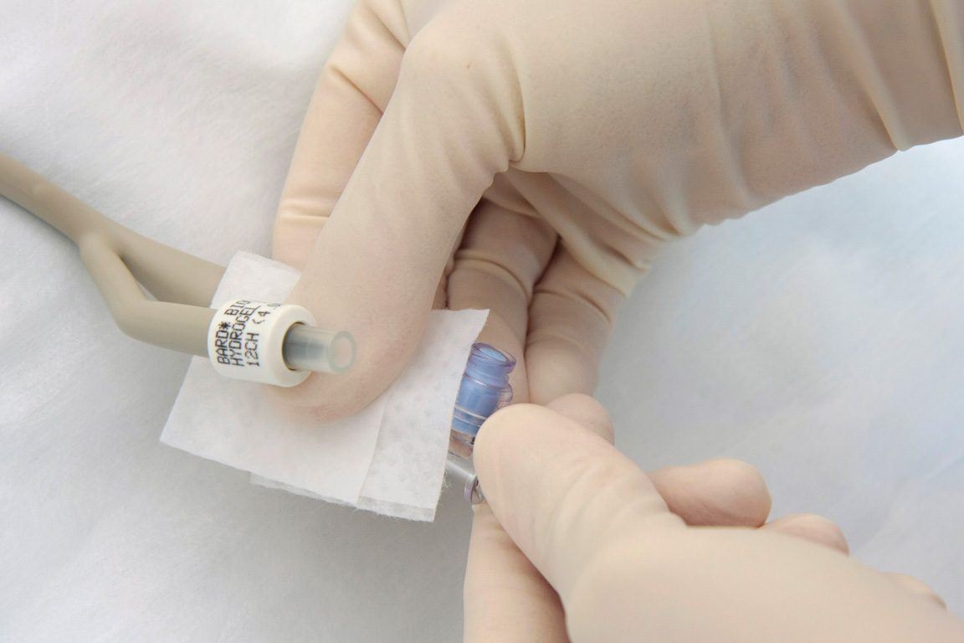
RENAL TRACT INFECTIONS
GP Shared Care AM2
More common during pregnancy (hormonal and mechanical factors)
Symptomatic (cystitis) or asymptomatic colonization of the urinary bladder are associated with increased risk of pyelonephritis
Asymptomatic bacteriuria affects ~ 10-15% of pregnancies
Screening and treatment for asymptomatic bacteriuria is recommended
Screening requires MSU MCS , usually with other routinely recommended antenatal blood tests

Slide 8
PYELONEPHRITIS
GP Shared Care AM2
Ascending UTI with involvement of the upper renal tract (kidney/ureter)
Presentation: variable
Classic(fever, rigors, loin or back pain) + urine frequency/urgency/dysuria
Threatened preterm labour(regular uterine activity)
Sepsis of un-clear source
Sequelae: PTB, AKI, Sepsis/ICU admission
Treatment: IV antibiotics, IVF, analgesia +/- USS KUB

Slide 9
GASTROINTESTINAL TRACT- LISTERIOSIS
GP Shared Care AM2
Listeria monocytogenes, intracellular G+ve bacteria
Acquired by ingesting high-risks foods( uncooked/smoked meats or seafood, soft cheeses etc.)
febrile “flu-like” symptoms, usually 3rd trimester
Infection in 2nd /3rd trimester is associated with ~ 40-50% stillbirth rate
Diagnosis requires blood/CSF cultures or PCR (serology not available)
Treatment with Ampicillin 14/7 +/- gentamicin (severe cases)

Slide 10
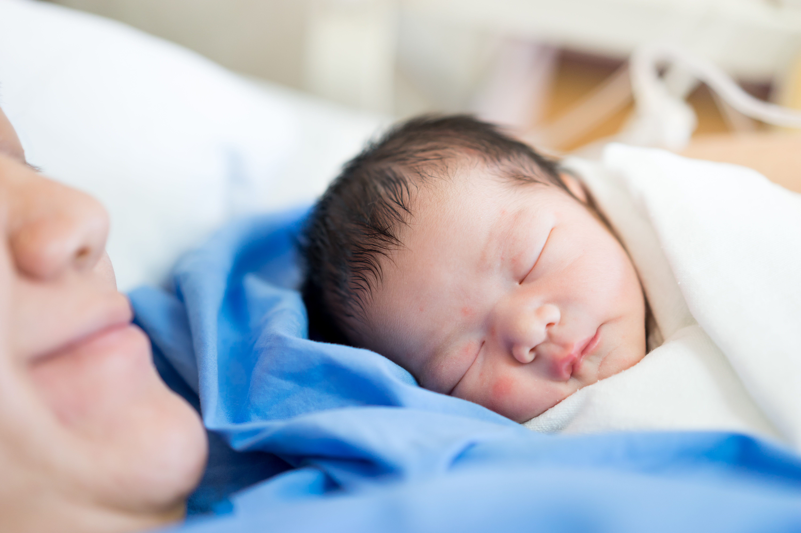
CHORIOAMNIONITIS
GP Shared Care AM2
Infection of upper genital tract and feto-placenta unit (fetus, placenta, membranes)
Usually ascending polymicrobial infection
Clinical: maternal sepsis, abdo pain +/- malodorous vaginal discharge
Risk factors :prolonged ROM, preterm labour, maternal comorbidities
Consequences: risks of perinatal death and cerebral palsy, and sepsis and its sequelae to the mother
Treatment: wide-spectrum IV antibiotics and delivery at any gestation

Slide 11
PERINATAL INFECTIONS- TORCH
GP Shared Care AM2
Toxoplasmosis: toxoplasma gondii is a protozoal parasite
Often asymptomatic or mild (malaise, fever , cervical lymphadenopathy)
Acquired by ingesting undercooked meat/unwashed vegetables or contact with garden dirt/cat litter contaminated with shed parasite
Cat litter box needs changing daily with gloves
Diagnosis is confirmed by serology (+ve IgM with –ve IgG or low IgG avidity)
Most protocols recommend repeat testing after 1-6 months or at delivery (seroconversion)

Slide 12
TOXOPLASMOSIS
GP Shared Care AM2
Fetal infection risk is highest in 3rd trimester and lowest in the 1st trimester
Sequelae (if fetal infection) are highest in first trimester
Confirmation of fetal infection requires +ve amniotic fluid PCR (usually 4 weeks after maternal infection)
Possible USS features hydrocephalus, brain/liver calcifications, ascites
Treatment with spiramycin* or pyrimethamine and sulfadiazine (with folinic acid) from 18 weeks (potentially toxic in T1)
*not routinely available in Australia
does not readily cross placenta.

Slide 13
SYPHILIS
GP Shared Care AM2
Treponema pallidum, G-ve spirochete
Ongoing state and national outbreak (including SEQ)
QH has specific Syphilis in Pregnancy guideline:
Guideline: Syphilis in pregnancy (health.qld.gov.au)
QLD has a dedicated Syphilis Surveillance Service QSSS: Southern QLD email:
QLD-Syphilis-Surveillance-Service@health.qld.gov.au
Source: sexually acquired
Diagnosis: universal screening at booking (and 28 weeks soon) using:
Treponemal specific test (TPPA,TPHA or EIA- remains +ve even after successful treatment)
Non-treponemal test (RPR or VDRL– confirms diagnosis and assesses response to treatment)

Slide 14
SYPHILIS
GP Shared Care AM2
Stages: primary/secondary/latent (early and late)/tertiary
Risk of Congenital Syphilis CS depends on
stage at time of diagnosis (highest with primary infection during pregnancy)
completion of stage-specific treatment course (>4 weeks prior to delivery)
“adequate "response to treatment (>4 fold drop in RPR titre)
Treatment with Benzathine penicillin 1.8 g IM (stage specific protocol)
If penicillin allergic , need to desensitize/seek expert advice

Slide 15
SYPHILIS
GP Shared Care AM2
Impact: PTB/PPROM/ risk of vertical transmission of HIV/other STIs/Congenital Syphilis
CS -43 cases notified in Australia between 2007-2017
Presentation: variable
Antenatal: USS features -hepato/placentomegaly/hydrops/IUGR/polyhdramnios/anaemia → stillbirth
Neonatal:
Facial/cutaneous/skeletal
Visceral (Hepatosplenomegaly/LAP)
Sepsis
CNS involvement

Slide 16
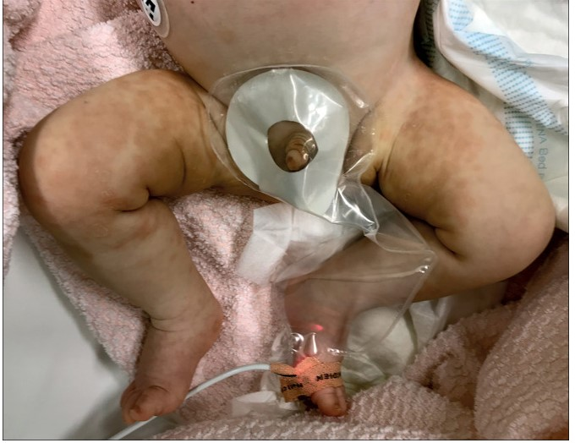
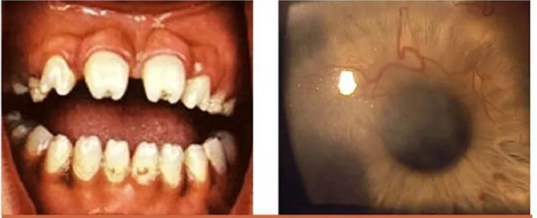
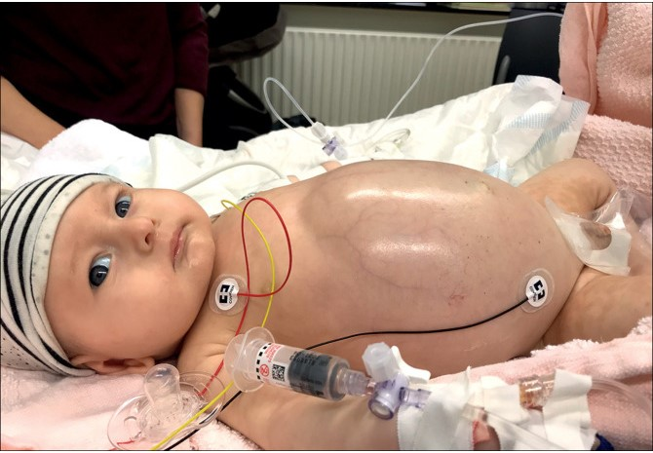
GP Shared Care AM2
SYPHILIS

Slide 17
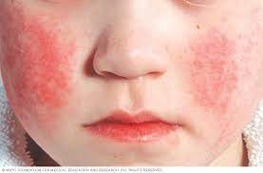
PARVOVIRUS- “Slapped Cheek”
GP Shared Care AM2
40% of women are susceptible
Risk of maternal infection after exposure is
<20% if exposed at home
8-12% if exposed at school/child care
<8% if exposed in community
If proven maternal infection:
10% excess fetal loss<20/40
3% hydrops (33% IUFD without IUT)
<1% congenital abnormality

Slide 18
VARICELLA
GP Shared Care AM2
No risk of maternal infection if previous maternal chicken pox / VZ vaccine/ Positive VZV IgG
If no history of above, check serology:
IgG –ve and exposure <96 hrs-→ ZIG indicated
IgG-ve , exposure>96 hrs and RF for severe disease(chronic resp disease, smoker )→acyclovir

Slide 19
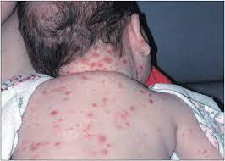
VARICELLA
GP Shared Care AM2
Risk of FVS is highest if maternal infection between 12-28 weeks~ 1.4%
MFM referral for tertiary USS 5 weeks post primary infection
Amniocentesis not routine advised if USS is normal
FVS manifestations:
- Skin scars/eye or limb abnormalities/LBW/PTB/neurocognitive delays

Slide 20
RUBELLA
GP Shared Care AM2
MMR vaccination part of Australia’s NIP- live vaccine
Waning immunity is the basis for routine screening each pregnancy and post partum re-immunization if low titre
Maternal primary infection and re-infection can occur if exposed while susceptible
Risk of fetal infection and congenital abnormalities highest if maternal infection in first trimester (~85%)
Consideration of ToP is an option

Slide 21

CMV
GP Shared Care AM2
Leading cause of congenital infections in Australia- 3.85/100000 births is likely underestimate
Most maternal primary infections are asymptomatic/mild viral illness
Universal screening not recommended –selective screening has a role
CMV IgG and IgM antibodies- interpretation requires caution
Counselling for maternal CMV infection and hygiene precautions should be part of routine antenatal education

Slide 22

CMV
GP Shared Care AM2
High risk groups for maternal CMV acquisition are day care workers and parents with child in day care
HCW have similar seroconversion rate to the general public
Diagnosis by maternal IgG and IgM+ IgG avidity if IgG and IgM positive
Fetal infection requires USS and amniocentesis (>6 wks after maternal infection)
USS features of fetal CMV
micro-hydrocephaly/intracranial calcifications
Hepatomegaly/ascites/abdominal calcification/echogenic bowels
IUGR/oligo or polyhydramnios/hydrops/pleural or pericardial effusions

Slide 23

CMV- THE CHALLANGES
GP Shared Care AM2
“Immune” women can develop re-activation
Low sensitivity and specificity of USS and low sensitivity of amnio if prior to 21 weeks
Positive results do not predict the degree of fetal impairment
No commercially available vaccine
Therapeutic interventions to prevent fetal CMV sequalae are limited (emerging evidence of reduction benefit with high-dose valaciclovir )*
Shahar-Nissen et al
Lancet 2020

Slide 24
Herpes Simplex virus
GP Shared Care AM2
Serotypes 1and 2- most neonatal infections in Australia caused by HSV1
Primary and recurrent genital tract infections can occur
First episode after 30 weeks associated with 20-50% risk of fetal transmission-→C-section reduces risk
History of genital HSV-with no active lesions during pregnancy→ suppressive therapy with valaciclovir or acyclovir from 36 weeks
Active genital lesions any stage→ genital swab+ HSV serology
In labour-careful speculum exam if no active lesions→ no indication for CS

Slide 25
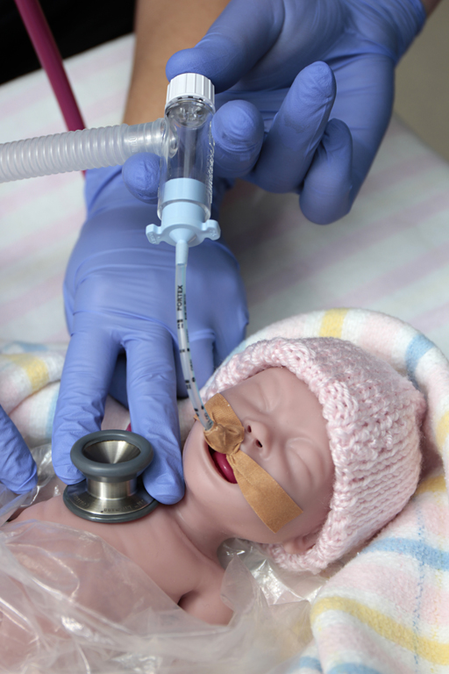
HSV NEONATAL INFECTION
GP Shared Care AM2
85% acquired peri-natally
Most mothers of infants with neonatal HSV unaware of their own infection
Infants can by asymptomatic at birth
Symptoms can include skin vesicles/eye lesions→ CNS and multisystem involvement (seizures/unexplained sepsis/DIC/elevated LFTs)
Sequelae: potential hearing impairment/ vision impairment and neurological sequelae

Slide 26
ZIKA virus
GP Shared Care AM2
Flavivirus transmitted predominantly by mosquitoes
Endemic in Africa/South America, Pacific Islands and Caribbean.
History of exposure while pregnant should prompt testing
Exposure: travel to endemic area OR sexual contact with infected /exposed person
Clinical: fever, rash ,arthralgia and conjunctivitis +asymptomatic infection
Testing :serum ZIKV PCR +IgM and urine PCR
No vaccine or specific antiviral therapy is available

Slide 27
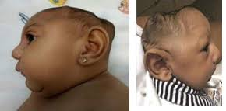
ZIKV FETAL INFECTION
GP Shared Care AM2
Frequency is difficult to accurately quantify- 65% in one study
Mostly CNS involvement with potential for :
Microcephaly
Ocular abnormalities (microphthalmia/microcornea/optic n abnormalities)
SN hearing loss
Arythrogryposis (contractures) /club foot
Neuromotor abnormalities (spasticity/dysphagia/hyperreflexia) & seizures
Neuroimaging abnormalities(IC calcification/ventriculomegaly/cortical atrophy)
Cardiac defects (ASD/VSD/PDA)

Slide 28
HIV
GP Shared Care AM2
Universal screening recommended
MDT management (Obs, Neonatology ,Adults and Pediatrics ID)
Prevention of MTCT possible with evidence –based interventions:
HAART regimes to achieve /maintain biological suppression
CS only when not biologically suppressed by 36 weeks
Formula feeding (traditional recommendation)

Slide 29
HEPATITIS B
GP Shared Care AM2
Universal screening with HBsAg
Positive→ Anti HBe+ viral load /LFTs and referral to hepatic clinic
High viral load → tenofovir to further reduce risk of vertical transmission
In addition to HB vaccine at birth (universal) , give HBV IgG at birth (different thigh)
No role for CS , breast feeding is permitted

Slide 30
HEPATITIS C
GP Shared Care AM2
Selective screening (jurisdiction based)
Screening with HCV IgG
If positive needs HCV RNA to confirm current infection (IgG remains positive for life even after cleared/treated infection)
Perinatal transmission risk~5%
Treatment is contra-indicated during pregnancy and no available vaccine
No role for CS or avoiding BF to reduce MTCT but invasive procedures in labour should be avoided
Referral to Hepatic /ID clinic for consideration of postpartum antiviral therapy

Slide 31
GROUP B STREP-GBS
GP Shared Care AM2
Normal GIT flora
Genital tract colonisation in 10-30% of women
Early onset GBS disease occurs at <1/1000 livebirths
Intrapartum Antibiotics Prophylaxis IAP is highly effective in reducing neonatal colonization and EOGBS
Mainstay of IAP is Penicillin (lincomycin or cephalosporin if hypersensitivity to penicillin)

Slide 32
GBS Intra-partum prophylaxis
UNIVERSAL SCREENING | RISK-FACTORS
LVS+ anorectal swab | Previous infant with EOGBS
Between 35-37 weeks | GBS bacteuria (any colony count) this pregnancy
Self-collected | Pre-term labour
 | Prolonged ROM>18 hrs
 | Intra-partum fever*
 | GBS colonisation in current pregnancy QCG –Currently under review

Slide 33
BACTERIAL VAGINOSIS-BV
GP Shared Care AM2
Common cause of abnormal vaginal discharge in women of reproductive age
Shift of vaginal microbiota from lactobacilli spp towards more diverse bacterial spp ,including facultative anaerobes
Routine screening is not recommended
Diagnosis: established by HVS meeting Amsel criteria:
pH >4.5
Clue cells
Whiff test (amine)

Slide 34

BV TREATMENT
GP Shared Care AM2
Treatment goals:
Symptoms
Reduce risk of PTB (controversial)
Oral metronidazole 500 mg BD for 7 days OR
Oral clindamycin 300 mg BD for 7 days
Role of topical treatment not established during pregnancy

